Slide 1
Reading and writing
SEMESTER 2 LESSON ONE
2023/24

Slide 2
Course outline Wks 1-9: Units 7-10 May: CL commentary writing tests Group research paper

Slide 3
Course dates:
LESSON 1 20/03
LESSON 2 27/03
LESSON 3 03/04
LESSON 4 10/04*
LESSON 5 17/04
LESSON 6 24/04
LESSON 7 08/05
LESSON 8 15/05
LESSON 9 22/05
*VSR 004
No lesson 1 May (holiday)
CL commentary writing test 29/05
CL Research paper due June 5th

Slide 4
Final grade for Lingua Inglese II
Semester 1 language test
Semester 1 summary test
CL Research Paper
Semester 2 writing tests
L and S or Translation mark

Slide 5
COOPERATIVE LEARNING RESEARCH PAPER
Topics – linked to unit titles of book to be approved by me
Groups – chosen by me
Deadline – after week 9

Slide 6
Units 5 & 6 Grammar points to consolidate Readings and exercises to review
Unit 5
p. 80 Discussion point: cities and suburbs
How do you think the pandemic will affect sprawl?
What about working from home and commutes?
p. 82 Vocabulary preview
p. 89 Identifying similarities and differences
p. 90 phrasal verb academic alternatives
p. 91 eco-friendly homes
Unit 6
p. 98 Discussion point: brain development and behavior
p. 102 Identifying in-text referencing
p. 107-108 Cause and effect
p. 110 Strengthening an argument
p. 112 Inverted conditionals: unreal past

Slide 7
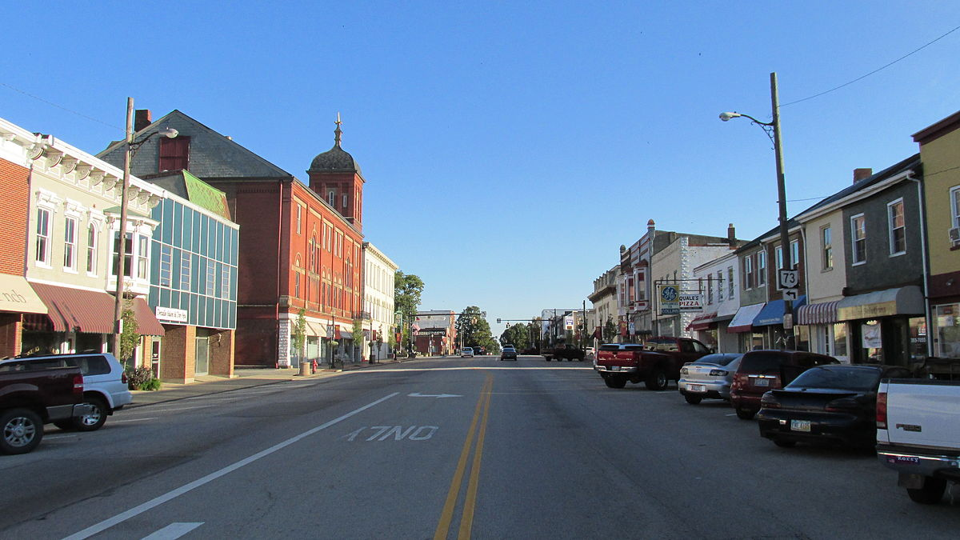
Urbanization pg 116 pre-reading – ideas? Experience? Read Reflect – new information? Facts, sources? My personal thoughts and opinions
DUBAI, UAE
Piqua, Ohio, USA

Slide 8
The benefits of urbanization p.119
Group reading – each group one paragraph
Take notes on the paragraph
Explain paragraph content to the others using your notes

Slide 9
verb + noun → make a mistake
adj + noun → heavy traffic
adv + verb → totally misunderstand
adv + adj → extremely dangerous
adj + prep → guilty of … ing
noun + noun → a ceasefire agreement
Collocation pg. 118
Collocational competence
Benefits: wider lexis
accurate stress patterns
improved intonation

Slide 10
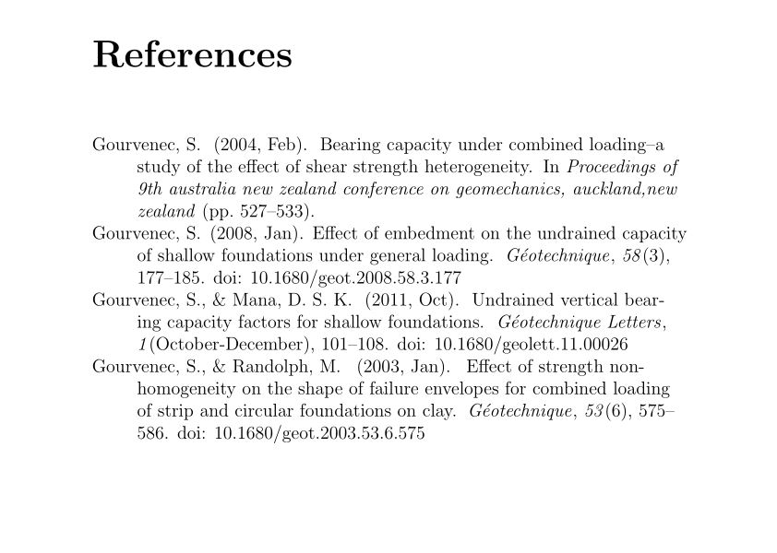
Research paper skills: Citing your sources
https://owl.purdue.edu/owl/research_and_citation/apa_style/apa_formatting_and_style_guide/reference_list_electronic_sources.html
http://libraryguides.vu.edu.au/apa-referencing/getting-started-in-apa-referencing

Slide 11
Homework
pp. 116, 117: read and watch video p. 118-120: all exercises
p. 123: STUDENT A ( surnames A-G): read and prepare notes for discussion
p. 124: STUDENT B( surnames H-Z): read and prepare notes for discussion
Ted.com = Technology, Entertainment, Design
Watch these talks:
Student A: https://www.zipcar.com/ziptopia/future-city/envisioning-cities-of-the-future-through-ten-ted-talks
8. Vicki Arroyo: Let's prepare for our new climate
Student B: https://www.zipcar.com/ziptopia/future-city/envisioning-cities-of-the-future-through-ten-ted-talks
5. Haas & Hahn: How painting can transform communities
Take NOTES on the key points and bring to class

