Slide 1
Reading and Writing
Semester 2 Lesson 9 2023/24

Slide 2
Homework for today
Read articles on pg 155, 159/60
Exercises 161, 164,165, 167,174, 182
Download and read:
CL Research Paper: Checking your work >Titles for Talks on Moodle Contents will be discussed in the last lesson.
Upload your proposal for your final title
.

Slide 3
CL commentary Writing test Wednesday May 29, 2024 9-11
Time: 120 minutes
Subject: Cooperative Learning
Length: max 500 words
Article on CL to read and analyze (700 words)
Results will be posted on Moodle by matric number
Print out answer sheets from Moodle before the test and bring them to class
Paper assessed on structure and content

Slide 4
CL commentary writing test
1. analyze the academic article on the Cooperative Learning method
2. Summarize the article
3. Comment on the content of the article
4. Add your personal experience of Cooperative Learning this semester
Remember to plan and structure your writing
Cohesion, clarity, proper syntax and grammar

Slide 5
CL paper deadline
June 5, 2024
Printed and delivered to my office by 12 by one group member
One copy uploaded to Google Docs (check the formatting of the final version)
If you want to turn it in early, I have a mailbox in VSR
Paper and portfolio of all group work
Online feedback by appointment with all group members TBA

Slide 6
Test Re-takes
Sem 1 Language Test
Friday June 14th VSR 006/007 9-11
CL Writing Commentary re-takes
June 20, 2024 9-11 VSR 007

Slide 7
Verbalizzazione
Reading and Writing final grade
Listening and Speaking or Translation final grade
Sign up online (unifi → prenota esami)

Slide 8
In-text citation: quoting
According to Smith (1998), “ … ” (p. 32).
For quotations of fewer than forty words, use quotation marks as above.
Longer quotations should be freestanding with BOTH margins indented and no quotation marks.

Slide 9
Citation 1. reference to a published or unpublished source (not always the original source) 2. purpose of acknowledging the relevance of the works to the topic of discussion at the precise point where the citation appears 3. combination of the in-text citation and the bibliographic entry constitutes what is commonly thought of as a citation 4. an abbreviated alphanumeric expression (Rockwell, 2021) embedded in the body of an intellectual work 5. an entry in the bibliographic reference page

Slide 10
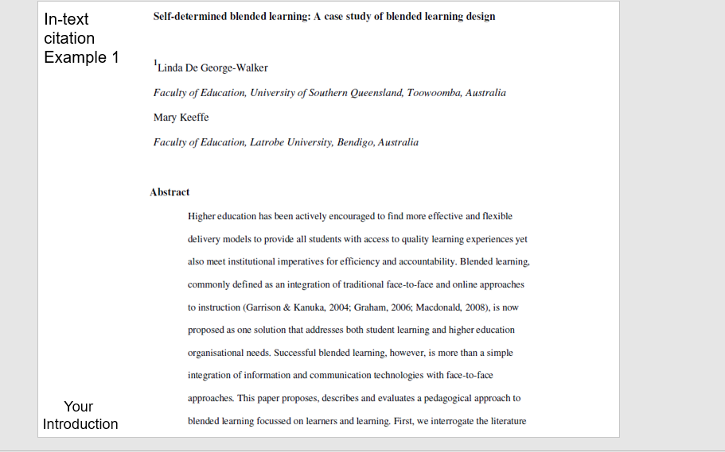

Slide 14
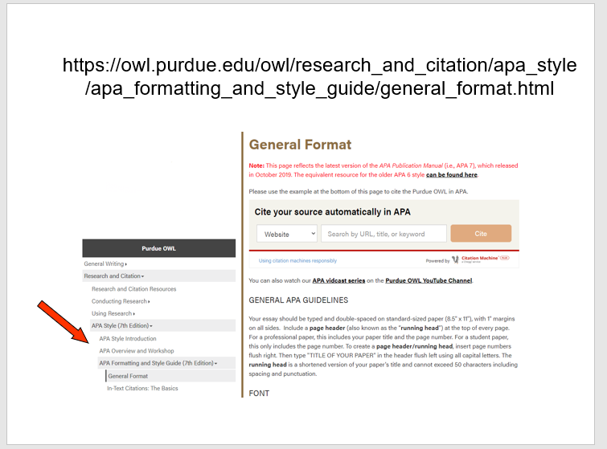

Slide 15
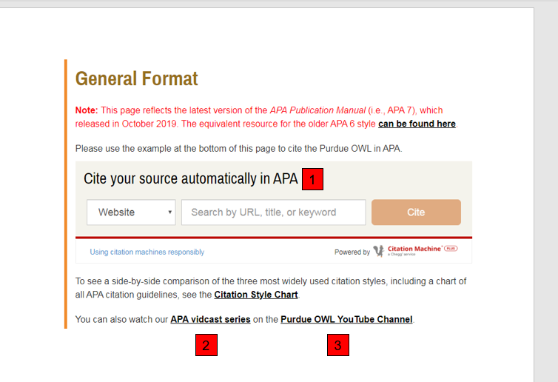

Slide 16
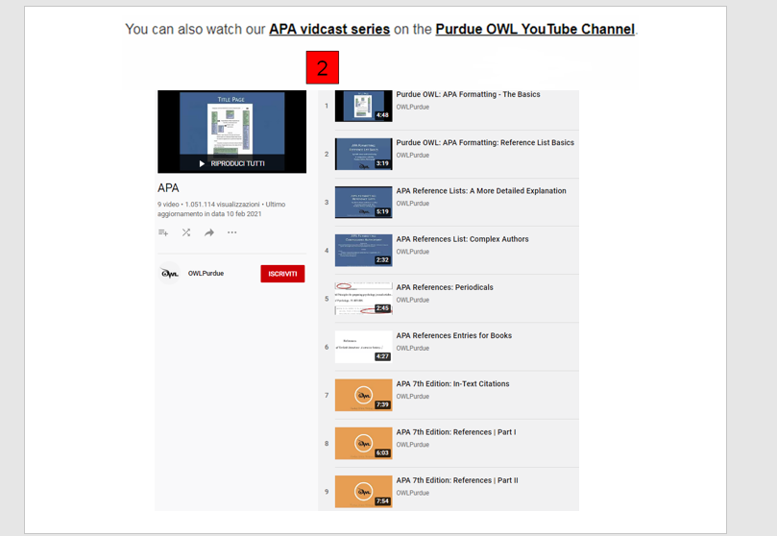

Slide 17
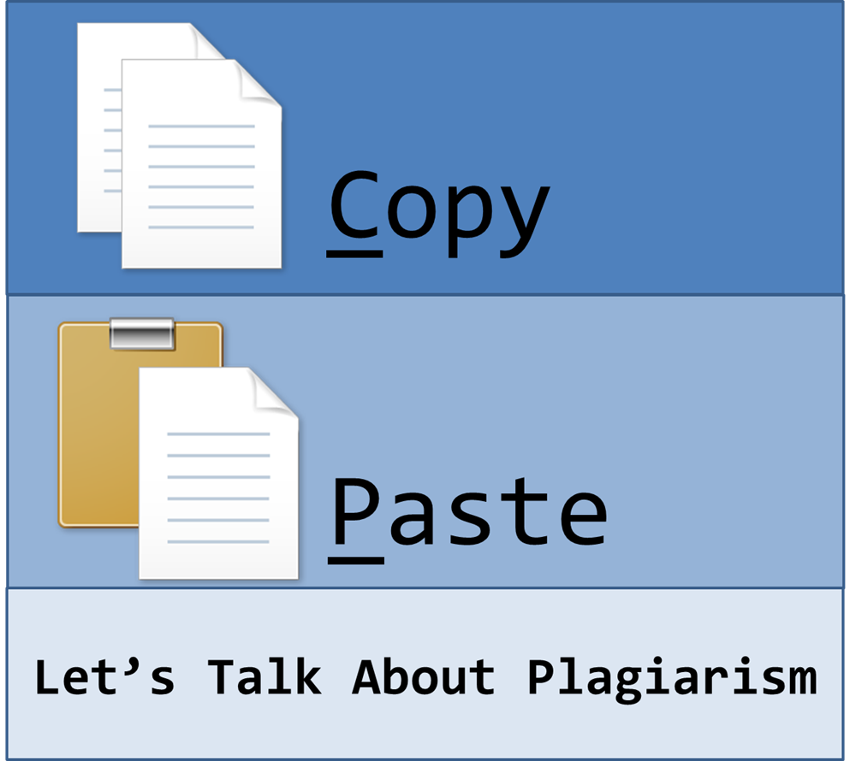
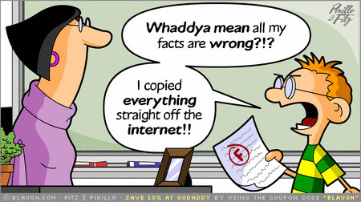
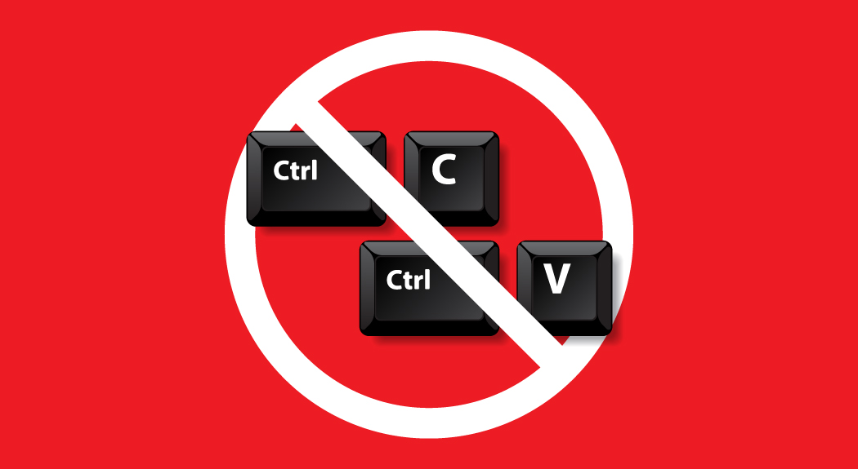
Why citation?
Questa foto di Autore sconosciuto è concesso in licenza da CC BY-ND
Questa foto di Autore sconosciuto è concesso in licenza da CC BY-SA
Questa foto di Autore sconosciuto è concesso in licenza da CC BY

Slide 18
‘Altering’ quotations
Sometimes we have to ‘alter’ quotations to make them fit the structure of our sentence.
Any such changes should be signalled to the reader by the use of square brackets.

Slide 19
Square brackets
Use [ ] around any words you need to add to clarify the grammatical sense.
Use [ … ] for words you want to omit if a quotation is very long.
Use [sic] when the original quotation contains an error to show you have copied it correctly and are aware of the mistake.

Slide 20
Section headings
You may need to number sub-sections within a section.
1. Notebooks
1.1 Organisation
1.2 Contents
2. Dictionaries
3. Corpora

Slide 21
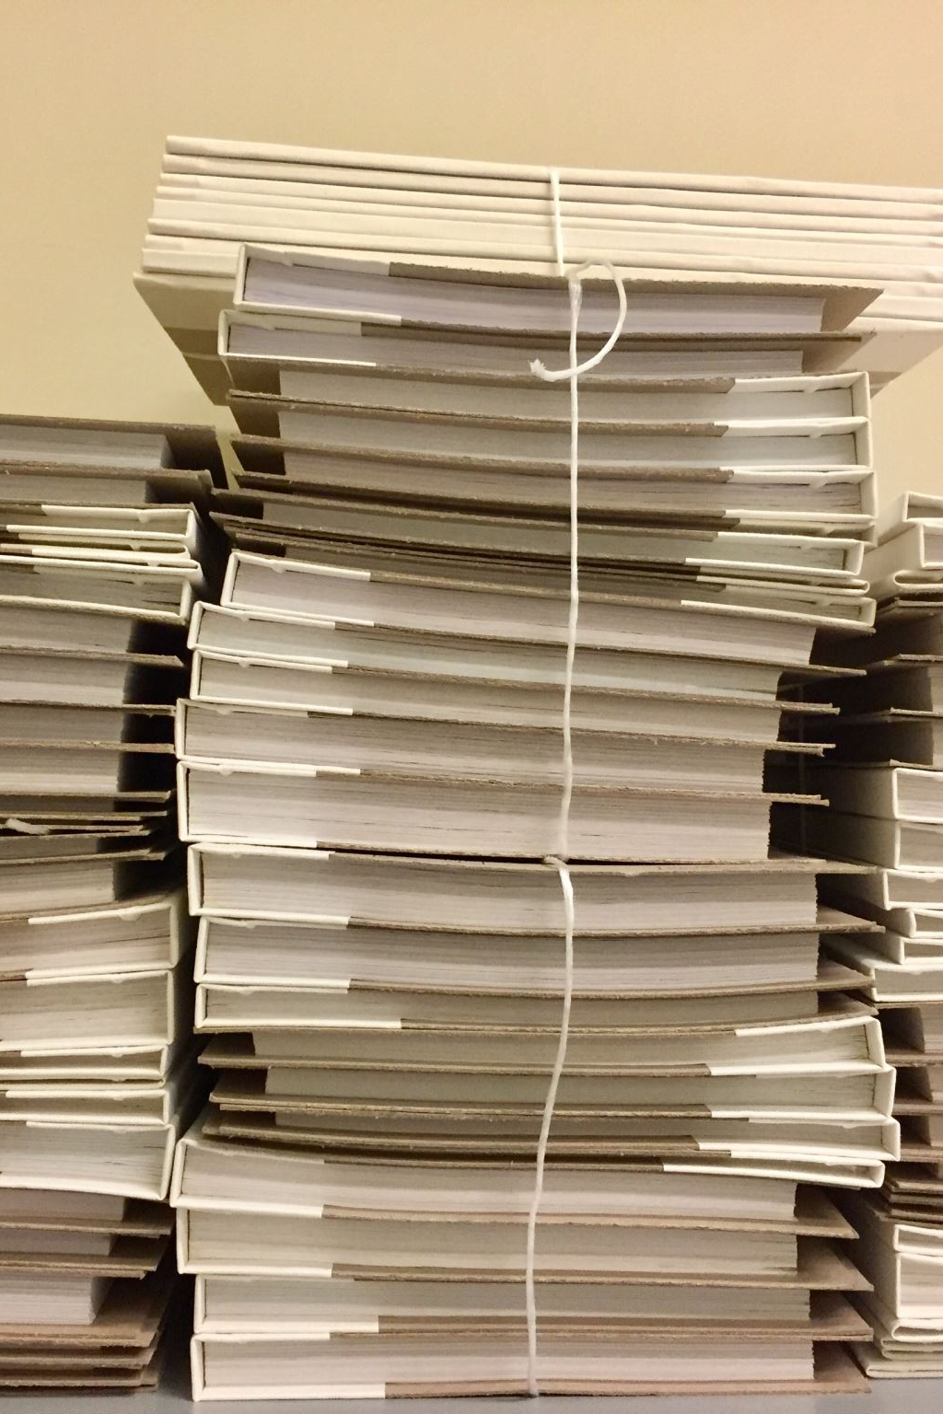
Components of the CL Research Paper
Title page
Table of Contents
Introduction
Chapters
Subheadings or subjects within chapters
Findings
Prediction/forecast/recommendation
References

Slide 22
Dates
Your topic will dictate to what extent you need to consult recent sources.
For any ongoing event / current situation you will be expected to be as well-informed as possible.

Slide 23
Dates
When was the information published?
Look for the publication date or last updated date.
Is it still useful? Has it been updated?
Does the ‘About Us’ section provide information about the updating policy?

Slide 24
DO NOT UNDERESTIMATE: FORMATTING
Formatting: careful with spacing and indentation
Title page, page numbers

Slide 25
Titles
Read file on Moodle?
Got ideas for a final title?
Purpose: attract reader’s attention, make them curious, focus on subject.
Tend to be telegraphic, using a colon where the information that follows it explains the first part.

Slide 26
Checking your work
Introduction: FOCUS
Does it explain clearly your intentions and reflect the content?
Paragraph 2: does it explain the organisation of the paper?

Slide 27
CL PAPER
Body of paper: does it illustrate what was
announced in the introduction?
Does it contain in-text citation and supporting evidence? Is there critical thinking?
Discussion of findings: does it summarise the main points; state implications?

Slide 28
Title and subtitles
Is the title appropriate?
Do chapter titles and subtitles reflect content?

Slide 29
Evidence
Evidence you use needs to be relevant to the point you are making.
Checklist:
When evaluating an agument check:
Is the evidence relevant to the topic?
Is it needed to substantiate the reasoning?
Does it make a difference to the conclusion?
If so, does it support it or contradict it?
Is the evidence needed to substantiate interim conclusions?

Slide 30
One Voice
Your essay should not have a distinct change in style that corresponds to a new contribution by one of the members of your group.
Read it through critically to check that the style and language is consistent throughout.

Slide 31
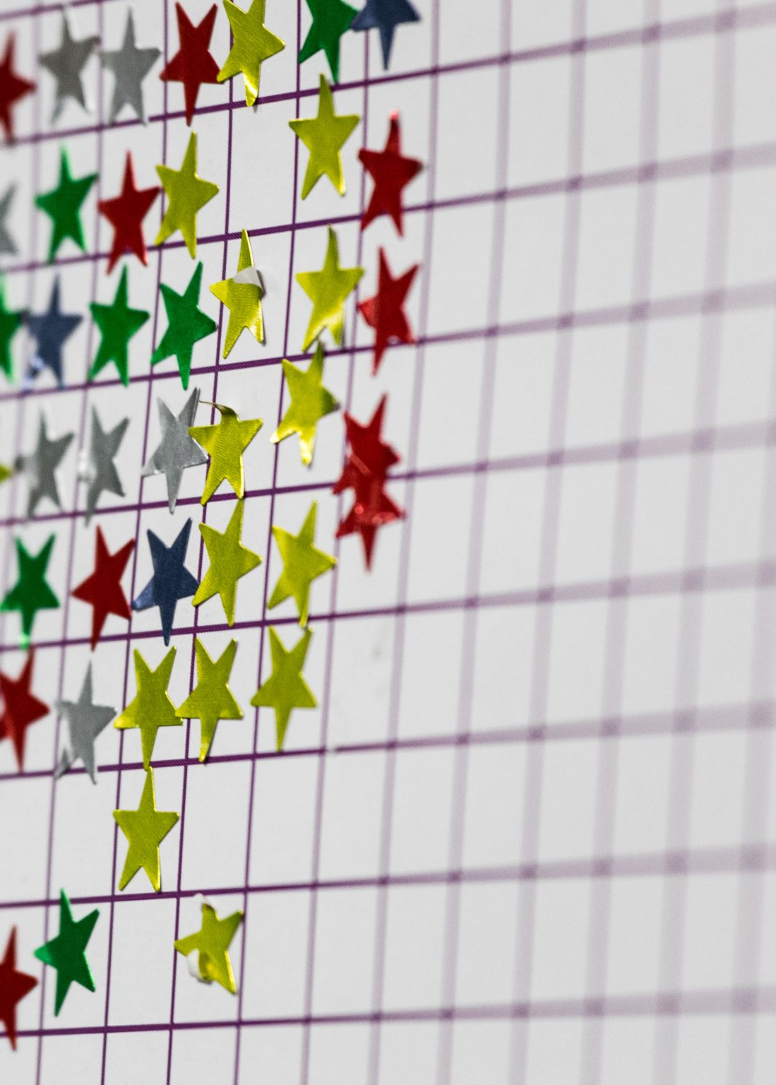
Language work
In groups of two and three:
Pg. 166 Verb patterns ex 1 and 2
Pg. 175 Using material of suitable quality and content
P. 184 Conjunctions

Slide 32
Answers to exercises
Pg. 163 Verb and noun collocations
e 2. a 3. b 4. h 5. f 6. d 7. g 8. c
2. 1. reducing demand 2. slow the decline 3. assess the impact 4. accelerate, change 5. considering the role 6. cast doubt
7. allocate resources 8. address the issue
Pg. 163
eventual 2. ongoing 3. intensity 4. advocate 5. legislation 6. resolution
7. equate 8. finite

Slide 33
Pg. 164
Cloud seeding is the best solution for dealing with drought; it has worked in five different countries.
What was the accepted standard of “proof”? How much rainfall did it generate? Is it possible to directly attribute the rainfall to cloud seeding or might it have rained anyway? Which countries? Do they have climatic or geographical features in common? What is the success of other methods? How much water did the technique produce?
2. 1. The degree to which carbon emissions have risen; the percentage of this increase that is directly attributable to human activity, NASA is likely to have published these figures.
2. A breakdown of energy consumption per country comparing those that desalinate water and those that don’t, and the percentage of the energy that is used to power the desalination plants. Government websites are likely to hold this data.
3. A comparative breakdown of energy consumption by type ( including efficiency) in the twelve countries. Government websites are likely to have this information.
Pg. 166
to support 4. building
making 5. don’t permit
to make 6. closing
1. resources to support 2. to paying 3. on encouraging
4. people not to waste 5. companies to pay

Slide 34
HOMEWORK
UNIT 10
Pg 174, 180 (useful for your CL paper)
Article pg. 177-8 (useful for your group work!)
Any questions should be sent by email by the secretary of the group to me.
Useful website:
https://www.phrasebank.manchester.ac.uk/

Slide 35
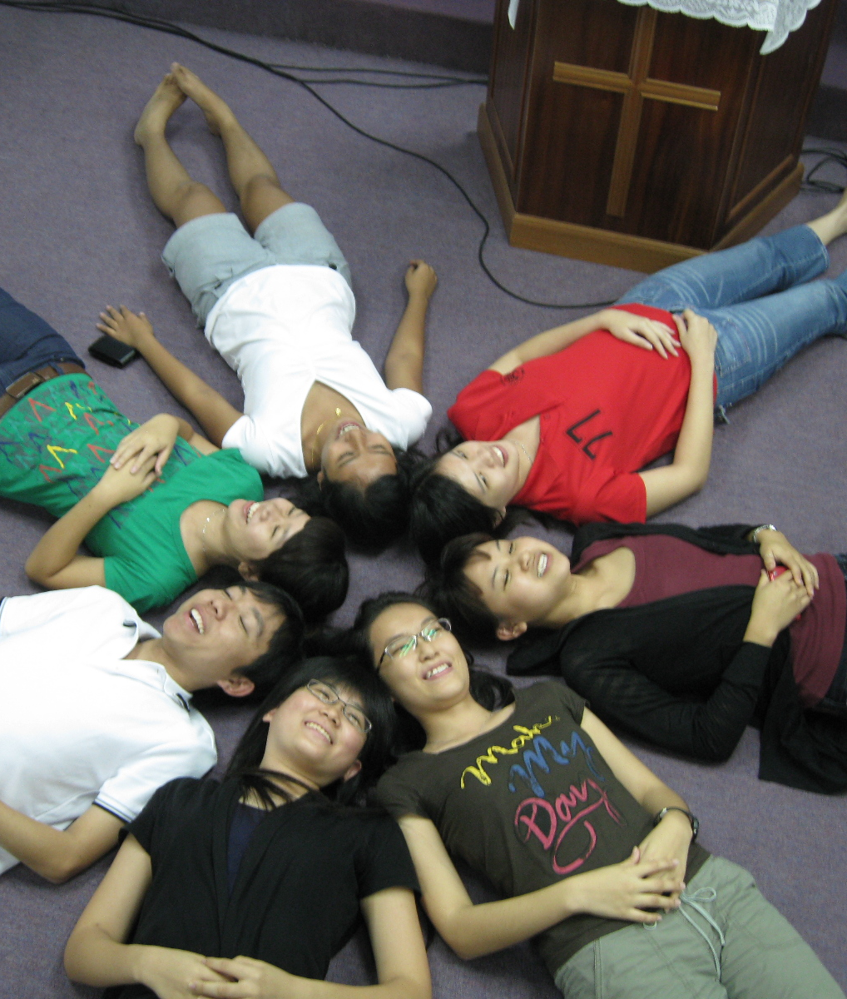
Questa foto di Autore sconosciuto è concesso in licenza da CC BY

