Slide 1
Reading and Writing
Semester 2 Lesson 8 2023/2024

Slide 2
Homework for today
Complete Watergrabbing essay and hand in a printed copy or upload it to your group’s GoogleDocs file folder
Continue to work on your CL paper, especially authoritative sources.

Slide 3
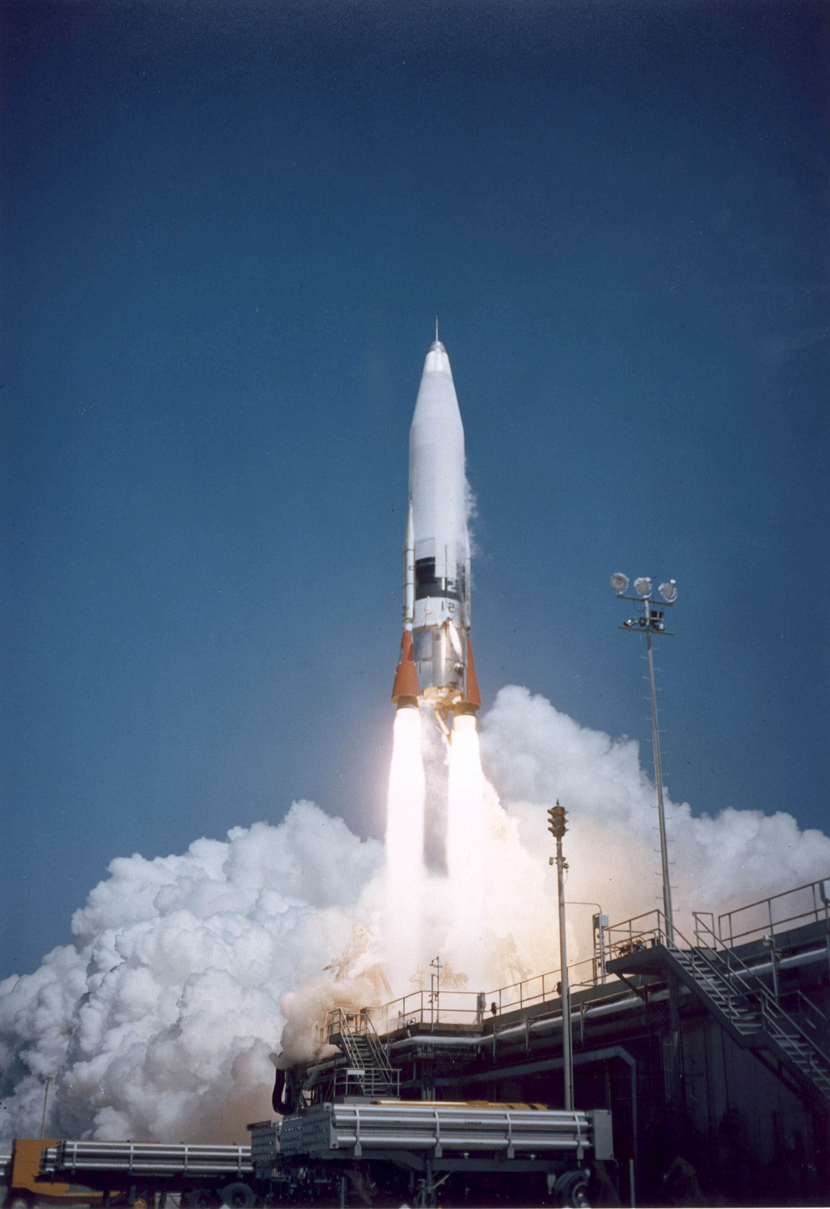
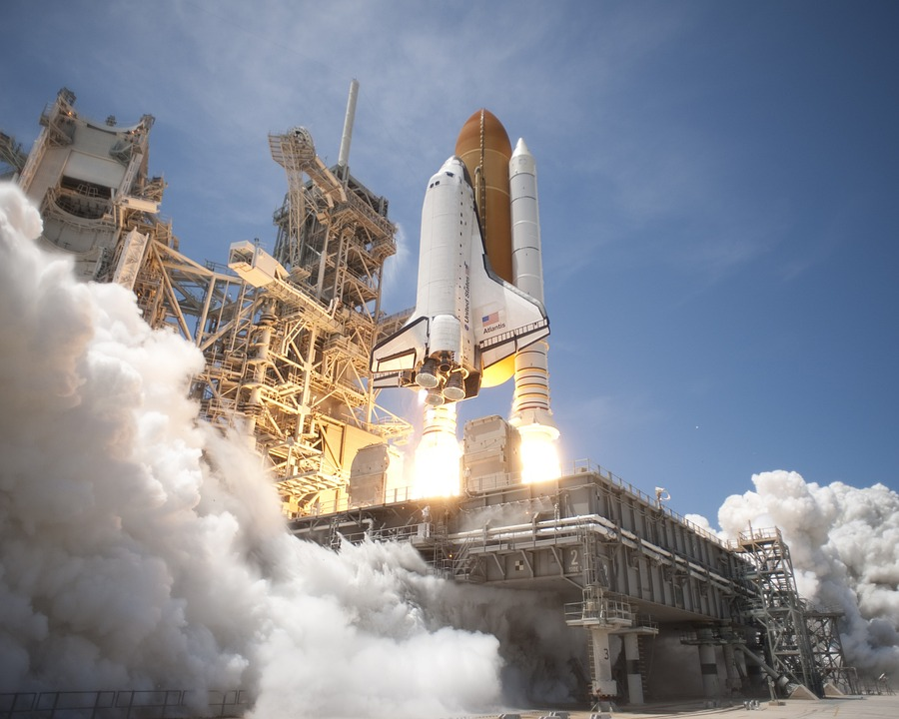
T minus 22 days
Questa foto di Autore sconosciuto è concesso in licenza da CC BY-SA

Slide 4
Key words – Lexical nets Exercise
Group work
Create 3 groups of key words
1. related to your specific topic
2. connected to research
3. academic words

Slide 5
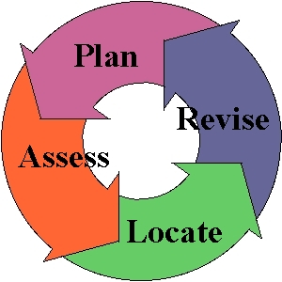
Plan-Assess-Locate-Revise
For any research process be certain to understand the assignment and/or your goal to be achieved through the writing.
The process of locating materials, sources, to support your writing should be logical and methodical:
Plan your writing and identify your goal or conclusion in the writing.
Assess which points you will be making in your writing which need authoritative support.
Locate authoritative sources as foundations for each of your points which will logically lead the reader of your writing to your intended goal or conclusion.
Revise your goal, conclusion, and/or points to reflect what you have learned from your research.
http://www2.estrellamountain.edu/faculty/freeman/Shared/miniprep/usingsources1miniprep/usingsources1miniprep_print.html

Slide 6
Remember:
Make a point
Support that point
Comment on that point

Slide 7
Authoritative Sources
General Encyclopedia, online web pages, Wikipedia, dictionaries, etc.. are general resources and are neither authoritative nor scholarly. While these sources may be informative such sources are never deemed sufficient for university level work... they may represent a good beginning for preliminary research but that is all.
Use authoritative and scholarly articles or books for resources supporting your college writing. Be sure to familarize yourself with the advanced search features in using library databases such as "peer reviewed journals" and “using online resources”
Check your city library.
Check other college and university libraries.
Consider ordering books and other resources if you wish to have a copy for your personal library.
http://www2.estrellamountain.edu/faculty/freeman/Shared/miniprep/usingsources1miniprep/usingsources1miniprep_print.html

Slide 8
Research articles
Tell us why you have chosen the article.
Why is it pertinent to your topic?
How is it scholarly and authoritative?

Slide 9
Evaluating Sources When using online resources evaluate the authority and veracity of the information before using it to build knowledge or to refer to it as a source.
Reliability
is contact information available on the author?
what specifically are the author's scholarly credentials?
Is it a respectable scholarly publication?
Are sponsoring organizations identified?
is the published article subject to the peer-review process?
Quality
does the article avoid broad generalizations? Stereotypes? Limited point of view?
is the source up-to-date or appropriate regarding its publication date?
does the source demonstrate consistency of facts?
is a comprehensive review or the article or book available?
is the resource an original source which the reader will recognize as authoritative?
does the source itself have authoritative support or corroboration of facts provided?
http://www2.estrellamountain.edu/faculty/freeman/Shared/miniprep/usingsources1miniprep/usingsources1miniprep_print.html

Slide 10
Usefulness
is the content of the source related to your goals?
is the content of the source directly related to your writing or your research?
is the level of the source appropriate to you and to your audience?
is the appropriate level of detail present in the source?

Slide 11
Rivers Quiz!
9 questions worth 21 points

Slide 12
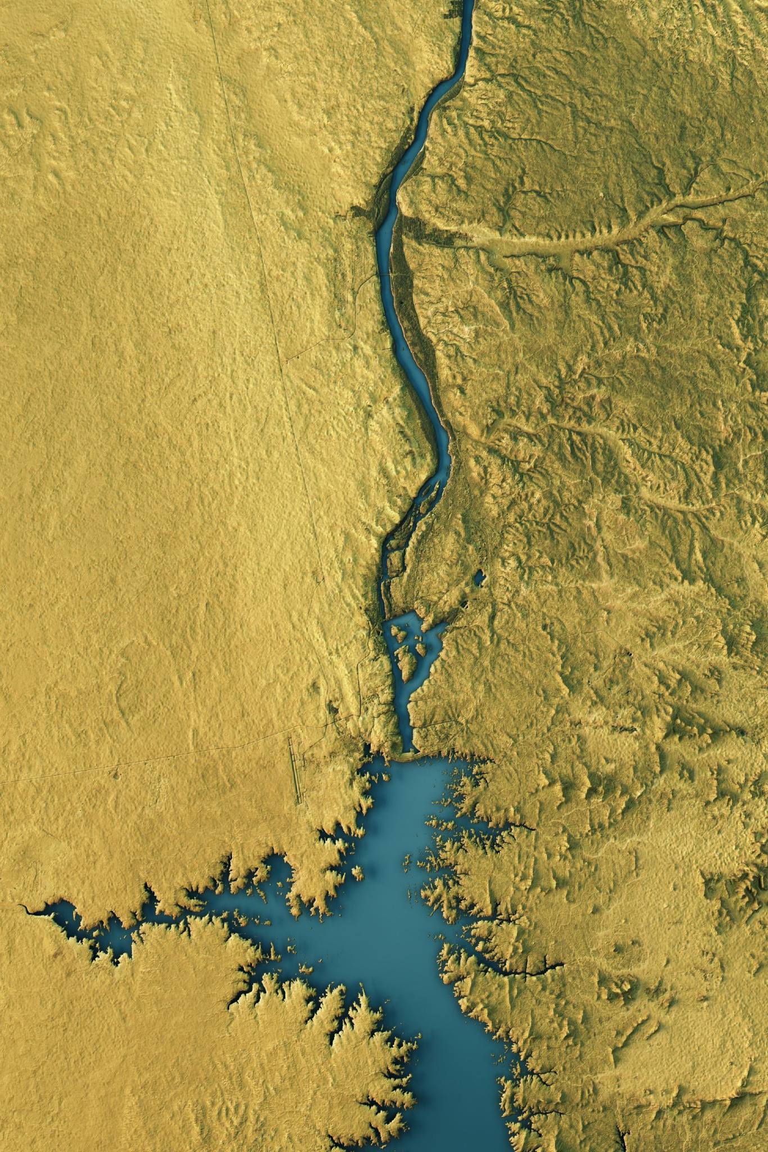
Q. 1
The world’s longest river is the Nile.
Name three countries it flows through.

Slide 13
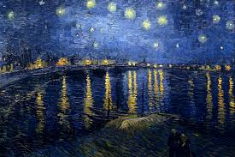
Q. 2 Name the artist, title, river and location.

Slide 14
Q. 3
Which capital city lies on the Potomac River?

Slide 15
Q. 4
The novel The Adventures of Huckleberry Finn by Mark Twain is set in a town on the banks of which river?
Questa foto di Autore sconosciuto è concesso in licenza da CC BY-ND

Slide 16
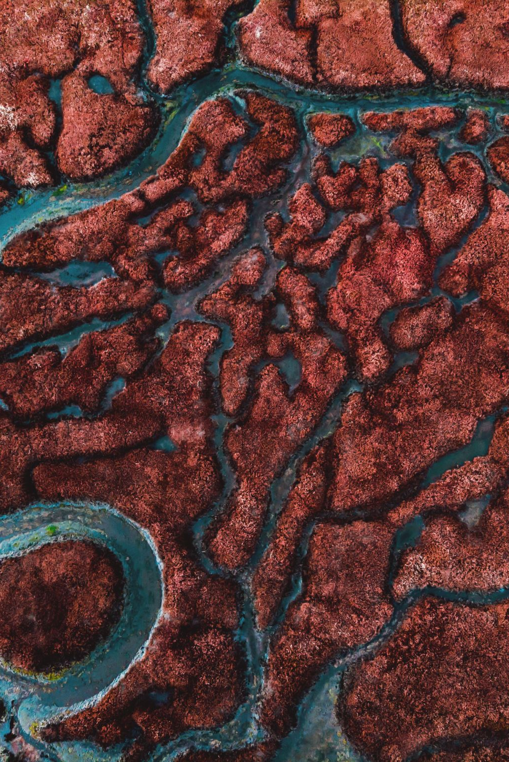
Q. 5
Name the biblical river that rises in Syria, flows through the Sea of Galilee and empties into the Dead Sea.

Slide 17
Q. 6
The composer Johann Strauss is famous for a waltz named after a river.
Which river is it?

Slide 18
Q7 The Rhine and the Rhone are often confused. Match the following information to the correct river.
Mediterranean Sea
Cologne
Length 1230 km
North Sea
Lyon
Length 813 km

Slide 19
Q. 8
Although Austria is a landlocked country its main river provides access to a sea.
Name the river and the sea.

Slide 20
Q. 9 This European city was hit by the worst floods in its history in 2002. Name the city and the river.

Slide 21
Q. 1
Egypt
Eritrea
Ethiopia
Sudan
South Sudan
Rwanda
Uganda
Kenya
Tanzania
Burundi
DR Congo

Slide 22
Q. 2 Starry Night over the Rhone, Vincent Van Gogh, Arles

Slide 23
Q. 3 Washington DC
Q. 4 The Mississippi
Q. 5 The River Jordan
Q. 6 The Danube

Slide 24
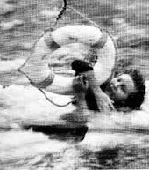
Plane crashes into the Potomac river 1982

Slide 25
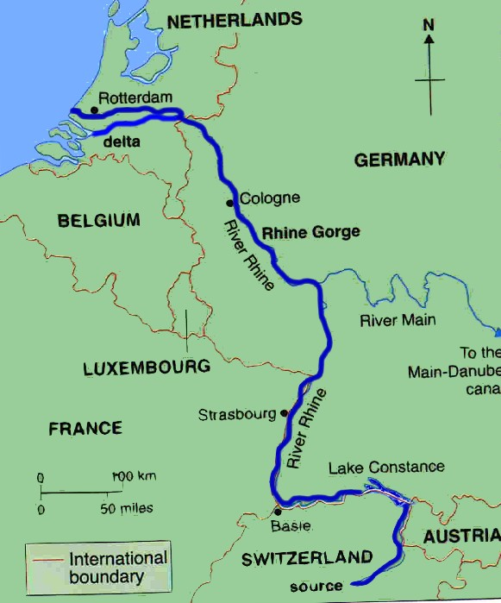
Q. 7 The Rhine
Rhine
Cologne
North Sea
1230 km

Slide 26
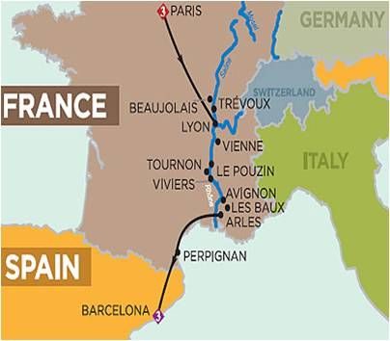
Q. 7 The Rhone
Rhone
Lyon
Mediterranean Sea
813 km

Slide 27
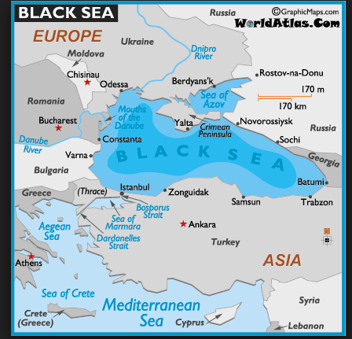
Q. 8 The Danube

Slide 28
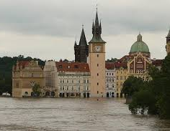
Q. 9 Prague, The Vltava

Slide 29
Causality
Before a clause →
because, so, as, since
Beginning of sentences, after semi-colon→
as a result, consequently
Expressions with prepositions →
result from, lead to, have an effect on

Slide 30
Causality
Adjectives that show causality →
resulting, consequent, ensuing
Noun phrases →
A factor in, a cause of, a role in, a consequence of

Slide 31
Top 5 challenges facing humanity pg. 152
Writing task brainstorming pg. 168

Slide 32
Titles
Purpose: attract reader’s attention, make them curious, focus on subject.
Tend to be telegraphic, using a colon where the information that follows it explains the first part.

Slide 33
Example titles
Expectations and reality: A case study of return migration from the United States to Southern Italy
The role of the underground economy in irregular migration to Italy: Cause or effect?
Academic writing for graduate students: Essential tasks and skills

Slide 34
Group work
Think of your topic
Work on key words that you feel need to be in your title to clarify the content to the reader.
Write down some possibilities and decide which one is most suitable.
Obviously, the title may require revision once you have written the content.

Slide 35
Homework for lesson 9
Read articles on pg 155, 159/60
Exercises up to pg 166
Download and read:
CL Research Paper: Checking your work >Titles for Talks on Moodle Contents will be discussed in the last lesson.
Upload your proposal for your final title

