Slide 1
Reading and Writing
Semester 2 Lesson 3
2023/2024

Slide 2
Homework for today
Read articles on Cooperative Learning
Student A: article 1 by Elizabeth Cohen
Student B: article 2 by Susan Ledlow
Come to class with notes, prepared to discuss content
Water quiz

Slide 3
World Water Day
https://www.worldwaterday.org/theme/
https://captainsforcleanwater.org/
https://www.brockovich.com/
IS IT FREE?
IS IT CLEAN?
WHAT HAPPENS IF IT ISN’T?
Questa foto di Autore sconosciuto è concesso in licenza da CC BY-NC-ND

Slide 4
Nominal clauses
That clauses → after adjs and verbs describing thoughts / opinions and reporting verbs
It has been estimated that the world’s population will reach 9 billion by 2050.
Question clauses →how / what / when
Education is what countries must promote to combat over-population.
p. 130

Slide 5
Nominal clauses continued
If / whether → for yes / no questions in a
statement
Whether education will help is the key issue.
For more on noun clauses go to:
www.grammar-monster.com/glossary/noun_clauses.htm

Slide 6
Group Research Paper
How it works
Week 3: groups formed
Week 4: read article ‘Working in Groups’ on Moodle
Week 6: presentation of 2 articles

Slide 7
Week 6
Deadline for working document
- Topic
- Framework
- Perspective
- Division of tasks

Slide 8
Week 7
Feedback on suitability of topic and framework
The working document is part of the final mark

Slide 9
Week 9
Progress report on research paper
(part of final mark)

Slide 10
Individual Responsibility
Sources: 4 per student
Length of written work: 2 pages of body text minimum per student

Slide 11
Group Responsibility
Cover page
Contents page
Introduction
Discussion of findings
References
Final revision stages

Slide 12
Deadline
Wednesday, June 5, 2024
Digital copy uploaded to Googledocs and printed copy brought to my office from 9-11

Slide 13
Your topic
The three Cs
Curiosity
Computer
Critical thinking

Slide 14
Number 4
Controversy

Slide 15
Quiz question
Who said this?
Computers are useless. They can only give you answers.

Slide 16
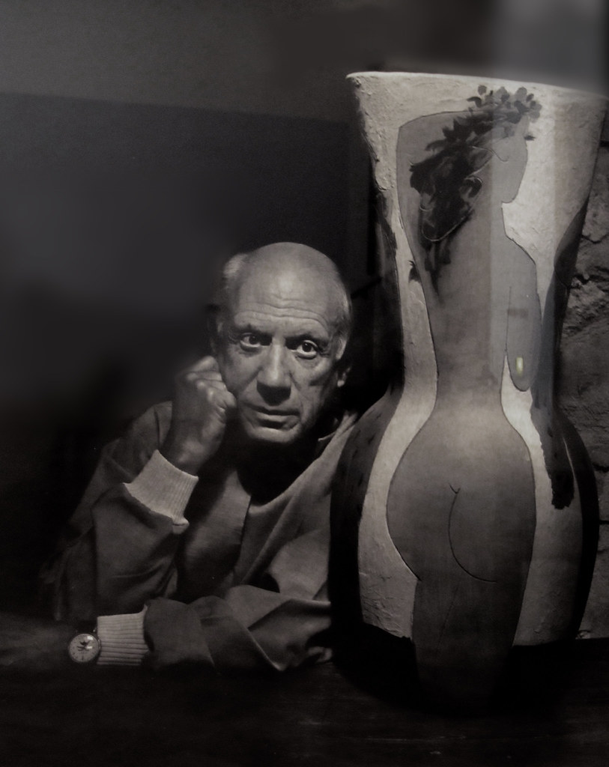
Pablo Picasso
Questa foto di Autore sconosciuto è concesso in licenza da CC BY-NC

Slide 17
Readings for today
Cooperative Learning articles
In pairs, explain and discuss the articles you read.

Slide 18
CL Key principles
Positive interdependence
Individual accountability
Equal participation
Simultaneous interaction
PIES

Slide 19
Cooperative Learning Groups
Group A: Tofani, Bettini, D’Innocenzo, Alfaleh, Olivieri
Group B: Scandagli, Baldi, Radi, Innocenti, Pinori
Group D: Menchini, Di Gregorio, Morosi, Fontana, Loizzi
Group E: Voria, Fabbri, Pasqua, Puccioni
Group F: Borgioli, Cianciulli, Orrù, Para, Baggiani
Group C: Bandini, Pali, Martini, Migliari, Vogl

Slide 20
CL groups: Getting organised
Contact details*
*if anyone is missing I need to know asap
Arrange to meet
Sharing info
Writing
Checking
Printing

Slide 21
Cooperative Learning
Write down three adjectives to describe your opinion of CL from what you have read.
Share and discuss in your groups.

Slide 22
Group task 1
Write the body of a persuasive essay based on the articles about behavior (see Moodle).
Provide three valid reasons and support them.
Upload to Google Docs (please create group folder) by week 5.
Length: max 300 words

Slide 23
One Group One Document
Cloud File Sharing
drive.google.com
dropbox.com
Why?????

Slide 24
Organise your group
One member → 1. creates file
(= owner of file)
2. shares with other members
(with editing powers)
All members can work on the SAME document, all changes are automatically saved

Slide 25
Share the workload
Task 1 → 3 articles to read
How are you going to organise yourselves?
What do you need to decide BEFORE writing?

Slide 26
Authoring and Crafting
Research
Organise
Draft
Write
Check and correct - framework, paragraphs, referencing, spelling, grammar
Upload (or print)

Slide 27
Homework for lesson 4
Organise your first meeting
Read article ‘Working in Groups’ on Moodle
Read articles on behavior on Moodle
Work on first draft of body of persuasive essay about behavior
Start thinking about your group topic
Continue with digibook Unit 7/8
Group writing task due

