Slide 1
Reading and Writing
Semester 2 Lesson 5 2023/2024

Slide 2
Homework for Lesson 5
Upload essay on behavior in your OWN group folder on GoogleDocs with your group name
Start brainstorming ideas for essay topic
Deadline for outline : Week 6
Book p. 128 Assessing the logic of an argument
Book p. 139 Study skills
Continue in textbook and online workbook Unit 8
2

Slide 3
Online workbook/investment
Your textbook is a tool
Years of research and teaching experience went into it
It cost money
It is digital
It is interactive
It is how you practice the skills we learn in class
Self study is the key to improvement
Why haven’t you done it yet???

Slide 5
Group Portfolio
This is a folder which includes all the work and documents used to research, prepare and write your Coooperative Learning Paper.
It includes the ‘working document’ which is a progress report of the project with dates of meetings, deadlines and decisions made, tasks assigned, etc.
The portfolio is taken into consideration for the final mark.

Slide 6
Week 6 24/04/24
Deadline for proposal
(part of group portfolio)
- Topic
- Framework
Perspective/intentions
- Division of tasks
- Sources
Deadline for code of CL
file of document uploaded to Moodle
must be completely filled out

Slide 7
Group meetings
^{Friday April 26th}
^{9:30-10:00}
^{10:00-10:30}
^{10:30-11}
^{11-11:30}
^{11:30-12}
^{12-12:30}

Slide 8
Formatting your proposal
Top left corner:
Reading and Writing, 2nd sem 2023/2024
Top right corner: 1
Centred: Research Paper Proposal

Slide 9
Text
Subheadings: Group members
Topic
Framework
Perspective/intentions
Division of tasks
Sources
For each subheading, provide brief information in paragraph form

Slide 10
Font sizes
All text to be in Times New Roman 12 with double spacing apart from the title (Research Paper Proposal) which should be TNR 16.

Slide 11
Week 7
Feedback on:
suitability of topic and framework
Perspective/intentions sources

Slide 12
Week 8
Each group brings the articles chosen for the paper.
Minimum of four articles per student.
Articles should cover a spectrum and not be limited to one area (e.g. newspapers).

Slide 13
Materials
Primary sources
Secondary sources
Articles should be prevalently in English

Slide 14
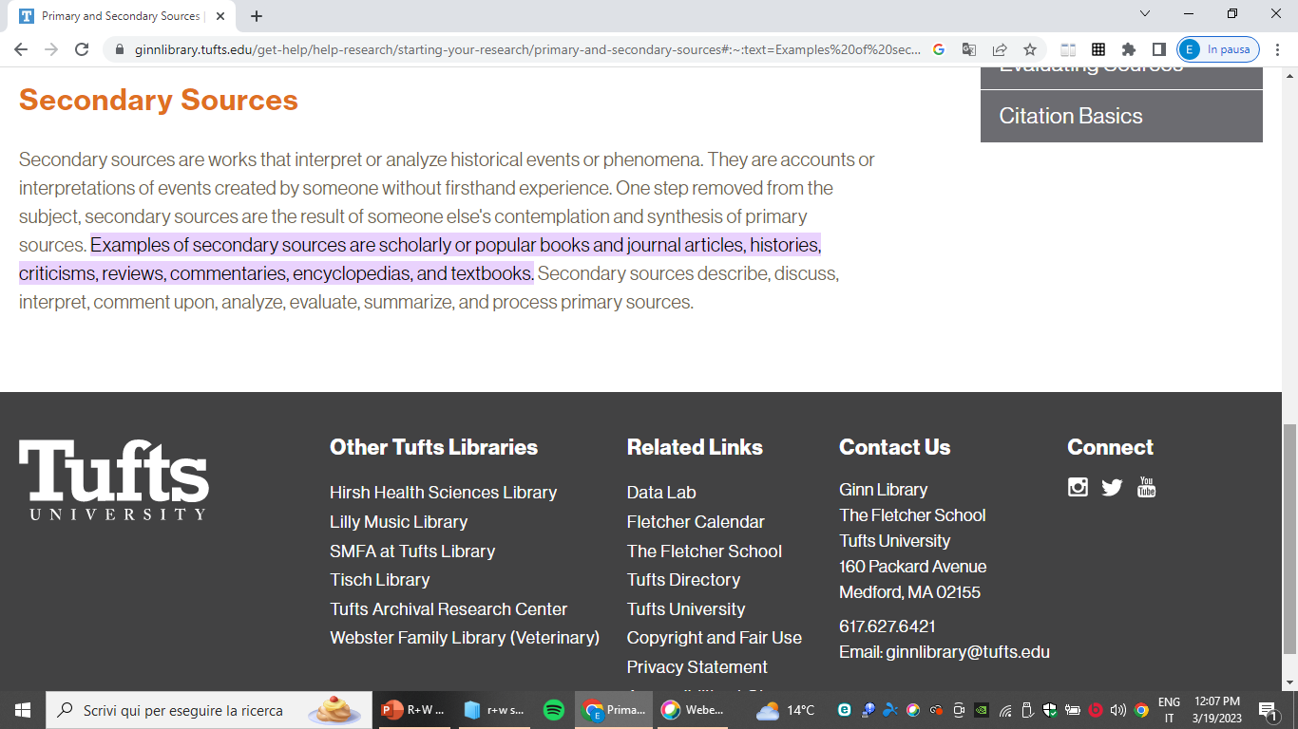

Slide 15
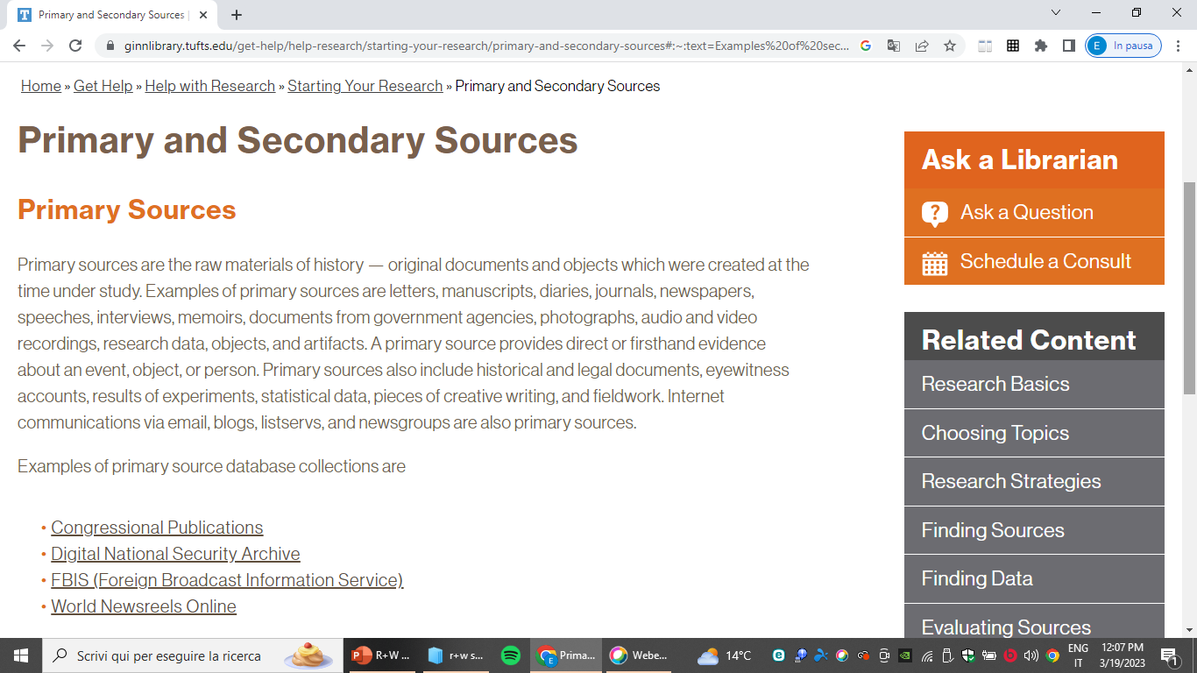

Slide 16
Primary sources
Direct or first-hand evidence →
Historical, legal documents, eyewitness accounts, statistical data, speeches, interviews, surveys, research based on experimentation.

Slide 17
Secondary sources
These describe, discuss, interpret, comment, analyse, evaluate, summarise primary sources.
(Articles in newspapers/magazines or in scholary journals discussing and evaluating original research).

Slide 18
Week 9
Progress report on research paper
(part of final mark, to be included in portfolio)

Slide 19
Skillful Textbook Unit 8
Discussion point – Four start-ups that changed the world
Any local examples?
Personal experience?
What has happened during the pandemic and what are your predictions for the future?
Video and exercises
Pg. 136 Vocabulary
Read pg. 137 Article: Adapt or Die

Slide 20
Reminder Homework for Week 6
Deadline for proposal (part of group portfolio)
- Topic
- Framework
- Perspective/intentions
- Division of tasks
- Sources
Deadline for Code of Cooperative Learning (file on Moodle)

Slide 21
Homework for Week 6
Continue digital workbook units 7 and 8
Article Leadership and change management, pg. 140--143
Download and read these files uploaded on Moodle
1. Language and Objectivity
2. Research and Citing Sources
https://www.rasmussen.edu/student-experience/college-life/15-educational-search-engines/

