Slide 1
Listening and Speaking
Semester 2 Lesson 6 2023/24

Slide 2
Homework for lesson 6
TED TALKS project video and worksheet uploaded by May 6th. (two separate files)
Presentation topic proposal uploaded by April 22, 2024
Skillful pgs 146-150 Prepare an interview regarding moving to a 100 per cent digital classroom*
Unit 9 pgs 152-156, read pg 157
Digital workbook: complete units 8 and 9

Slide 3
April 22, 2024 is the day!
Upload the proposal for your final presentation.
Feedback in Lesson 7.

Slide 4
Presentations
Dates to be confirmed
SIGN UPS ON Moodle May 10, 2024 at 9 a.m.
Monday May 20, 2024 9:00-11:00 (6)
Monday May 27, 2024 9:00-11:00 (6)
13:00-15:00 (6)
Monday June 3, 2024 9:00-11:00 (6)
13:00-15:00 (6)
LISTENING TEST RE-TAKES
JUNE 14, 2024

Slide 5
Practice
Pronunciation p 149
Catenation and elision
Listening 8.9 where is the catenation or elision
Listening 8.10 predictions
Practice

Slide 6
Counter-arguments
A good speaker considers and evaluates perspectives that oppose their argument.
Considering, refuting or disproving these alternative perspectives, the speaker strengthens his or her own argument.
Use words and phrases that signal counter-arguments.
Ex. On the other hand / Nevertheless / I would argue that …

Slide 7
Unit 5 review
2. pg. 95 Rhythm in rhetorical devices
Exercises 1-3
1. Pg 94 Persuasive statements

Slide 8
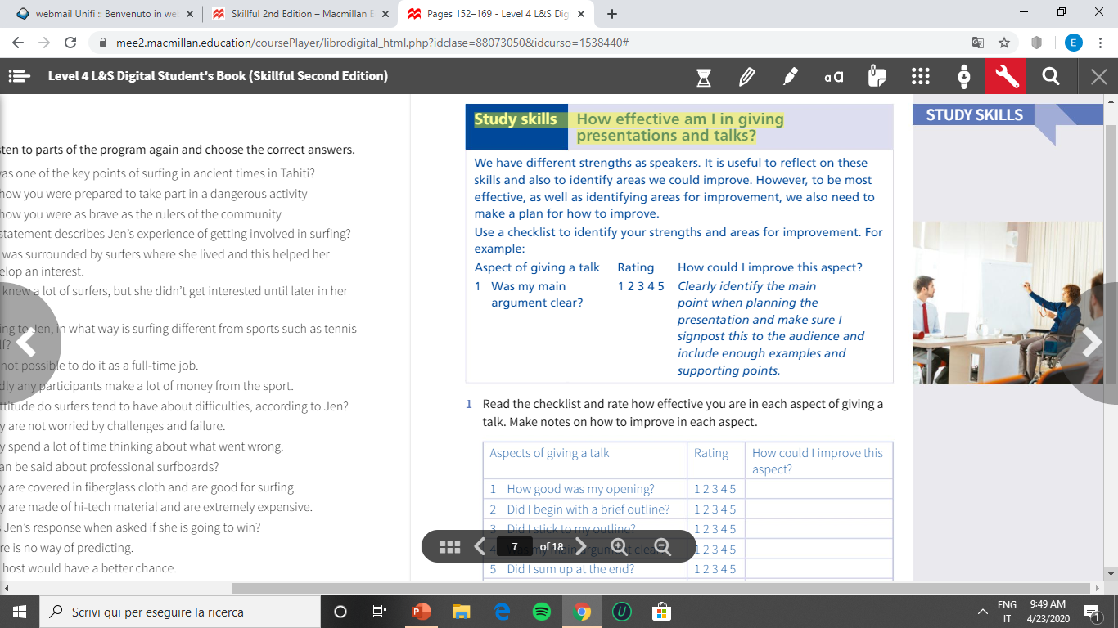
Book pg 157

Slide 9
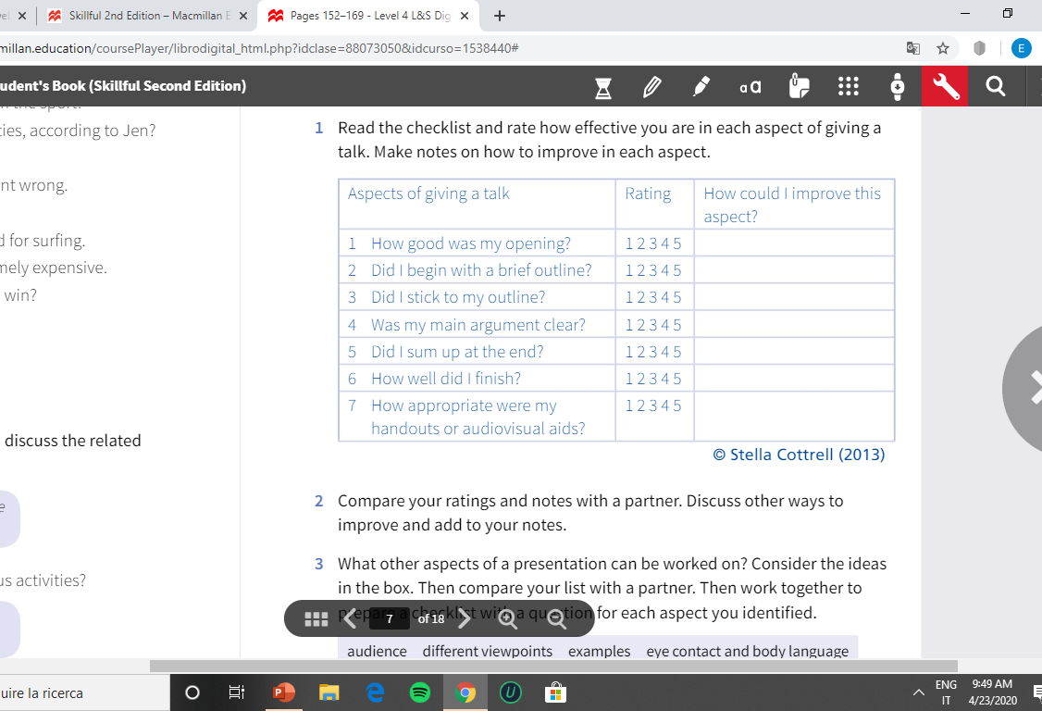

Slide 10
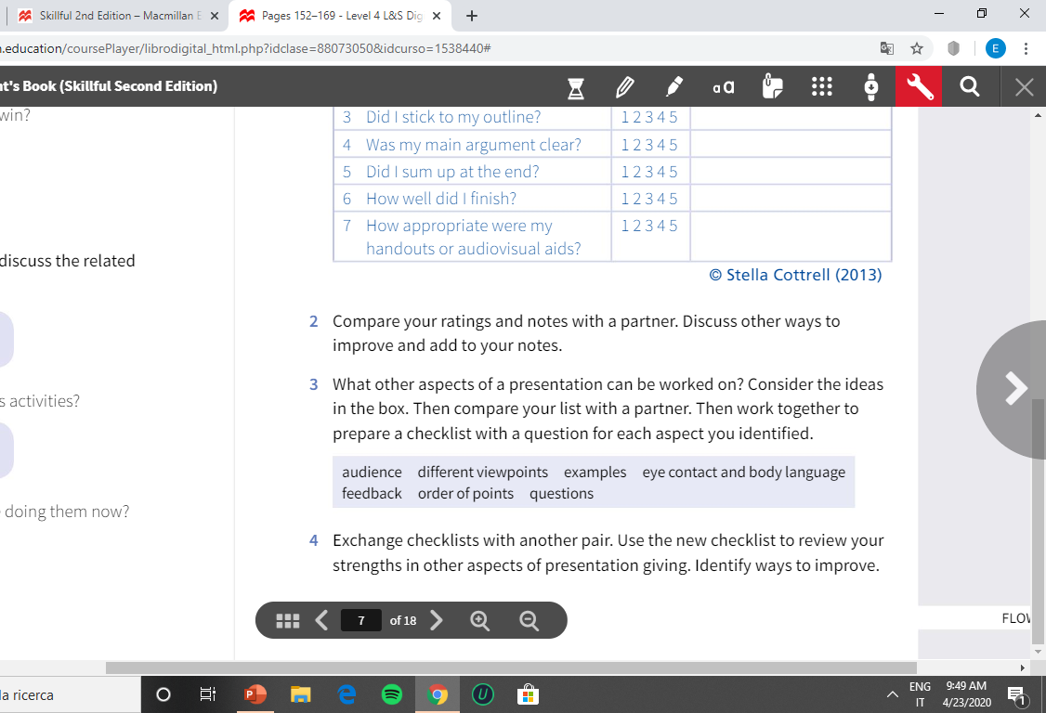

Slide 11
Homework for Lesson 7
Finish pg 95 Pronunciation for Speaking
Download and read pdf files:
Signposting: bridging and linking
Public Speaking and Body Language
Watch and take notes:
https://www.youtube.com/watch?v=HX4Txmn3gY
*With a partner, using the questions prepared for this week, interview each other and make notes for a 4-min talk In lesson 7 you will use your notes to give your talk to a small group of students.

Slide 12
Reasons for learning to give a presentation:
“…public speaking course can help you be a better, more informed
and critical listener; it can “encourage you to voice your ideas and
take advantage of the influence you have;” and it gives you an opportunity
to face a major fear you might have in a controlled environment (Massengale,
2014). Finally, the course can attune you to the power of public
speaking to change the world. Presentations that lead to changes in laws,
policies, leadership, and culture happen every day, all over the world.
From «Exploring Public Speaking» Barbara Tucker, Dalton State, 2019

