Slide 1
Listening and Speaking
Semester 2 Lesson 9 2023/24

Slide 2
Homework for today
1. Unit 10 Conflict pg. 170 – 171
Read infographic and take notes
Watch the video Smash Things
2. Pg. 172 Conflict resolution
A. Vocabulary
Exercises 2, 3
Pg. 173 Listening B, C, D
3. Work on presentation outline and slides

Slide 3
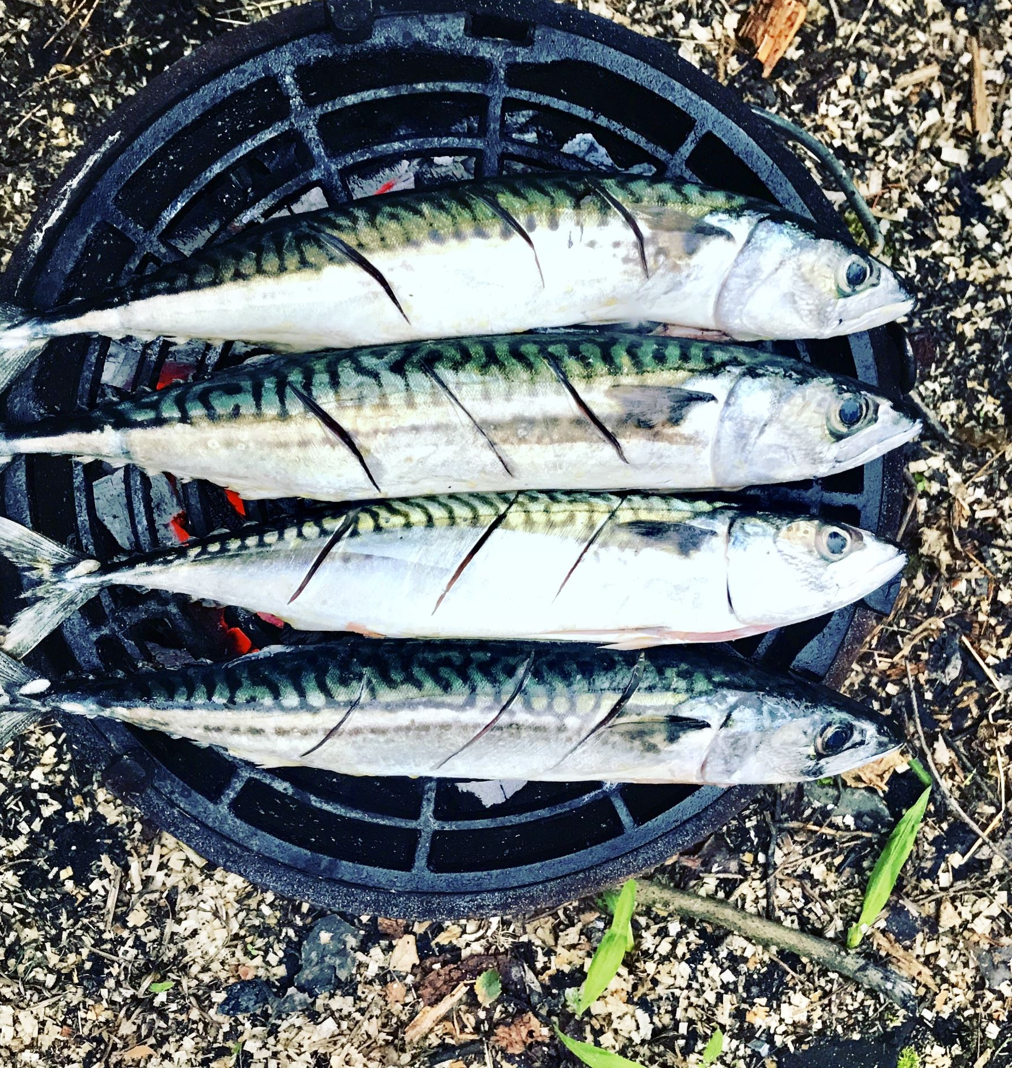
Ted Talks Chef Dan Barber
How I fell in love with a fish
https://www.ted.com/talks/dan_barber_how_i_fell_in_love_with_a_fish/transcript

Slide 4
How are you going to feed the world?
Can I be honest? I don't love that question. No, not because we already produce enough calories to more than feed the world. One billion people will go hungry today. One billion -- that's more than ever before -- because of gross inequalities in distribution, not tonnage. Now, I don't love this question because it's determined the logic of our food system for the last 50 years.
15:55
Feed grain to herbivores, pesticides to monocultures, chemicals to soil, chicken to fish, and all along agribusiness has simply asked, "If we're feeding more people more cheaply, how terrible could that be?" That's been the motivation, it's been the justification: it's been the business plan of American agriculture. We should call it what it is: a business in liquidation, a business that's quickly eroding ecological capital that makes that very production possible. That's not a business, and it isn't agriculture.
Highlights from the beloved fish

Slide 5
Unit 10 Before you watch
Work with a partner. Answer the questions
To what extent is conflict inevitable in life?
Would the world be perfect if there were no conflict?

Slide 6
While you watch After you watch
Book vocab p. 171
After, tell the others….p. 171
P. 179 Critical thinking
P. 185 Speaking Skills

Slide 7
Presentation organisation
Sign ups are closed.
If you need to change, you must do so by communicating with your classmates and email me 24 hours beforehand with the changes.
Check Moodle and unifi email for any last-minute changes
Failure to appear at selected time → exam in September
Email yourselves a copy of your slides

Slide 8
Organization
Arrive a few minutes early.
Have pen drive ready
Email me references and thumbnails
Each exam ‘block’ last 1hr 20 mins
Max 6 students
Results and feedback at the end of the ‘block’

Slide 9
Introduction
Introduce yourself.
Hello / Good morning / Good afternoon
I am … NAME AND SURNAME
.

Slide 10
Titles
This is the first thing the audience sees so …it needs to have an impact and be effective.
Titles are telegraphic and often in two parts separated by a colon.
e.g. General topic: specific areas examined
Questions should be avoided.

Slide 11
Concluding
The end is important and needs to be clearly signalled. Thank your audience and invite questions.
I’d like to end by emphasising the main points …. Thank you for listening. I’ll be very happy to answer any questions.

Slide 12
Last minute tips
Before the presentation : practice, practice, practice
Then: relax right before and take a deep breath.
During the presentation:
Pause, slow down, smile.
Take your time to answer the questions.
It’s ok if you do not know the answer.
After: breathe again and then listen carefully to the other presentations.
When it’s all over you can celebrate!

Slide 13
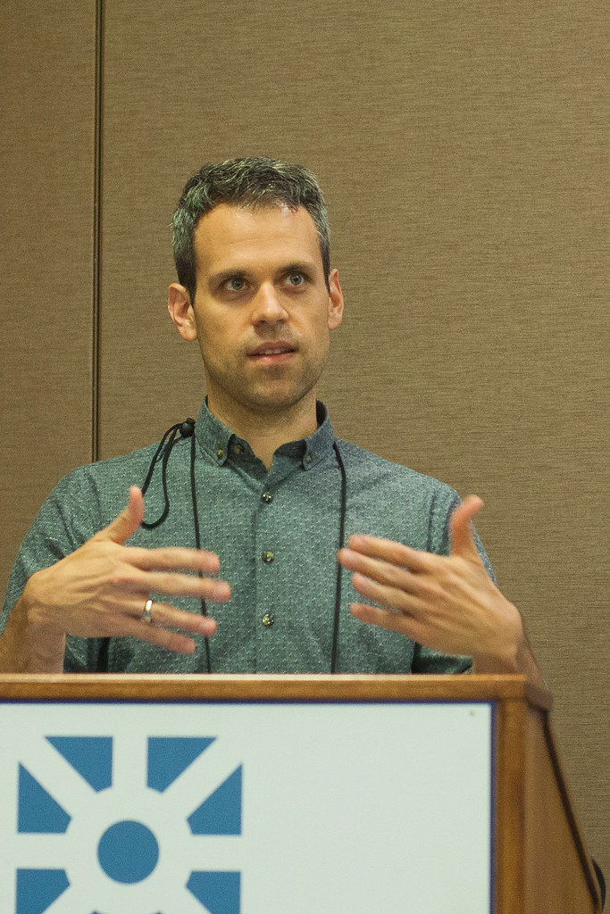
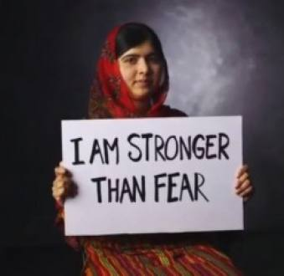
See you for your presentation
Questa foto di Autore sconosciuto è concesso in licenza da CC BY-SA
Questa foto di Autore sconosciuto è concesso in licenza da CC BY-SA-NC

