Slide 1
Listening and Speaking
Semester 2 Lesson 5
2023/24

Slide 2
Homework for Lesson 5
Textbook Change Unit 8 pgs 134-139
Prepare pgs. 140-142
Page 143 prepare to discuss
Pgs 144-45
Digital workbook - Unit 7 and Unit 8

Slide 3
Game!!!!!!
S. Korean won
Hungarian forint
Danish krone
Swedish krona
Sri Lankan rupee
Israeli shekel
Swiss franc
Brazilian real
Czech koruna
Indian rupee
Uzbekistani som
Russian rouble

Slide 4


Match the currencies
₩
CHF
kr.
₪
Ft
₸
kr
R$
Kč
Rs

Slide 5
₩ S. Korean won Ft Hungarian forint
kr. Danish krone kr Swedish krona
Rs Sri Lankan rupee ₪ Israeli shekel
CHF Swiss franc R$ Brazilian real
Kč Czech koruna Indian rupee
₸ Uzbekistani som
Russian rouble

Slide 6
In groups
Skillful Book pg 136
Discuss
Take NOTES
Listening p. 137
Pg. 138 Critical Thinking 1, 2

Slide 7
100% Digital Classroom Q and A pg 146
Read the discussion and analyze the situation.
Discuss the changes about your studies

Slide 8
Perspective
Positive?
Negative?

Slide 9
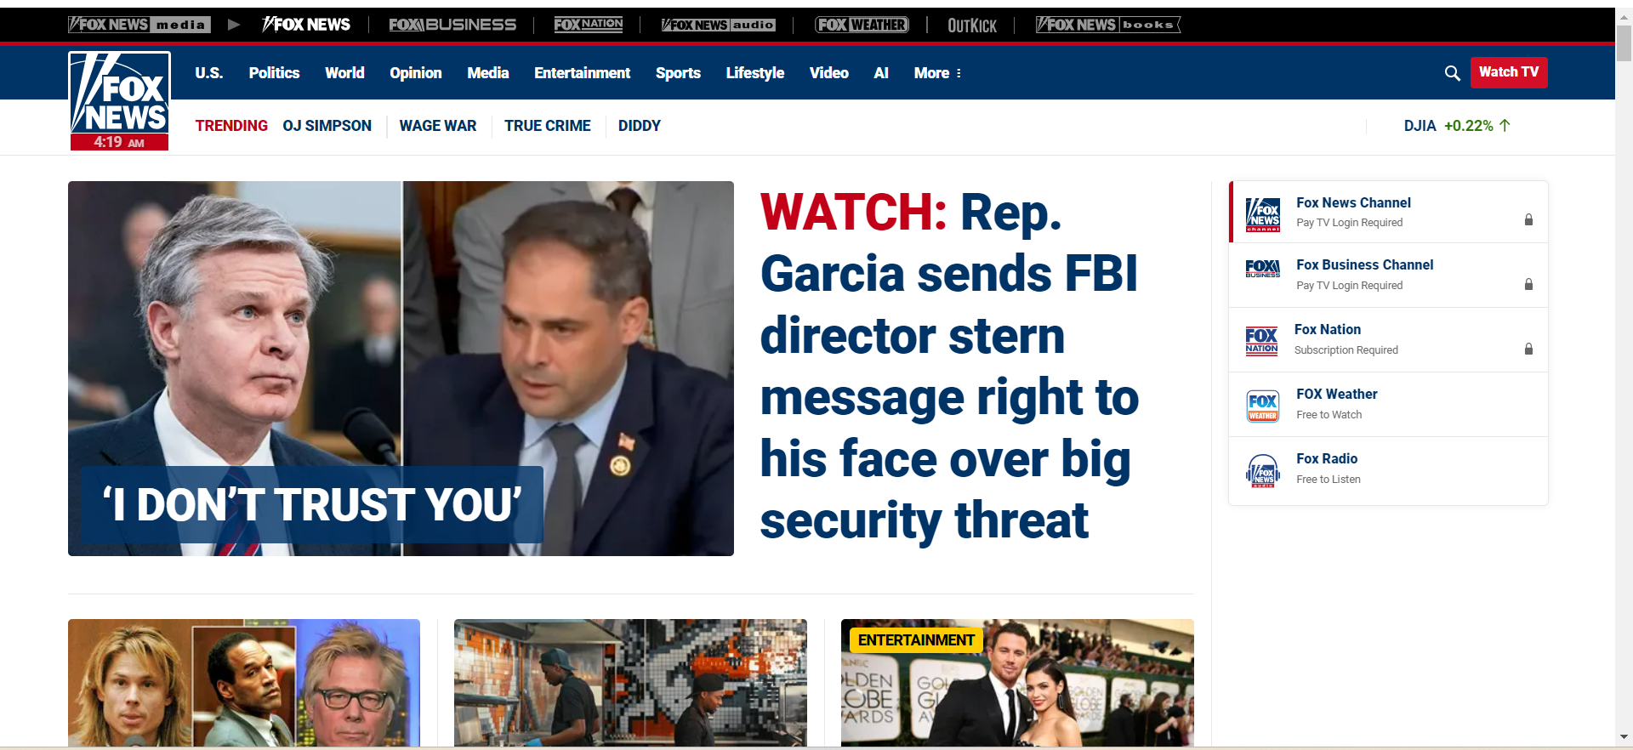
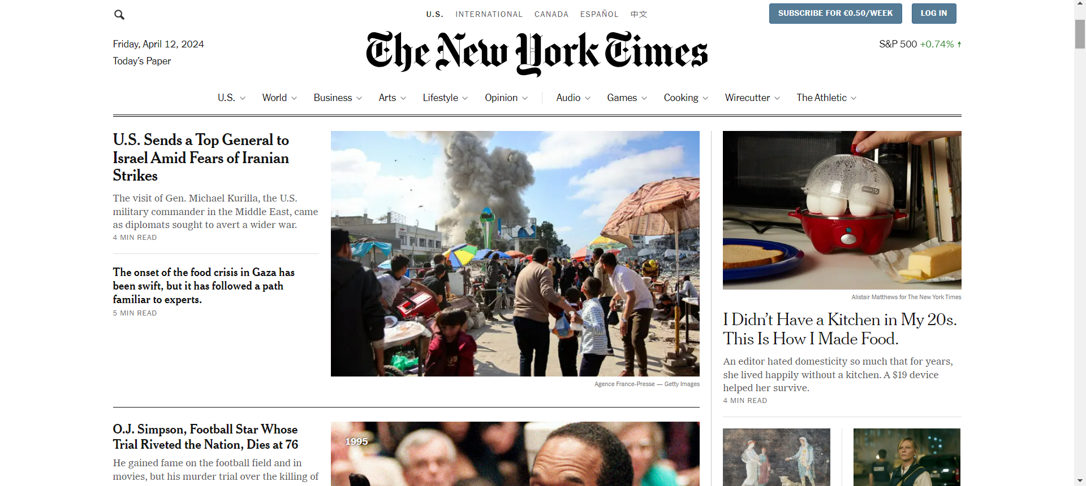
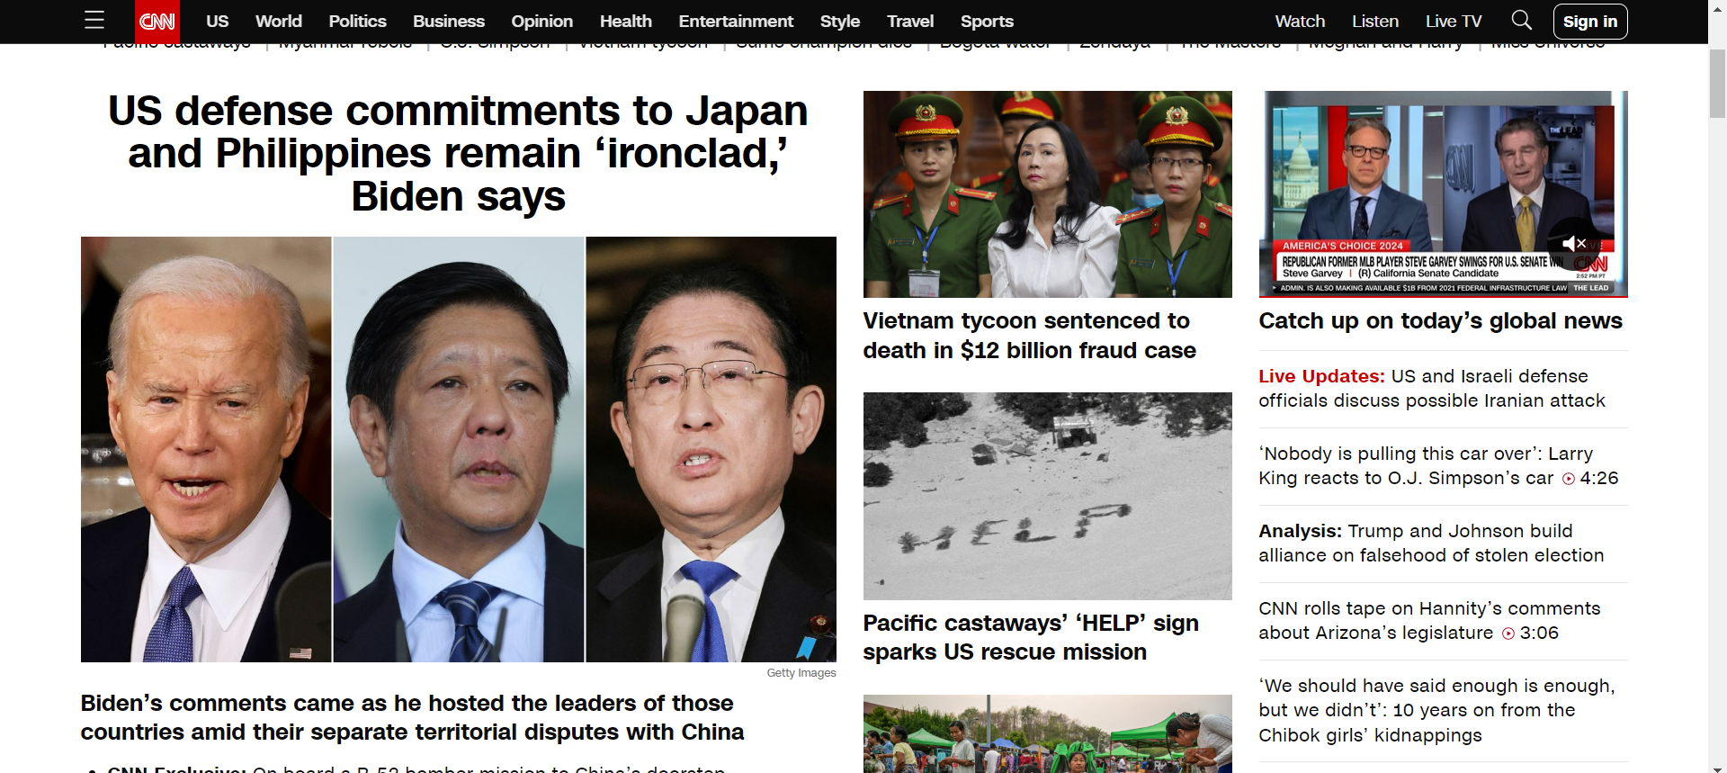
TOP NEWS STORIES

Slide 10
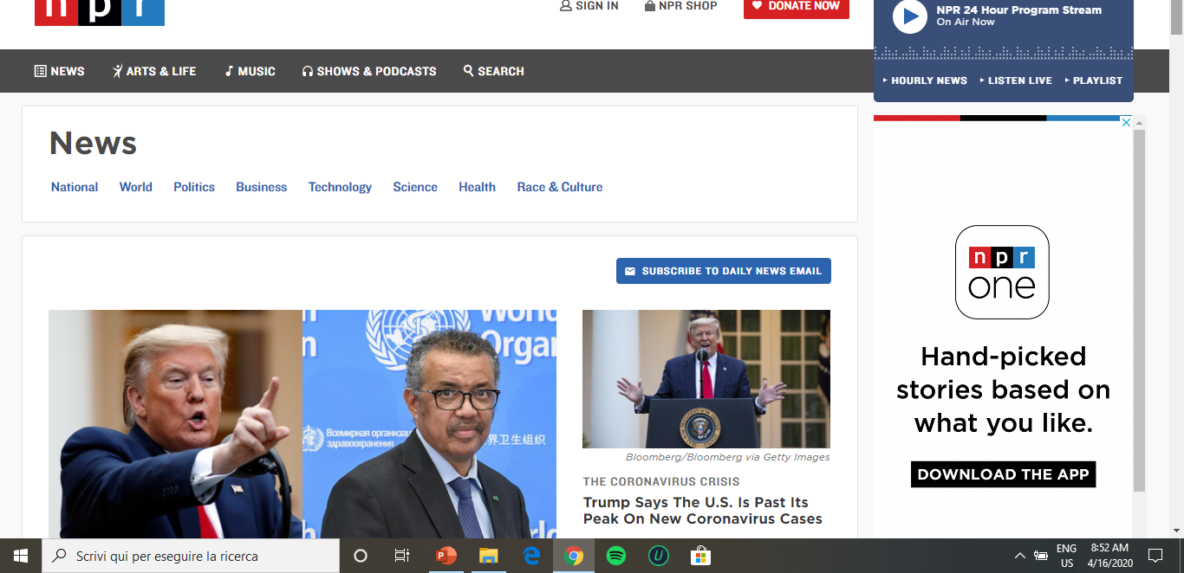
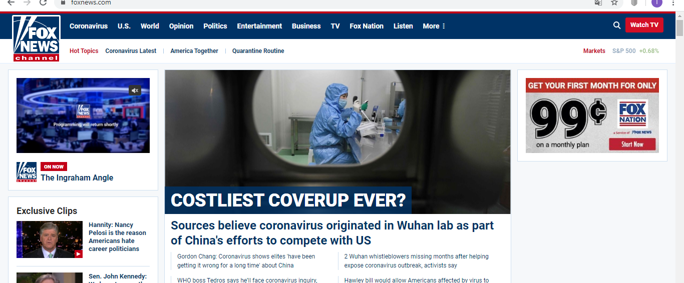

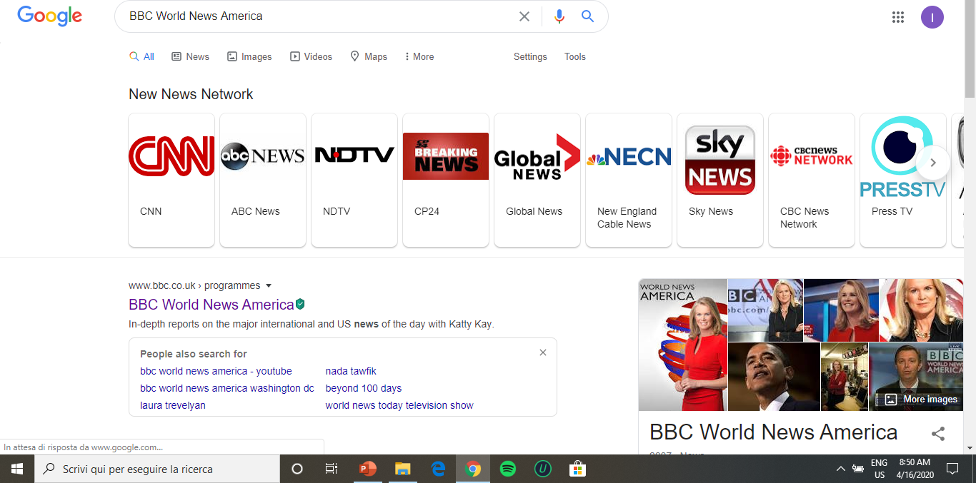
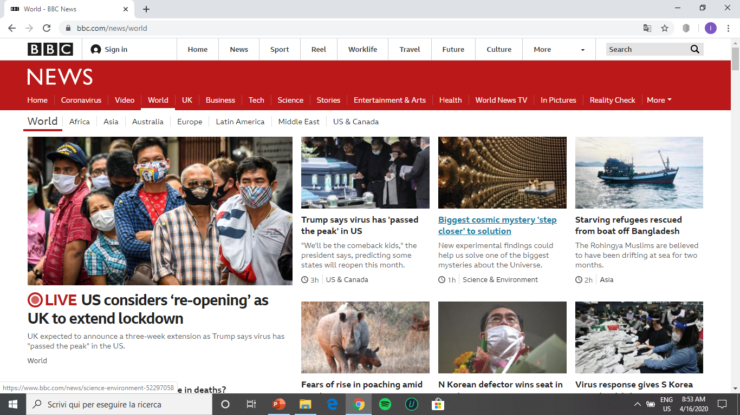
Who do you follow?

Slide 11
How important is word choice?
We should start by understanding that in a propaganda war language is crucial. […] The real point of using Daesh is that it separates the terrorists from the religion they claim to represent and from the false dream of a new caliphate that they claim to pursue.
Alex Salmond, MP

Slide 12
Language and Objectivity
Colorado suspect got assault weapon 6 days before shooting
Colorado suspect bought gun six days before shooting
The suspect, Ahmad Alissa, had a history of angry outbursts and was previously arrested for assaulting a classmate.
Authorities said Alissa purchased a Ruger AR-556 pistol on March 16, six days before Monday's shooting. The affidavit said authorities found a semi-automatic handgun, a tactical vest and jeans and shirt at the scene of the killings
A gun used by a man suspected of shooting and killing 10 people at a Boulder King Soopers would have been illegal under the city’s assault weapon ban that was recently blocked by a judge, though nobody ever had been cited under the ban while it was active.

Slide 13
NATO chief stresses unity in pushback against Trump's worldview
NATO boss tells Congress President Trump’s tough talk to alliance members is … working
NATO chief addresses Congress but appeals to Trump in anniversary speech
NATO Chief Warns of Russia Threat, Urges Unity in U.S. Address
Objectivity
NATO Chief Tells Congress Alliance Remains Urgently Needed

Slide 14

Final Presentation Topics
Need to be focussed
Need to have direction

Slide 15

Ask yourselves
Why am I TALKING about this?
What will the AUDIENCE gain?
Where is the DEBATE/CONTROVERSY/
DISCUSSION/POLEMIC?
Where is the CRITICAL THINKING?
Where is the RESEARCH?
Do I have AUTHORITATIVE SOURCES?
Where does MY OPINION emerge?

Slide 16

DEADLINE
Deadline for topic proposal
April 22, 2024
- Topic
- Framework
-Perspective/intentions
- Sources
Uploaded to Googledocs folder saved under your surname

Slide 17

Remember
curiosity
computer
controversy
critical thinking

Slide 18

Formatting your proposal
Top left corner: Listening and Speaking, 2nd sem 23/24
Top right corner: Your name and the number 1
Centred: Presentation Topic Proposal

Slide 19

Text
Subheadings: Topic
Framework
Perspective/intentions
Sources
For each subheading, provide brief information

Slide 20

Font sizes
All text to be in Times New Roman 12 with double spacing apart from the title (Presentation Topic Proposal) which should be TNR 16.

Slide 21
Week 7
Feedback on:
suitability of topic and framework
Perspective/intentions
Sources
If your proposal is not uploaded on time, I will not be able to give you feedback in week 7

Slide 22

Homework for lesson 6
Google docs folder saved under your surname
TED TALKS project in progress…
Presentation topic proposal uploaded by April 22, 2024
Skillful pgs 146-150 Prepare an interview regarding moving to a 100 per cent digital classroom
Unit 9 pgs 152-156, read pg 157
Digital workbook: complete units 8 and 9
Listening Test June 14th 11 a.m.

