Slide 1
Listening and Speaking
Semester 2 Lesson 1 2023-2024

Slide 2
Units 5 & 6 text book and workbook Revision
Pg. 83 C Global listening
Pg. 85 Study skills – overcoming nerves/presenting
Pg. 89 Rhetorical devices
Pg. 90 Vocabulary
Pg. 93 Grammar: Inversion
Pg. 105 Listening for main ideas
Pg. 107 Identifying loaded questions
Pg. 108 Vocabulary development

Slide 3
Course outline
Wks 1-8: Units 7-10
TED talks video marked assignment
May: Individual Presentations

Slide 4
Semester 2 Lesson dates
Lesson 1 February 19
Lesson 2 March 18
Lesson 3 March 25
Lesson 4 Aprile 08 VSR 005 TED talk project presentation
Lesson 5 Aprile 15 VSR 005
Lesson 6 April 22
Lesson 7 April 29
Lesson 8 May 06 TED talk video deadline
Lesson 9 May 13
Final presentations to be arranged end of May/June
Proposed dates: 20/5, 22/5, 27/5, 29/5, 3/06

Slide 5
Presentation deadlines
You
Wk 6: choice of topic
Wk 8: framework draft
Wk 9: definitive title
Me
Wk 7: feedback
Wk 9: feedback

Slide 6
Course Content
Intonation
Critical thinking
Expressing opinions, argumentation and concession
Rhetorical devices
Slides
Body language and delivery

Slide 7
Supplementary Files
Topic Choice
Audience Awareness
Language and Objectivity
Using Visuals in Presentations
Researching and Citing Sources
Language and Bias
Signposting, Bridging and Linking
Public Speaking and Body Language
Using your Voice in Presentations
Titles for Talks

Slide 8
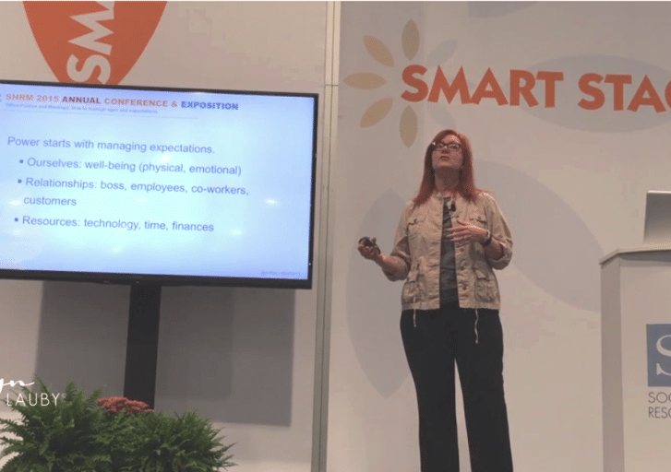
What is the difference?
Talking
Giving a talk
Discuss with a partner
Questa foto di Autore sconosciuto è concesso in licenza da CC BY

Slide 9
Giving a talk
Formality
Focus
Organisation
Lexis
Evidence of research

Slide 10
The three Cs
Curiosity
Computer
Critical thinking
and number four …
Controversy

Slide 11
Every talk is a work in progress
Read
Ask
Question
Think
Reflect

Slide 12
TOPICS Presentation> example
Berlin Wall → East Side Gallery →
art and legacy → Belfast Peace Wall →
Banksy → hotel in Bethlehem, West
Bank
Potential new topic:
Walls and Street Art as
a Form of Protest

Slide 13
The Walled Off Hotel, Bethlehem
http://www.bbc.com/news/world-middle-east-39157856

Slide 14
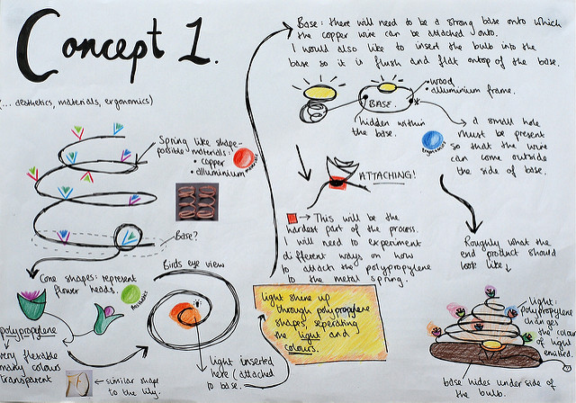
Ways to organize ideas
Questa foto di Autore sconosciuto è concesso in licenza da CC BY-SA
Questa foto di Autore sconosciuto è concesso in licenza da CC BY-SA-NC
Questa foto di Autore sconosciuto è concesso in licenza da CC BY

Slide 15
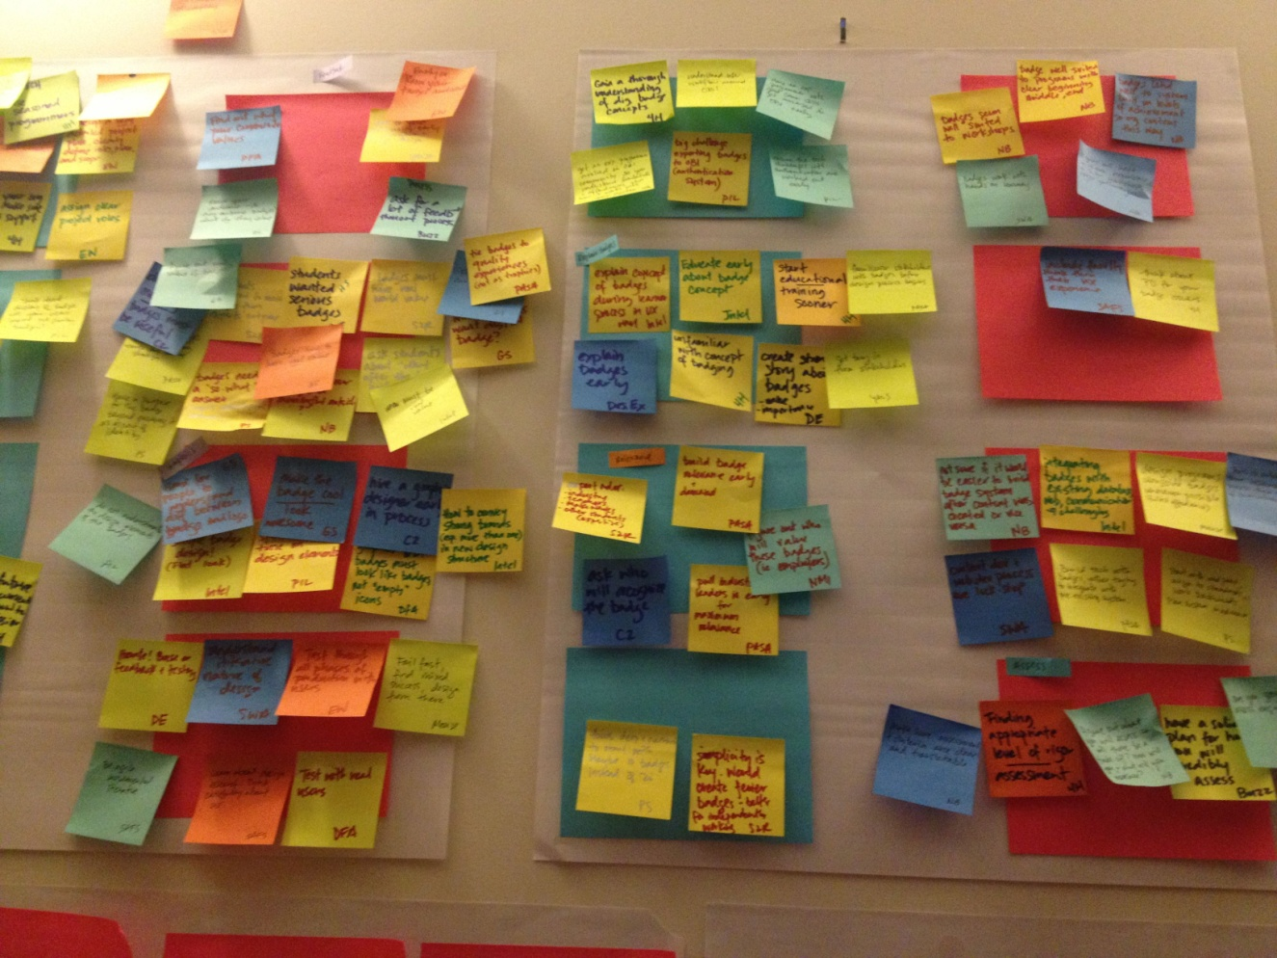
IMAGINATION & Visualization
Questa foto di Autore sconosciuto è concesso in licenza da CC BY-NC-ND

Slide 16
Now . . .
Ask
Question
Think
Reflect

Slide 17
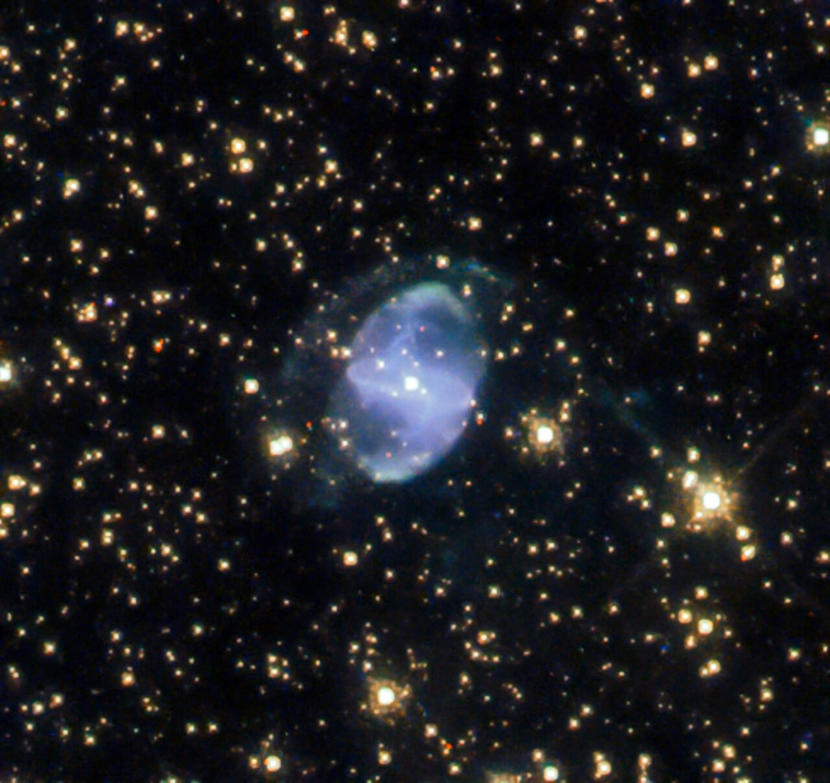
Unit 7 Expanse
Discussion point
Video
The New Space Race
Listening & Critical thinking pgs 118-120

Slide 18
Homework for lesson 2
Go to link on slide 13 and watch video
Do pages 121-124
Listening Practice
https://takeielts.britishcouncil.org/take-ielts/prepare/free-ielts-practice-tests/listening

