Slide 1
Reading and Writing
Semester I Lesson 7 a.a. 2023/24

Slide 2
Homework for lesson 7
1.Complete and check all vocabulary exercises in Units 1 and 2
2. Online workbook exercises
3. Start unit 3 Energy – pgs 44 & 45 and do first reading pgs 46, 47, and 48 and exercises
Read article on Superbugs (uploaded on Moodle) Prepare summary. Share it with a peer and do peer review.

Slide 3
Using data to support opinions
P. 41 Exercises
Use of email for personal correspondence has declined steadily since 2010 while social media has seen a rise to prominence. This strongly indicates that social media has become the preferred method of communication.

Slide 4
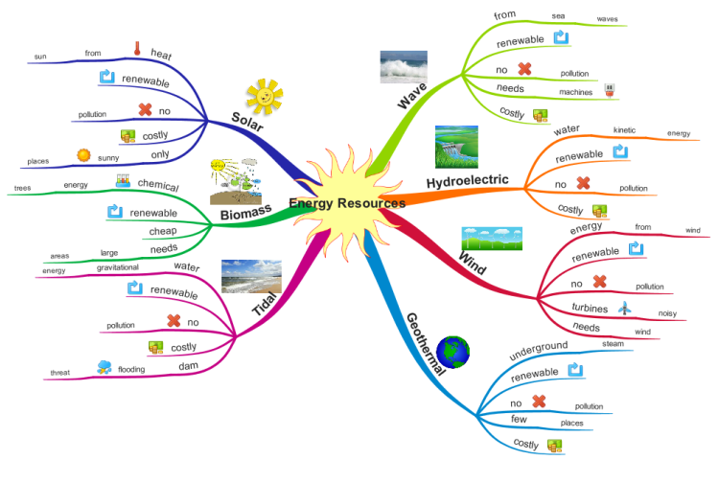
Unit three energy

Slide 5
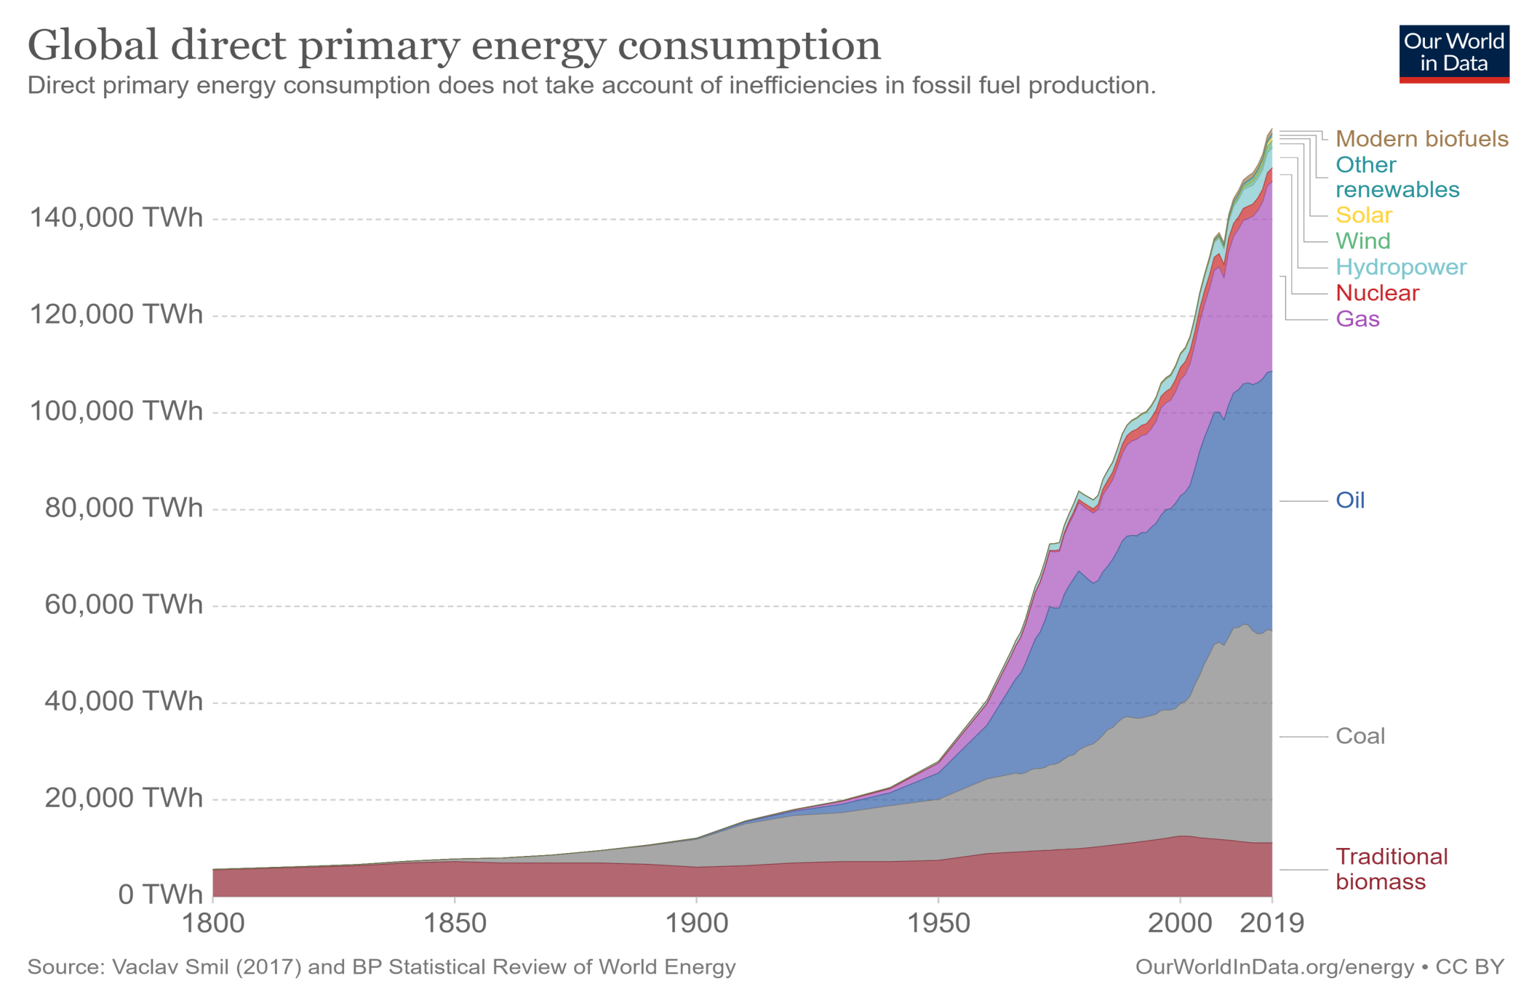
Global energy consumption pg. 44-45
What are the main sources of energy in your country?
What energy does your country produce?
Do you think we should continue to use fossil fuels? Why/why not?

Slide 6
Video unit 3
https://www.macmillaneducationeverywhere.com/resource-pack/skillful-2nd-edition/level-4-reading-and-writing/skillful-2nd-edition-level-4-reading-and-writing-teachers-resource-center/video/unit-3-the-nuclear-debate/
https://www.youtube.com/watch?v=8tOsT55W9iQ

Slide 7
Homework Lesson 8
Pg 49 Stages of the memory process
Exercises pg. 50, reading on pg 51-2 Fracking – the future
(research the latest on Fracking and where it is being done)
Prepare a summary of one paragraph of the article on Fracking.
Exercises pg. 54-55,58 & 59
Language test on January 18th VSR 9-11
Summary test: December 13th 9 a.m. VV Aula 2
Text given roughly 500 words – your summary 150 c.a.
90 minutes allotted to write

