Slide 1
Reading and Writing Semester 1 Lesson 6 a.a 2023/24

Slide 2
Homework for lesson 6
Read pgs 33-34
Pg 36, 37 and 39
Read pages 40 (+exercises) and 41
Summary Instant Satisfaction final text due to be uploaded
Writing task uploaded

Slide 3
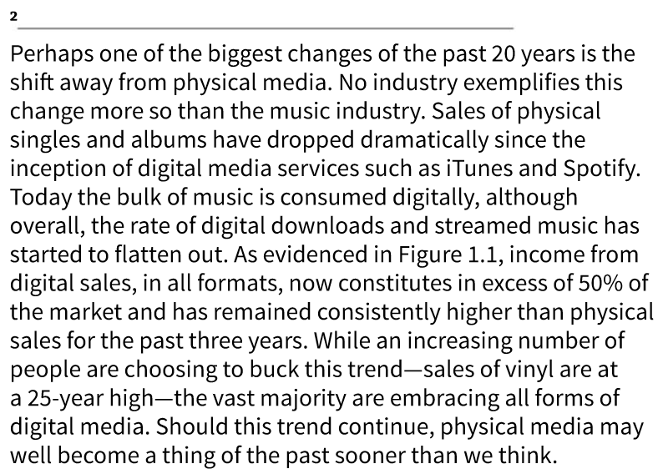
p.29
Select & Eliminate

Slide 4
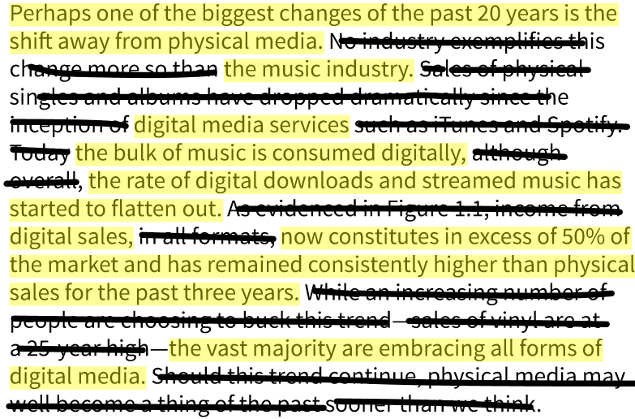

Slide 5
A possible answer
What has clearly emerged over the past twenty years is an increasingly noticeable shift away from physical media towards all forms of digital media. An analysis of data based on sales and the use of digital media services in the music industry reveals this overriding trend. Although it would seem that the rate of digital downloads and streamed music is beginning to level off, digital sales account for more than 50% of the market and consistently exceeded physical sales in the period 2014-17, as shown in figure 1.
First draft = 88 words

Slide 6
Summary
Decide how the three key points are signalled to the reader.
Identify the lexis that the writer has changed from the original. To which semantic fields does the lexis in the original largely belong?
Has sentence structure been modified?

Slide 7
Gaming, society and the individual pg 33
Vocabulary
Before you read
Global reading: Main ideas /paragraphs
P. 35 Close reading
Critical thinking p. 36-37

Slide 8
Evaluating supporting data pg. 38
Using percentages to make small sample sizes seem more impressive
Omitting results that contradict the main argument
Manipulating the presentations of a graph

Slide 9
Inverted conditionals real and unreal present pg. 40
Exercise 1
1-6
Exercise 2
a
b
c
Should + subject + base form
Were + subject + to + base form

Slide 10
How to lie with statistics
Here is one current example. Several weeks ago, Texas Governor Rick Perry made headlines when he pointed out that the affluent pay most of the Federal income taxes in this country while 47 percent of the earners pay none at all. He called this an "injustice". What's wrong with this statistic? First, it begs what should be the first question about any statistic: "Why would this be the case?" The answer is that our income taxes are progressive. Those who have more pay more. So the tax burden simply reflects the highly skewed income distribution in this country. In fact, the (famous) top 1 percent of income earners took home 24 percent of the total national income in 2010, while the top 10 percent took home 49 percent. In contrast, 47.3 percent of our workers earned less than $25,000—close to, or less than, the official poverty line of $22,343 for a family of four.
The other problem with Governor Perry's fine sense of justice is that he was engaging in a statistical charade. It was a prime example of statistical cherry picking. If you look only at Federal income taxes paid you get a very different result than if you consider the total tax burden of our income earners. Counting payroll taxes, sales taxes, excise taxes for gasoline, and the like, you get a very different result. According to the Tax Policy Center at the Brookings Institution, in 2010 the top 1 percent paid a total of 30.8 percent of their income in various taxes, while the poorest 20 percent actually paid 16.3 percent, a lot more than "none at all."
By Peter Corning Ph.D.
https://www.psychologytoday.com/us/blog/the-fair-society/201111/how-lie-statistics

Slide 11
http://owl.english.purdue.edu/
This site can
change your English.

Slide 12
ENERGY SOURCES
Questa foto di Autore sconosciuto è concesso in licenza da CC BY-SA
Questa foto di Autore sconosciuto è concesso in licenza da CC BY
Questa foto di Autore sconosciuto è concesso in licenza da CC BY

Slide 13
Homework Lesson SEVEN
1.Complete and check all vocabulary exercises in Units 1 and 2
2. Online workbook exercises
3.Start unit 3 Energy – pgs 44 & 45 and do first reading pgs 46, 47, and 48 and exercises
4. Read article “Superbugs”, summarize and upload to GoogleDocs folder
5. SUMMARY TEST December 13th
6. Language test January 18th VSR

