Slide 1
Reading and Writing
Semester 1 Lesson 3
Anno academico 2023/24

Slide 2
Homework
p. 13 Study skills Proof - Reading
Reading and exercises p 14-19
Google: Academic Word List

Slide 3
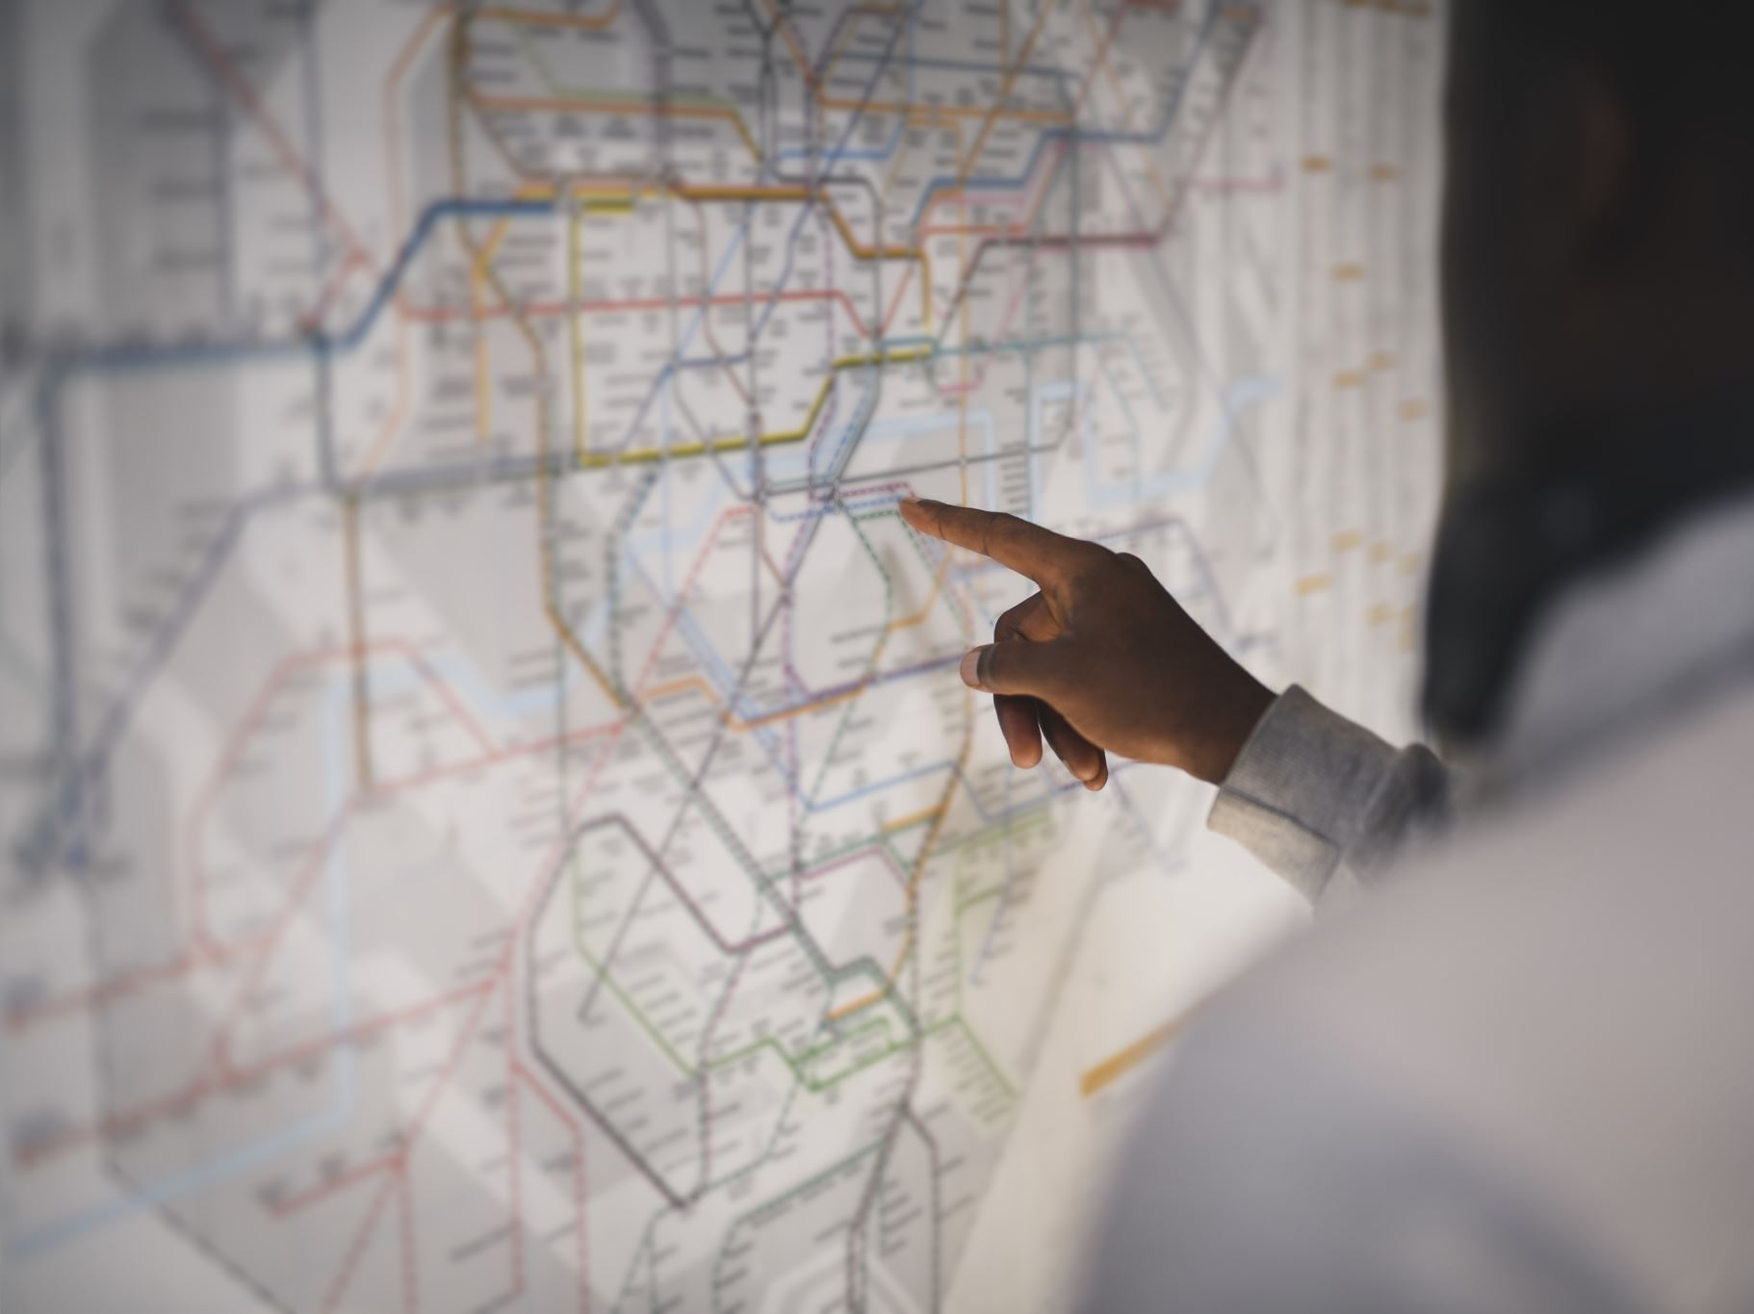
Listen. Follow instructions.

Slide 4
Email assignment:
1) Subject line
2) Introduction
3) Photo on Moodle.

Slide 5
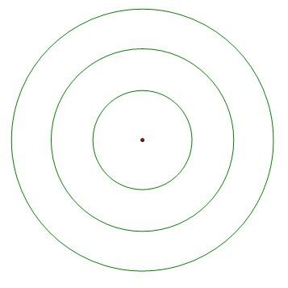
Strangers
Close friends
Acquaintances
Friends of friends
Colleagues/classmates

Slide 6
Identifying the writer’s position
Look for:
Positive or negative adjectives or adverbs
Opinion language
Linking phrases and signposts
Online Friends
Pg 14

Slide 7
Critical thinking
Identifying types of evidence pg 20
Data, statistics, or research from credible and unbiased sources
An opinion from a credible and unbiased expert
Anecdotal evidence

Slide 8
Discuss
Academic Word List
General Service List
Purposes
Differences

Slide 9
despite / in spite of
What’s the difference?
How frequently are they used?
How are they used?

Slide 10
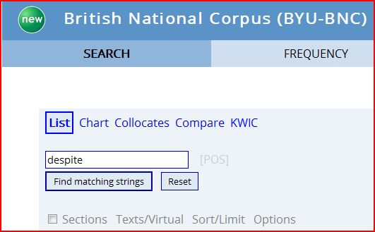
corpus.byu.edu/bnc/

Slide 12
Word in context

Slide 13
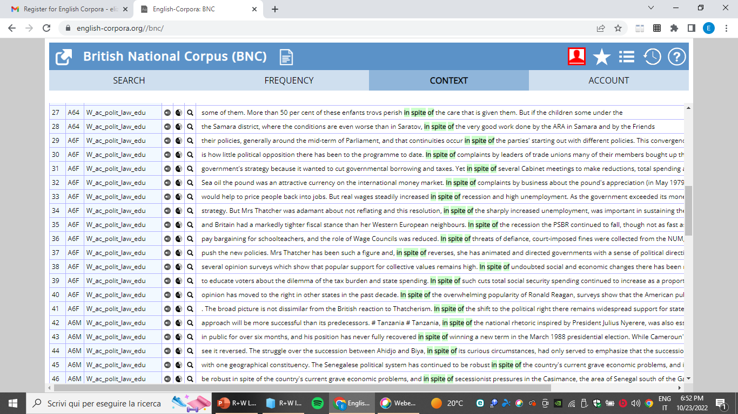
In spite of

Slide 14
Homework for lesson 4
Download AWL sublist 1
Mark words: X = don’t know
XY = understand but don’t use
XX = understand and use
Go to www.natcorp.ox.ac.uk
Go to corpus.byu.edu/bnc/ and search for ‘in spite of’
P. 21-25
Writing task pg 24 - Use critical thinking skills

