Slide 1
Lingua Inglese II a.a. 2023-24
English for Academic Purposes
Reading and Writing
Semester 1 Lesson 1

Slide 2

Reading and Writing Semester 1

Slide 3
Expand your vocabulary
https://www.braingle.com/mind/test_words.php#

Slide 4

Moodle
CercaChi
Office hours
Moodle: sign up for my page . Attività complementare
check my section for homework or communications
CercaChi: updates to any changes in lessons or office hours
Office hours: Thursdays 9:00-11:00 online
email for an appointment
elizabethrose.sherman@unifi.it

Slide 5

MOODLE
Sign up for my Moodle page: Go to homepage of e-l.unifi.it
Scroll down, click on Scopri le nostre piattaforme moodle
Find and click on Attività formative complementari
https://formstudelearning.unifi.it/
Scroll down and click on Lettorati di Lingua.
Choose Scuola di Studi Umanistici e della Formazione
Click on Anno Accademico 2023-2024
Click on L-11 Laurea in Lingue, Letterature e Studi Interculturali
Scroll down and find Lingua Inglese 2 (L-11) Sherman 2023-2024
You will have to login. Click on iscrizione spontanea.
Now you are on my Moodle page.

Slide 6
Materials
Skillful: Reading & Writing 4 (Macmillan) available at Libreria Alfani Editrice
Digital component: join the class
RW23_24
Password: 67115A5H
Additional materials made available on Moodle

Slide 7
Classroom procedures /consequences
(a.k.a. the RULES)
Roll call at the beginning of lessons If you are late, you must come to me at the end of the class.
Bring books to class If you do not have a book, look on with someone else.
Homework will be posted on Moodle. If you do not do your homework on time, I will not accept it.
Moodle should be consulted every day
Prepare before lessons, participate actively Raise your hand and say your name.
Written justification for absence on test dates Otherwise you cannot sit the test.
Do not interrupt the class if you leave early. Extra work will be given.
RESPECT for all – we are here to learn and practice.

Slide 8
Semester 1 Schedule
Week 1: 27/09
Week 2: 04/10
Week 3: 11/10
Week 4: 18/10
Week 5: 25/10
Week 6: 08/11
Week 7: 15/11
Week 8: 22/11
Week 9: 29/11
TBA:
Summary
Language test

Slide 9
Reading & Writing Tests
1st semester
Summary
Language and Grammar test
2nd semester
Commentary analysis on Cooperative Learning
Group research paper – Cooperative Learning Paper

Slide 10
Course Objectives
Focus on formal English
Expanding vocabulary
Identifying key information in texts
Summarising skills
Critical thinking
Independent research

Slide 11


Classroom dynamics
Teacher
Students

Slide 12
Teacher Student
intentions expectations
objectives

Slide 13

What you need
Curiosity
Critical thinking
Commitment
Concentration

Slide 14
Writing
Writer Reader
intentions expectations

Slide 15
Good writers …
Phase 1
Planning
read
select
organise
Phase 2
Production
write
proofread

Slide 16
Good writers …
produce original work
Please read our plagiarism policy on Moodle

Slide 17
Vocabulary: meanings
equity
P.10
crowdfunding
tangible
start-up
philanthropic

Slide 18
Learning vocabulary
What do YOU do?
How much effort do you make?
How can you improve?

Slide 19

Learning strategies: listening
https://youtu.be/I28vM-p1brQ

Slide 20
Vocabulary notebooks
definition(s)
parts of speech
collocations
pronunciation
example sentences
false friends
etc, etc.

Slide 21
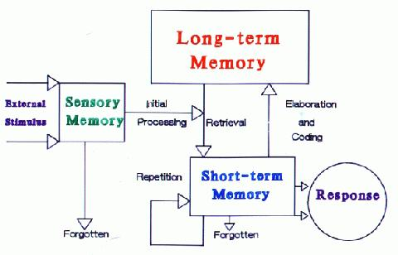
MEMORY
https://medium.com/swlh/want-to-improve-your-memory-science-tells-us-the-key-and-it-can-actually-be-fun-99a9c9b95d5b

Slide 22
Vocabulary
working with words
synonyms = variation
Academic word lists

Slide 23
Formality
What characterises formal writing?
passive voice
nominalisation
no slang / idiomatic expressions
no contracted forms / abbreviations

Slide 24
Understanding assumptions in questions
Define assumption.
Why do interviewers use assumptions?
Is the use of assumptions always successful?
Pg 12

Slide 25
Homework for Lesson 2
Familiarise yourselves with the book (read the contents, foreword and functional language pages)
Watch the first video and do the exercises.
Read the first reading passage in Unit 1
Do exercises on the first reading in Unit 1
Check out this website https://www.phrasebank.manchester.ac.uk/

