Slide 1
Listening and Speaking
Semester 1 Lesson 6
Anno academico 2023-24

Slide 2
Homework for lesson 6
P. 26-27 Video and tasks
P. 28-32 & p 35
Group discussion practice and feedback

Slide 3
ANSWERS
P. 32, ex. 2
1. motivate
2. interfere
3. outrage
4. prestige
5. protective
6. initiative
7. eliminate
8. enhance

Slide 4
Sports Video and Listenings
Video summary
Pre-listening
Global listening pg 29
Ordering the discussion
Close listening pg 30
Listening pg. 33

Slide 5
Discussion point
Pros:
1.
2.
Cons:
1.
2.
Should there be a separate category of sports for those who prefer to use performance enhancing drugs?

Slide 6
Years
1916
1701
1960
1015
1700
2013
1050

Slide 7
Years
300BC
BC = Before Christ
300BCE
BCE = Before Common/Christian Era
500AD
AD = Anno Domini
500CE
CE = Common/Christian Era

Slide 8
decimals and fractions
1 1/2
1 1/4
16.53
7 7/8
8.427
5 3/4

Slide 9
0
decimals: 0.64
phone numbers 055 239 3412
countdowns: 5, 4, 3, 2, 1, 0
football: 4 - 0
tennis 40 - 0
nought
0
zero
nil
love

Slide 10
a e i o u
J 3.142 | 13 | 40 | 67,815 | 14
Y 30 | 0.76 | 940,814,212 | 16 7/8 | 405

Slide 11
Homework for lesson 7
Speaking task pg 42 in groups
Problems in the world of sport
Book: Pgs 36-42
Download and revise pdf file Numbers and dates
Watch the video from Macmillan on word frequency at this link.
https://www.macmillandictionary.com/learn/red-words.html

Slide 12
Problems with sports
Problems Evidence Questions
Doping Cost of controls?
Technology
Rivalry-violence
Sponsorship
Injuries
Money as goal
Pressure to win
Over involved parents
Childrens’ identity
?

Slide 13
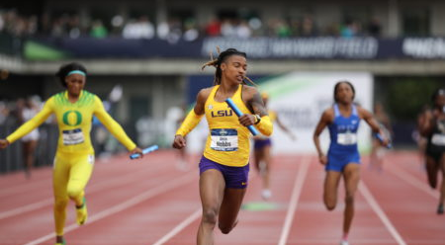
Discussion next week: Should transgender athletes be allowed to participate in sports?
Questa foto di Autore sconosciuto è concesso in licenza da CC BY-ND

