Slide 1
Listening and Speaking
Semester 1 Lesson 5
a.a. 2023/24

Slide 2
Homework for today
Revise videos and listenings from Unit One
Pg 17-19
Read pgs 182 and 184 in your book
With the same group members as today, research information and prepare to present your discussion
Watch video Unit 2 and do pages 26-27

Slide 3
Answers Listening pg. 15
2. Listening 1.6
6
3
7
8
2
5
1
4

Slide 4
Review: Logical fallacy: anecdotal evidence pg. 17
1. …people don’t…They think
2. ..you know, like Sam? We always end up doing what he..
3. ..what about last week in the tutorial when Susi…she never usually.. but everyone..
4. …because people just won’t…; I certainly won’t anyway I..; and I’m sure you do, too.

Slide 5
Notes and Sources
Why?
planning

Slide 6
Interactional skills
interrupting politely
asking for and expressing opinions
- agreeing and disagreeing
asking for clarification
hesitating and discourse markers

Slide 7
Group discussions
(end of course)
Time: 20 minutes
Five members per group
Two support topic
Two do not support topic
One member is the chairperson and summariser
Roles assigned immediately before discussion

Slide 8
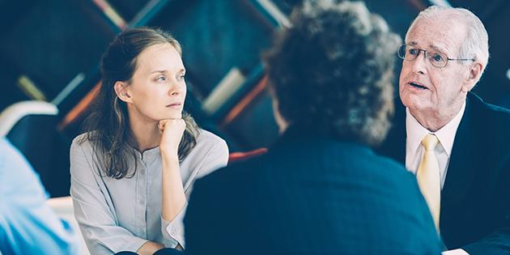
Discussion practice today and next lesson
8 mins min.
10 minutes max
Questa foto di Autore sconosciuto è concesso in licenza da CC BY-ND

Slide 9
PEER FEEDBACK
1. What positions were pointed out?
2. Did the chairperson introduce the topic?
3. How did the members intervene?
4. Which discussion phrases were used?
5. Did anyone interrupt?
6. What support was given in the arguments?
7. What sources were mentioned?
8. Were the arguments convincing?
9. Did everyone participate?
10. What did you like/what could be done better?
*****WAS THERE INTERACTION?

Slide 10
Review
How did you prepare your materials?
Did you have notes and sources?
Did you meet up?
° ° ° ° ° ° ° ° °
Did you have enough material?
What was easy / difficult?
What would you do differently?
Roles

Slide 11
Homework for lesson 6
Continue to revise and practise interactional skills expressions
Continue online workbook exercises
P. 26-27 Video and tasks
P. 28-32 & p 35
Next week: Unfinished discussions

