Slide 1
Listening and Speaking
Semester 1 Lesson 4
a.a. 2023/24

Slide 2
Homework for lesson 4
Revise interactional skills’ expressions
Listening: p. 16 p. 23
Articles on Moodle: Opinions and clarifications
Collocation next week
Watch an episode of The Pledge on Youtube (Sky production)
Prepare for an in-class discussion

Slide 3
Listening Test January 18th Recordings uploaded by the 17th at 6 p.m.
For your recordings I would like you to choose a novel and read the first three paragraphs and record your voice. You must then describe why you chose that text.
3-5 minutes (5 minutes MAX)
2 recordings uploaded to GoogleDocs folder

Slide 4
The Balloon Debate

Slide 5
Groups of Five
Your balloon is too heavy
Only three can stay
Argue why you SHOULDN’T be sacrificed
Support your points
As a group reach a consensus
One person gives feedback

Slide 6
Choose a role
surgeon
Questa foto di Autore sconosciuto è concesso in licenza da CC BY

Slide 7
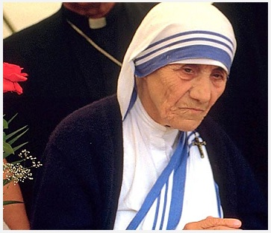
nun

Slide 8
mechanic

Slide 9
journalist

Slide 10
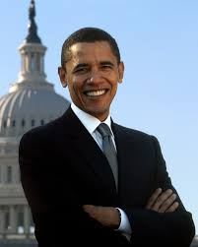
politician

Slide 11
Planning
Brainstorm ideas and write notes
to support your position

Slide 12
Planning
You have two minutes

Slide 13
Select
Select one phrase for each interaction skill
(interrupting, asking for/expressing opinions, agreeing/disagreeing, asking for clarification)
Write them down clearly to remind yourself
e.g. interrupting:
If I could just come in here …

Slide 14
Discuss
You have ten minutes
to save yourself

Slide 15
Feedback
One member from each group moves to another group and reports on the decision taken by his/her original group.
You have two minutes

Slide 16
Discussion dynamics
A
Holding the floor
Taking the floor
Yielding the floor
Holding the floor
Taking the floor
Yielding the floor
Holding the floor
B
A
B
C
B
C

Slide 17
Yielding the floor
This concludes my section of the presentation/discussion, I now yield the floor to the moderator.
I will now pass it over to my colleague, X, who will argue against….
Please, allow me to introduce my colleague, X, who will continue the discussion on Y. Here is, X.

Slide 18
The chairperson
Introduces topic
Clarifies and defines key words
Give background information
Gets the discussion started
Manages and encourages contributions
Changes perspective if necessary
Summarises main points

Slide 19
The chairperson
Today’s discussion will focus on ……… A and B will be supporting the argument and C and D will be arguing against it.
…….. is the topic of today’s discussion. A and B will be speaking in favour and C and D will be opposing the proposal.

Slide 20
Background information
XXX has been a topic of discussion for … years.
This is an important subject because …
At present there are a number of issues concerning this topic such as …
This topic is not unfamiliar since …
Let’s just clarify what is meant by …

Slide 21
Managing the discussion
A, would you like to start with your first point?
I’d like to ask B to open the discussion.
Let’s begin with C and the arguments in favour.
D, how do you feel about …?
----------------
A, would you like to add anything?
Let’s hear what B has to say on this point.
Thanks for your contribution C. Would anyone like to comment on what C has just said?

Slide 22
Summarising the discussion
Reiterate the topic of discussion
Mention two/three arguments for each side
Indicate the conclusions
Thank the speakers for their contributions

Slide 23
Practice Group discussions
Time: 10 minutes
Five members per group
Two members support topic
Two members do not support topic
One member is the chairperson and summariser

Slide 24
Juncture
my train
keep sticking
tray lending
grey tape
/maɪ treɪn/
/kiːp stɪkɪŋ/
/treɪ lendɪŋ/
/ɡreɪ teɪp/

Slide 25
Juncture
my train
keep sticking
tray lending
grey tape
might rain
keeps ticking
trail ending
great ape

Slide 26
Compare
/maɪ+treɪn/
/kiːp+stɪkɪŋ/
/treɪ+lendɪŋ/
/ɡreɪ+teɪp/
/maɪt+reɪn/
/kiːps+tɪkɪŋ/
/treɪl+endɪŋ/
/ɡreɪt+eɪp/

Slide 27
Homework for lesson 5
Revise videos and listenings from Unit One
Pg 17-19
Read pgs 182 and 184 in your book
Watch video Unit 2 and do pages 26-27
Watch podcast uploaded to Moodle and prepare 3 for and 3 against discussion points

