Slide 1
Listening and Speaking
Semester 1 Lesson 3
a.a. 2023/24

Slide 2
Homework for today
Complete pages 18 and 19
Do the exercises on pages 21 and 23
Review pg 25
Online workbook exercises
Research & prepare discussion: Euthanasia and the law

Slide 3
Conversation Exchange Project (CEP)
3. Meet 3 times in total
4. Video with slides and voiceover to introduce student, reflect on knowledge acquired, your impressions
5. Due in December

Slide 4
Fluency
Connected Speech
Liaison (apples and oranges)
Assimilation (good girl)

Slide 5
Stress on words
It’s not my hand you should kiss.
It’s not my hand you should kiss.
It’s not my hand you should kiss.

Slide 6
I gave him Jane’s book.
I gave him Jane’s book.
I gave him Jane’s book.
I gave him Jane’s book.
I gave him Jane’s book.
I gave him Jane’s book.

Slide 7
Topic 1
Cutting down trees for roads, tramlines, buildings, etc

Slide 8
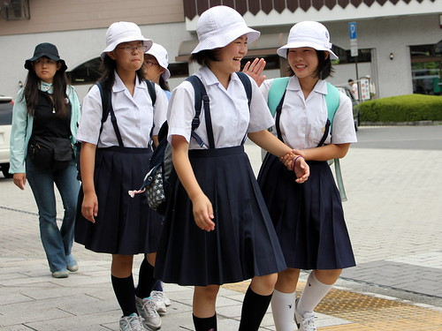
Topic 2 Dress codes at school/work

Slide 9
Topic 3
Ownership of pets in the city limits/ Spaying/neutering dogs and cats
Pets

Slide 10
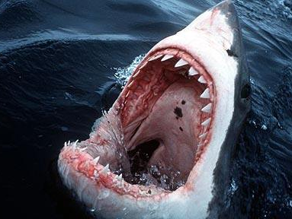
Topic 4
Shark attacks

Slide 11
Topic 5
Cyber bullying and punishment

Slide 12
Topic 6
Top trending show you watch

Slide 13
Speaking Activity
Groups of four
Topics on slides
In turns, choose one topic and then talk UNINTERRUPTED without notes for TWO minutes.

Slide 14
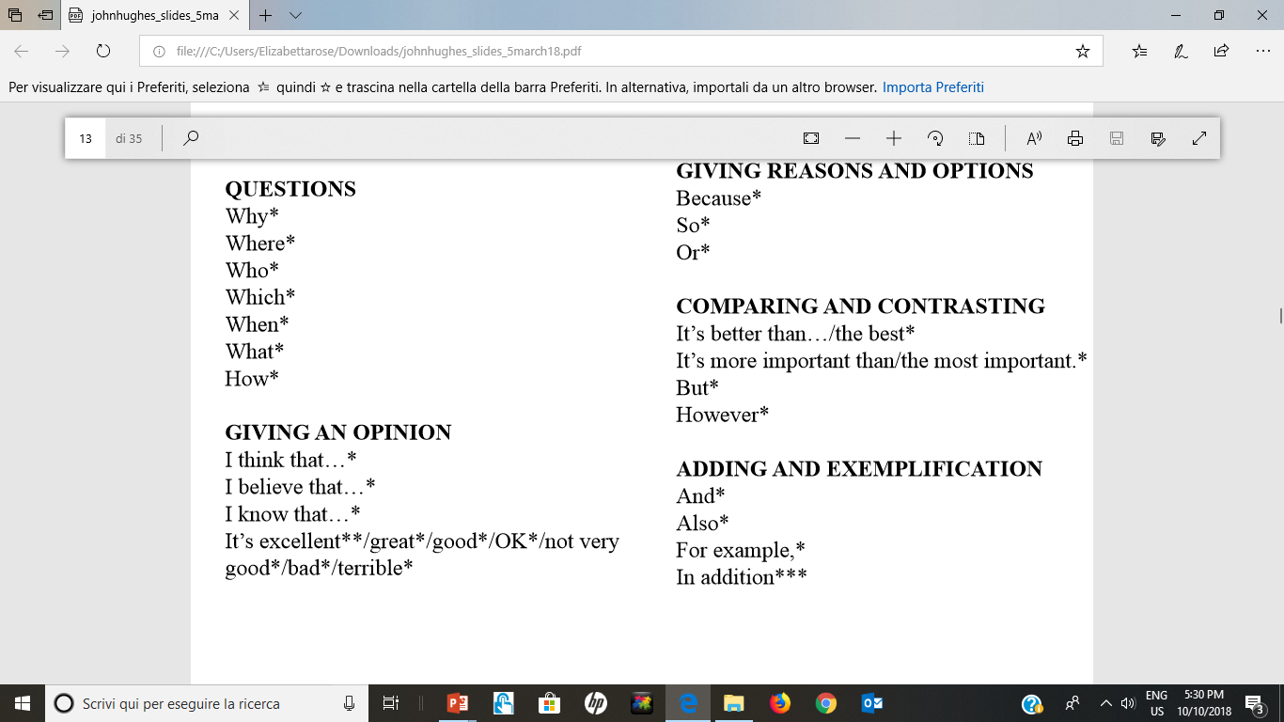

Slide 15
Discussions
Interactional skills
interrupting politely
asking for and expressing opinions
- agreeing and disagreeing
asking for clarification
hesitating and discourse markers

Slide 16
Interrupting politely
If I could just come in here …
Sorry to interrupt but …
I’d just like to say that …
If I could add something here …
Following on from that …

Slide 17
Asking for opinions
What’s your view/opinon of/on …?
What do you think of …?
Where do you stand on the question of …?
What’s your position on …?

Slide 18
Expressing opinions
In my opinion, …
I strongly believe …
I’m convinced that …
In my view, ….
To my mind, …
As far as I can see, …

Slide 19
Agreeing
I couldn’t agree more.
I agree entirely.
That’s a good point.
That’s just what I was thinking.
That’s exactly what I think.

Slide 20
Disagreeing
Yes, that’s true but …
I’m not sure I quite agree …
You have a point there but …
I see what you mean but …
There’s some truth in what you say but …
I agree to a certain extent but …

Slide 21
Asking for clarification
What was that?
What was that you said?
Could you repeat that please?

Slide 22
Asking for clarification
What do you mean by …?
Could you explain in more detail?
Could I ask you a little more about …?
I’m not quite clear what you mean by …
I’m not sure I understand what you mean by …

Slide 23
Hesitating and discourse markers
um … er … well …
How shall I put it …
Let’s see now …
You know …

Slide 24
Discussion Practice
Groups of four
Choose one of the four remaining topics each
Prepare NOTES
In turns, one person speaks and the other members interrupt POLITELY to agree / disagree / ask for clarification
Speaker must use phrases for expressing opinions

Slide 25
Homework for lesson 4
Revise interactional skills’ expressions
Listening: p. 15 p. 16 p. 23
Read and do exercises p 17 and 21
Articles on Moodle: Opinions and clarifications and Collocation
Watch an episode of The Pledge on Youtube (Sky production) https://www.youtube.com/watch?v=ICyMX5mVMPU
Prepare for an in-class discussion (2 for, 2 against, 1 moderator) Topic: Should Euthanasia be legal in Italy?
Get in groups of 5 and research the topic together
Mock discussion will be held in Lesson 5

