Slide 1
Lingua Inglese I a.a. 2022-23
English for Academic Purposes
Listening and Speaking
Semester 1 Lesson 2

Slide 2
L and S Tests
1st semester
Listening comprehension
Group discussion
CEP
2 recordings
2nd semester
TED talk project
Presentation

Slide 3
Join the digital class
Skilfull book
Class name: LS2324
Password: H0EEE489

Slide 4
Course Objectives
Focus on formal English
Expanding vocabulary
Improving fluency
Discussion and argument techniques
Critical thinking
Independent research
Giving a formal discussion

Slide 5
Conversation Exchange Project
What: Cultural and conversational exchange with your American peers
Who: 2 American students and one of you
Where: First meeting: Aula Batilani VSR 9-11 October 9, 2023
Second meeting and third meeting before December
Why: To practice speaking and listening and prepare a video /slide show of your meeting and what you did.
How: CEP preparation on Moodle for next lesson

Slide 6

Homework Lesson One
Unit one Video “ Drones and Security”
Exercises: pgs 8-10
Unit One Listening discussion
Exercises: pgs 11-13
Register and activate your book code and join the class

Slide 7

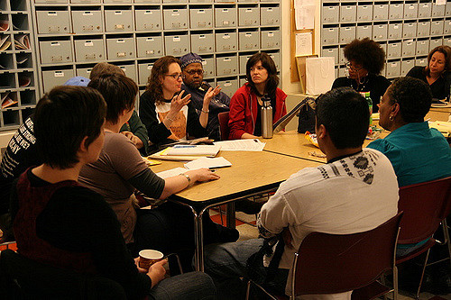
What’s the difference?
talking
formal discussion
Questa foto di Autore sconosciuto è concesso in licenza da CC BY-NC
Questa foto di Autore sconosciuto è concesso in licenza da CC BY-SA-NC

Slide 8
Breaking the Ice
Find someone who …
would like to speak English without a trace of an accent
can give an example of linking
can explain how to create a PowerPoint presentation
speaks without moving their hands
has spoken before an audience
isn’t shy
thinks s/he is a good conversationalist

Slide 9
Now consider:
Lexis
Formality
Difficulties
Were you talking or participating in a discussion?

Slide 10
What does giving a talk require?
Preparation and organisation
Signposting
Specific lexis and formality
Fluency and confidence
Awareness of audience
Awareness of body language

Slide 11
In other words …
What you have to say
and
How you say it

Slide 12

What makes an effective discussion?
Prepare. Observe. Listen.
Group actions
Useful phrases
Individual actions

Slide 13
Discussion topics
Climate change
Education
Social media
Libraries
Community associations

Slide 14

Listening:
Pros and cons of group work pg. 11 1.1

Slide 15
Homework for Lesson 3
Complete pages 18 and 19
Do the exercises on pages 21 and 23
Review pg 25
Online workbook exercises
Research for discussion: Euthanasia and the law
CEP preparation work to be found on Moodle

