Slide 1
The Study and
Production of
Texts
Spring Semester
3rd Class

Slide 2
https://www.theguardian.com/world/2022/mar/08/spain-plans-ban-on-influencers-pushing-unhealthy-foods-to-children
A Warm-up
A 2019 study found that 40.6% of Spanish children aged six to nine were over their recommended weight, of whom 17.3% were classified as obese.

Slide 3
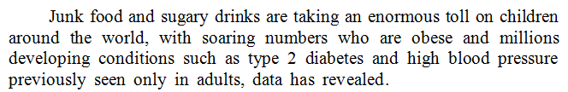
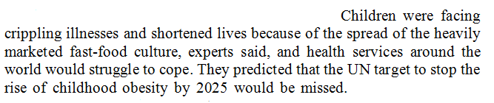
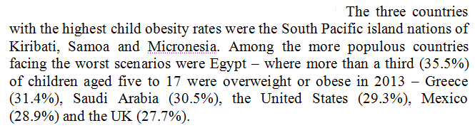
https://www.theguardian.com/society/2016/oct/07/junk-food-shortening-lives-children-obesity-diabetes-data
Introduction
to topic
Introduction
to problem
Data to
support claim

Slide 4
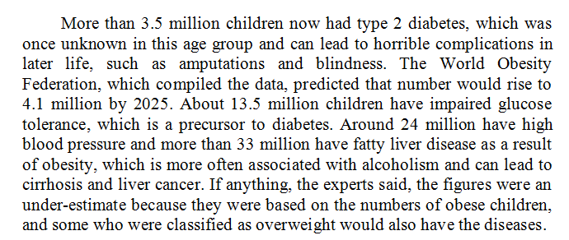
Second paragraph
Further data to
support claim
More than 3.5 milliion children
that number would rise to 4.1 million
by 2025
About 13.5 million children
Around 24 million
more than 33 million
the figures were an underestimate
based on the numbers of
Lexical net

Slide 5
Real Time with Bill Maher https://www.youtube.com/watch?v=mMBzfUj5zsg
William Maher, Jr., (born January 20, 1956) is an American comedian, actor, writer, and producer. He hosted the late-night television talk show Politically Incorrect on Comedy Central and ABC, and is currently the star of Real Time with with Bill Maher on HBO. Maher is known for his political satire and sociopolitical commentary. His commentaries target a wide swath of topics, from the right-wing to the left-wing, bureaucracies of many kinds, political correctness, Hollywood, the mass media, and persons in positions of high political and social power, among many others. He supports the legalization of cannabis and gay marriage.
“Maher often eschews political labels, referring to himself as ‘practical,’ although he has generally held moderately liberal views over the years. Maher stands against political correctness. In his words, The difference is that liberals protect people, and P.C. people protect feelings.’“
Watch the first 2.5 minutes of the clip and see how uses a chart to back up (support) his point on sexual identity. How do the visuals help what he is trying to point out? Does he actually have a point, or is this just comedy?

Slide 6
Data Commentary Week 1 Text Alcohol: some feedback
19/43 students (44% of the group) completed the homework
Generally good start
Language problems
Punctuation problems
Paragraphing
Location statements
Level of language varies
Thank you for your work!

Slide 7
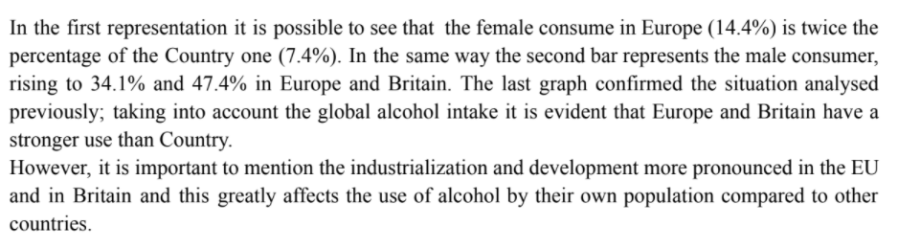
Paragraphing sample student writing
1
Punctuation

Slide 8
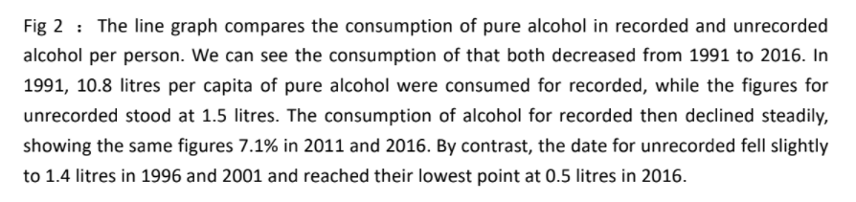
Location statement – Move 1 sample student writing
2
Text cohesion & transition

Slide 9
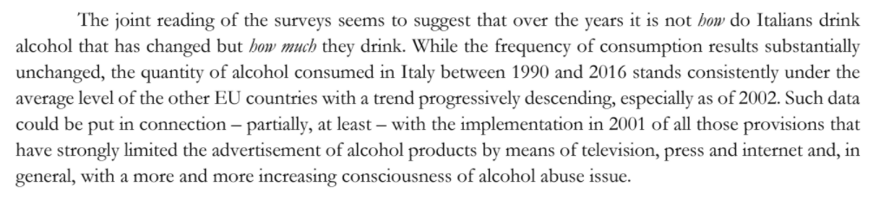
Comment – Move 3 sample student writing
3

Slide 10

HOMEWORK #2
Review the material from last class. Take notes & regularly update your Data Commentary section.
Study The Language of Data Commentary pp. 4-7 (course booklet)
Write a text brief based on the data on page 9. (course booklet/dispensa
Read the articles on pp. 10-11 and consider how data supports text.

Slide 11
What are students called?
Undergraduate = the first four years of university/college, bachelor’s degree (UK, USA)
Postgraduate = master and doctoral students (UK)
Graduate = master and doctoral students (USA)
Undergraduate (and high school) students in the USA:
freshman = first-year student
sophomore = second-year student
junior = third-year student
senior = fourth-year student

Slide 12

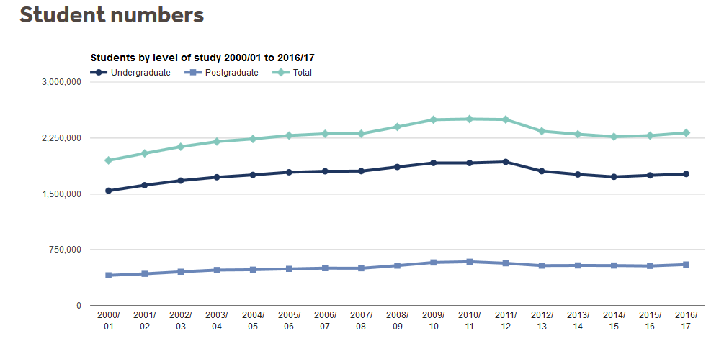

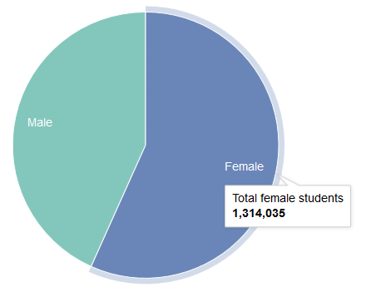
The time period
The peak
The stability
of the number
of postgraduates
p.9

Slide 13
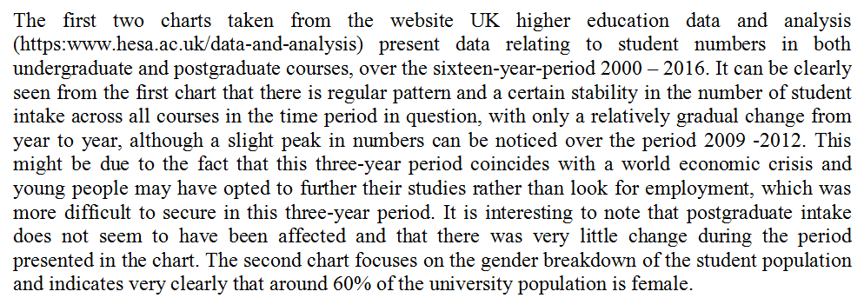
Thank you for your work!
Possible answer
Text cohesion
Use of the passive voice
Location statements & moves

Slide 14
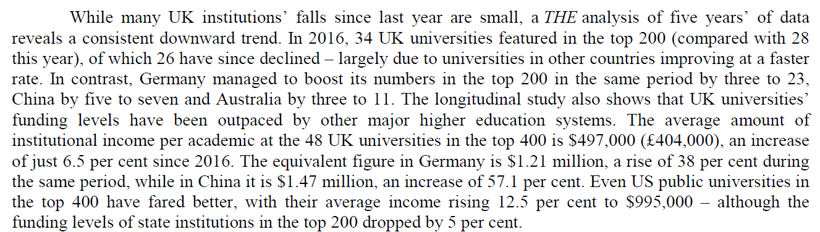
Paragraph 2
Lexical net of countries
p10

Slide 15
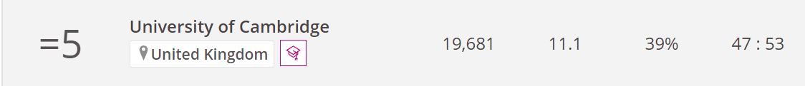
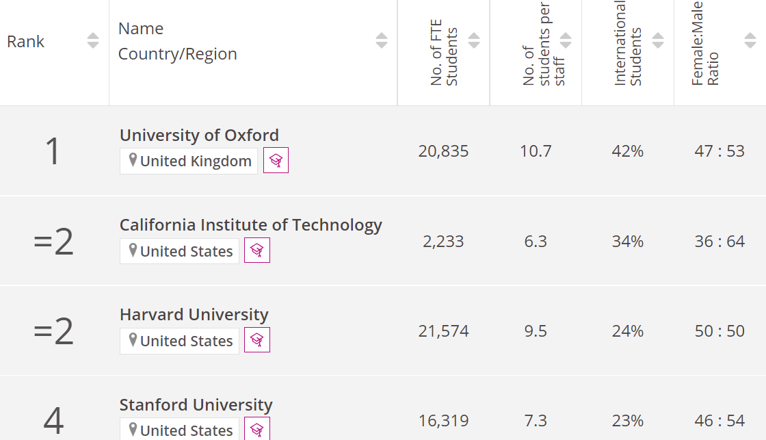
What are they basing the rankings on? https://www.timeshighereducation.com/world-university-rankings/2022/world-ranking

Slide 16
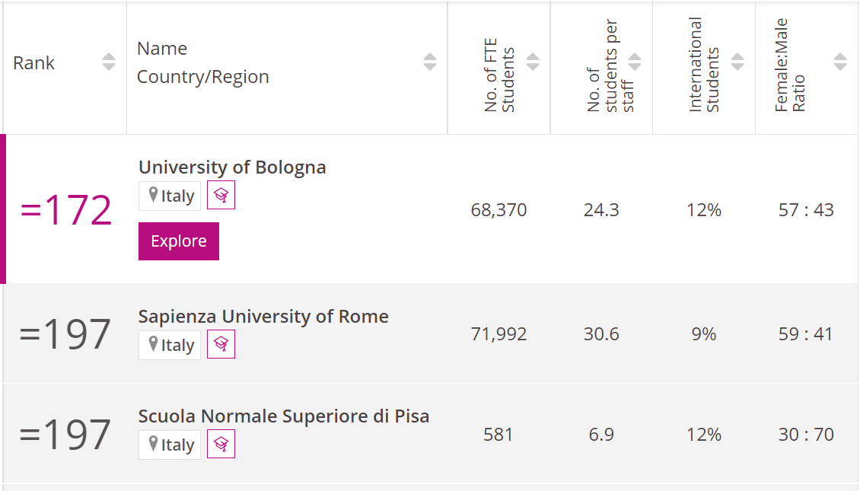
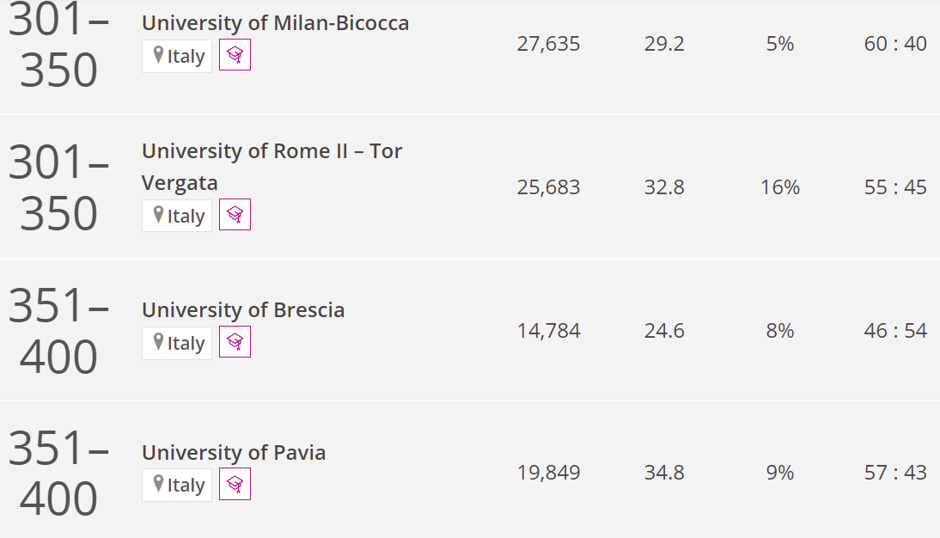
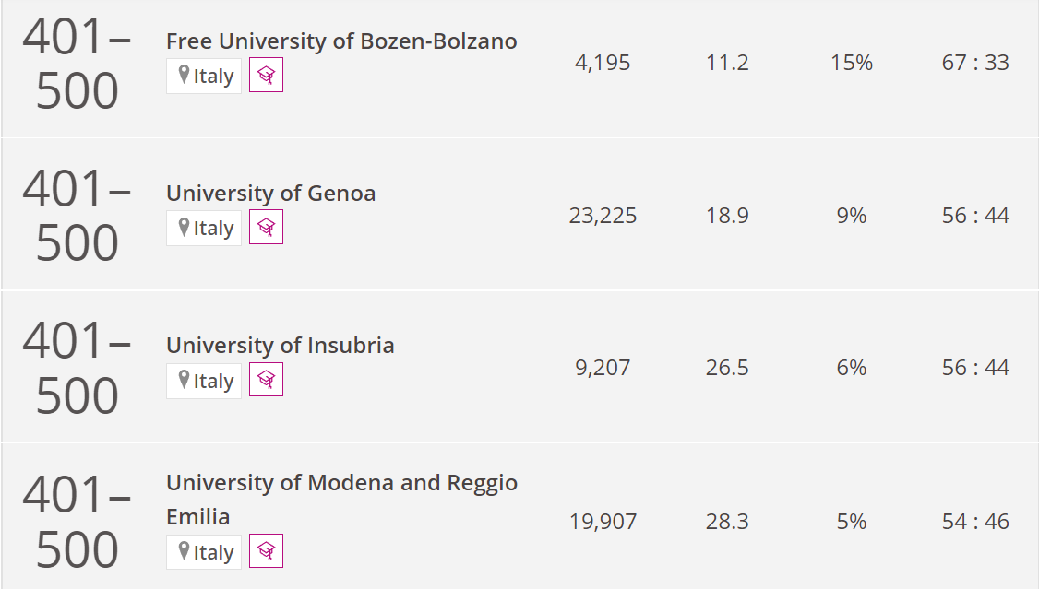
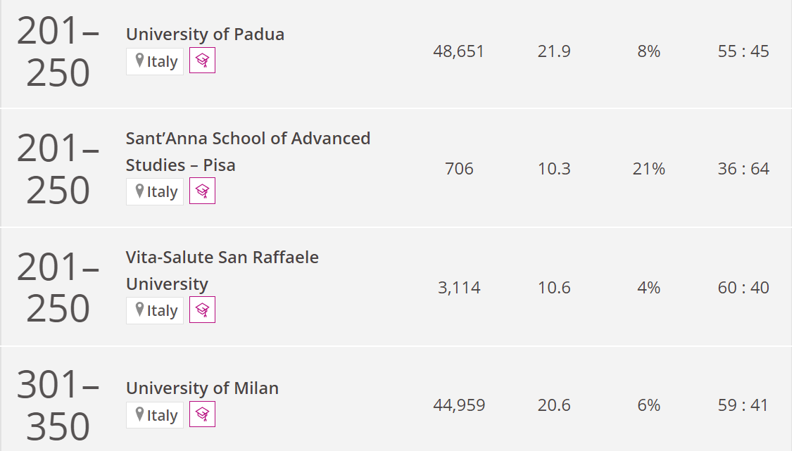
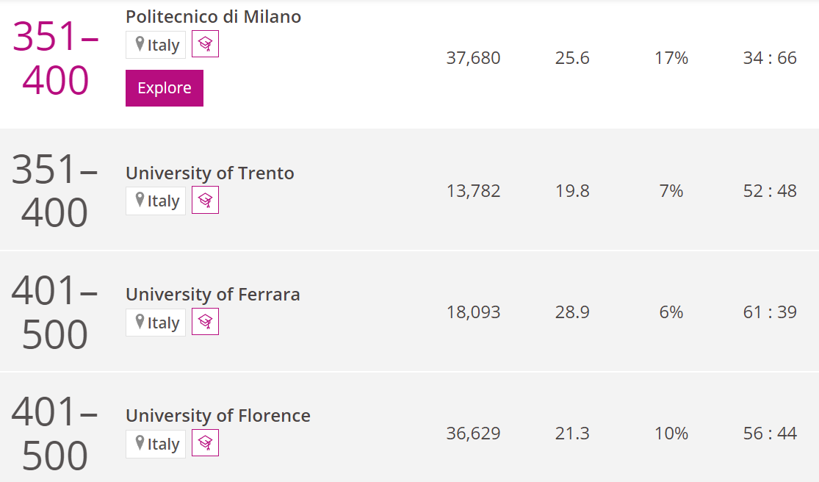

Slide 17



Slide 18




In-class task:
With a partner, comment on the
following data, presented on the
following slides (course booklet:
pp. 11-12.
Make a list of points to include.
Start writing a text.
FYI
This kind of bicycle, a tandem or twin, is usually called a “bicycle built for two.” Listen to the 1892 British song sung in 1962 by Nat King Cole.
https://www.youtube.com/watch?v=78MKBHR3NbU

Slide 19
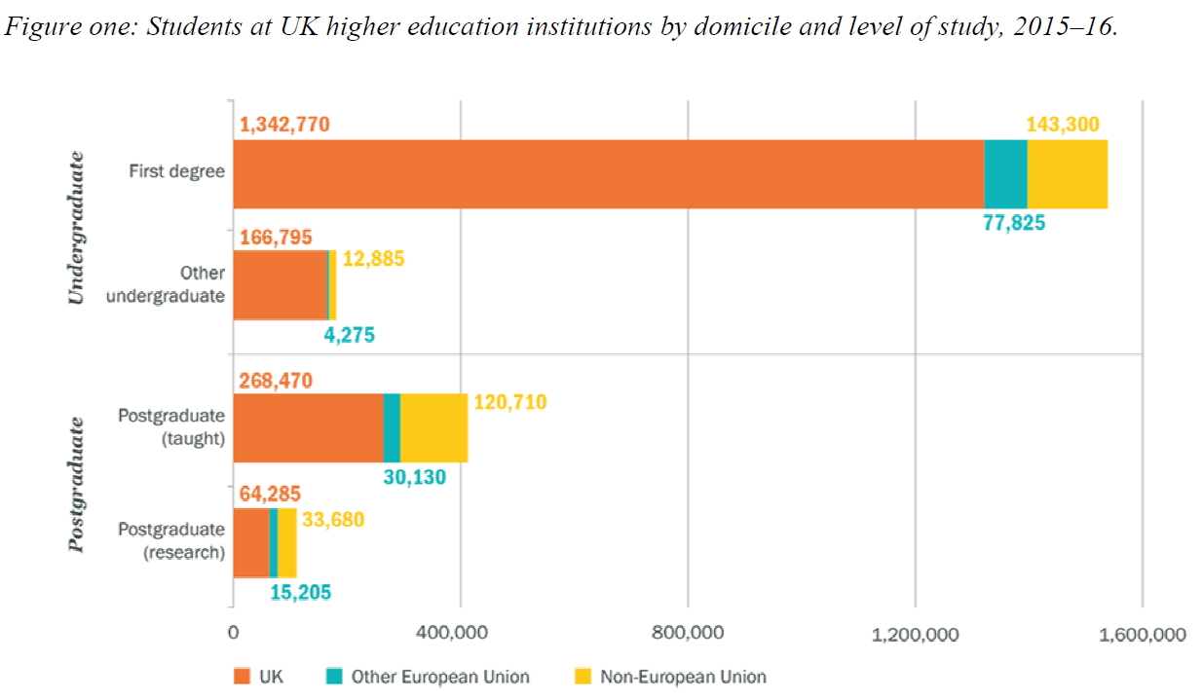
1.
p11

Slide 20
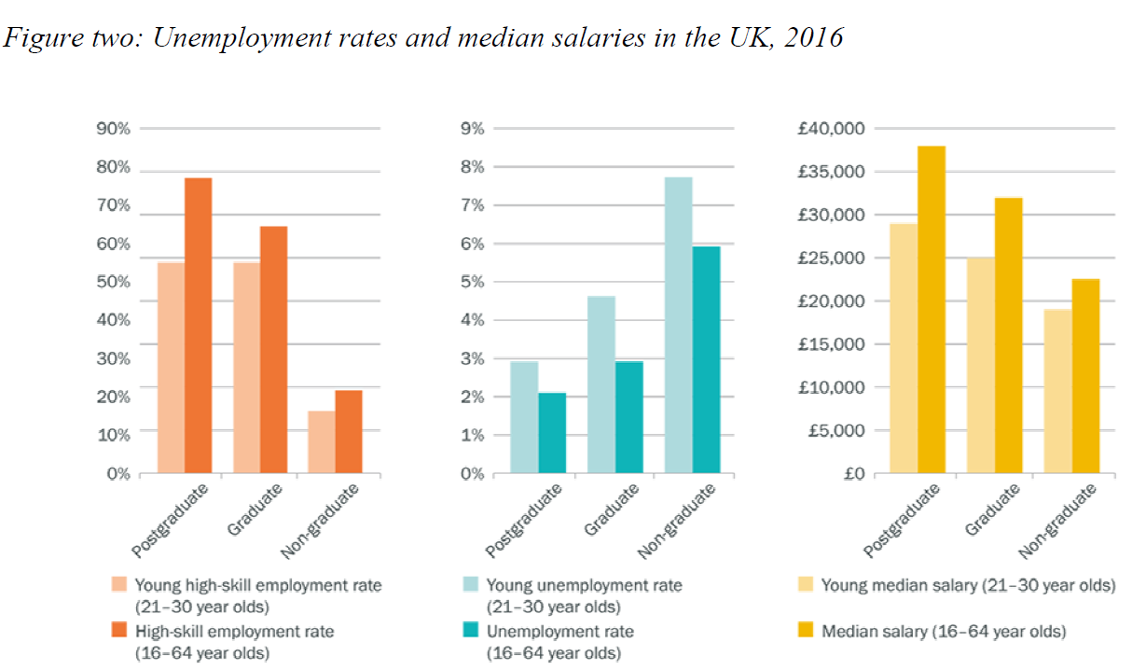
2.
employment
unemployment
p12

Slide 21
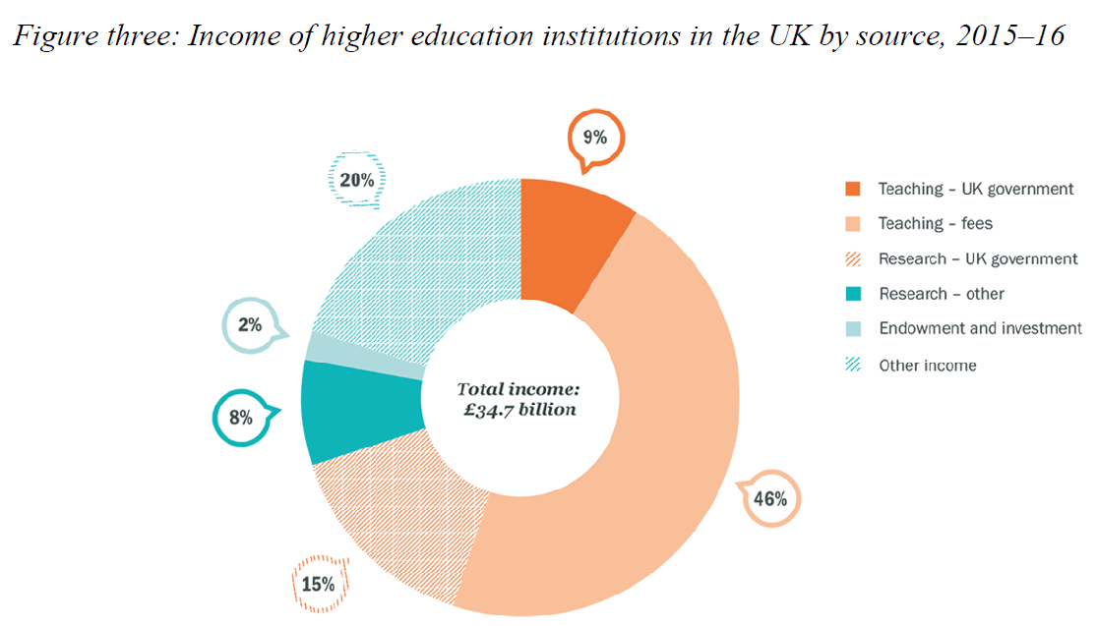
3.
p12

Slide 22

The three main moves in Data Commentary:
p. 4
Location Element and Summary Statement
Highlighting Statements
Comments

Slide 23
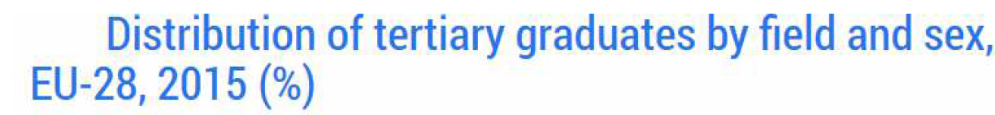
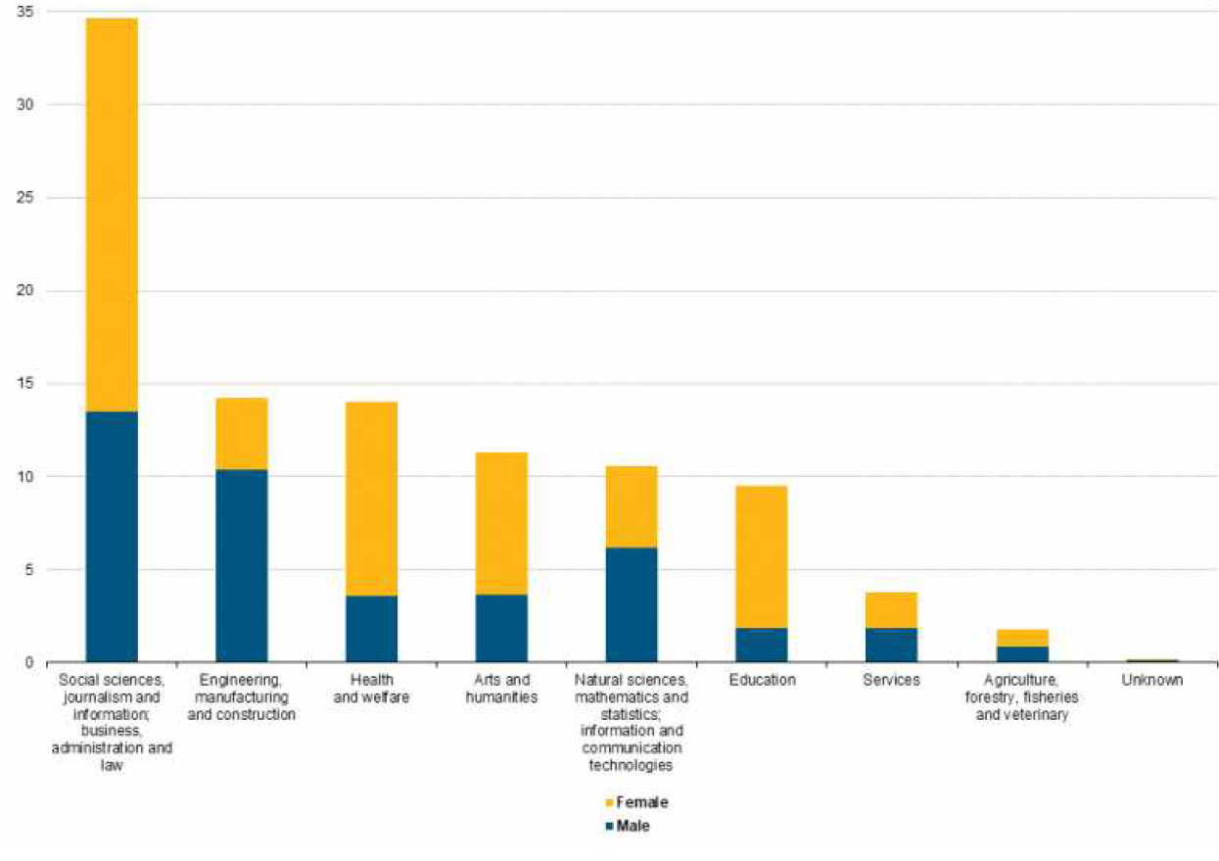

http://ec.europa.eu/eurostat/statistics-explained/index.php/Tertiary_education_statistics
p13
One final example

Slide 24
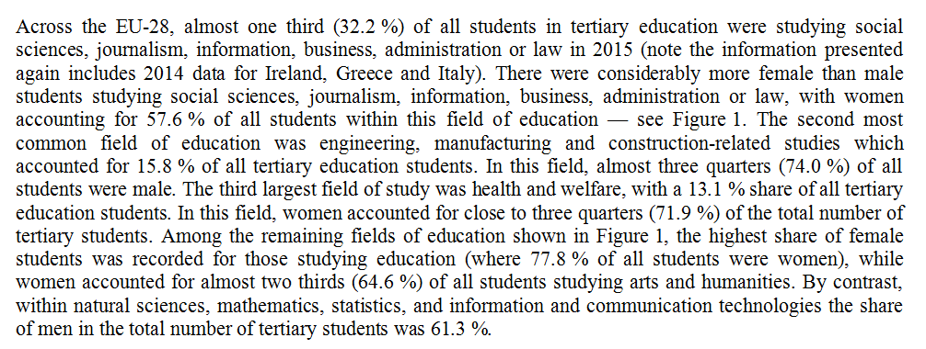
http://ec.europa.eu/eurostat/statistics-explained/index.php/Tertiary_education_statistics
p13

Slide 25
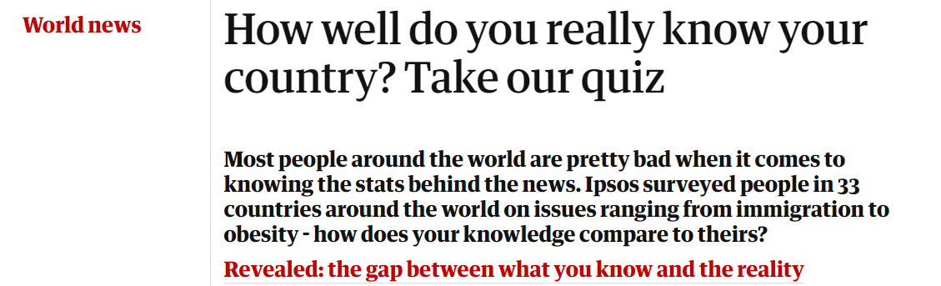
Global Issues
https://www.theguardian.com/society/datablog/2015/dec/02/revealed-gap-between-your-knowledge-reality

Slide 26
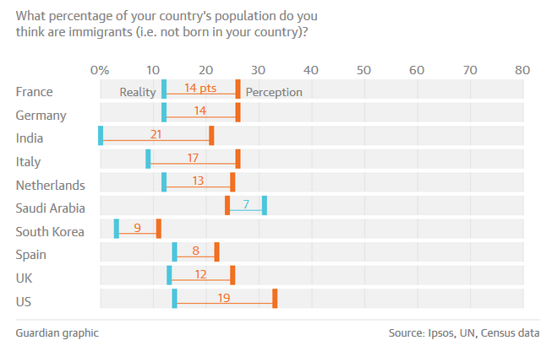
p.15

Slide 27
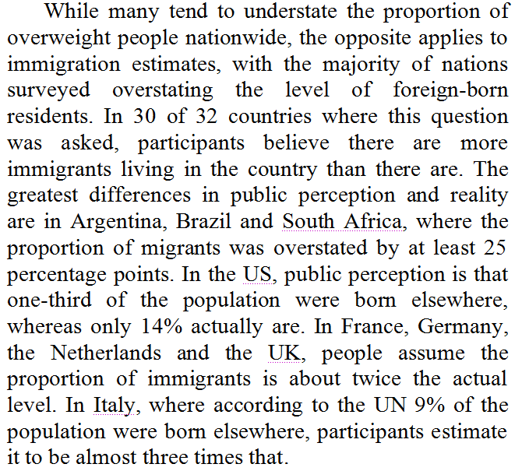
The structure
of paragraph
3
1
2
3
4
5
6

Slide 28
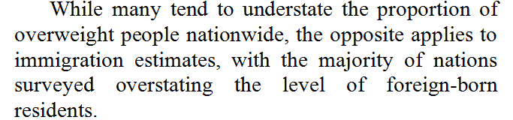
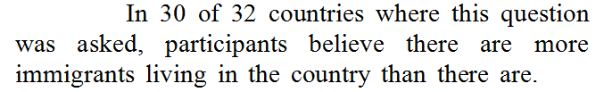
part 1 = transition
1
part 2 =new topic
+ data commentary
2
link , extension & consolidation

Slide 29
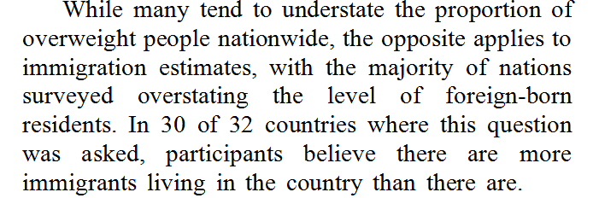

people nationwide
immigration
nations
foreign-born residents
immigrants
living in the country

Slide 30
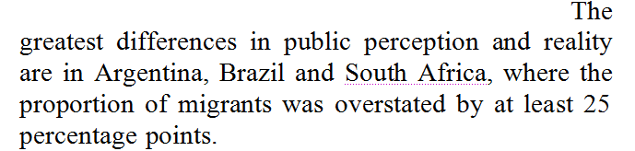
3
understate
overstating
public perception
of migrants

Slide 31
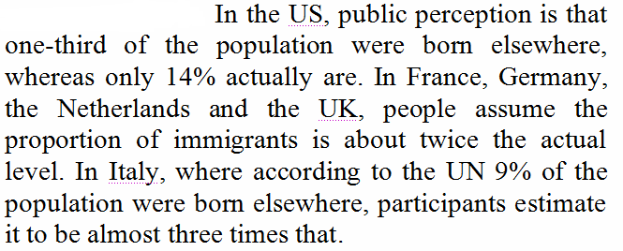
Exemplification:
4
5
6
Repetition of same pattern:
(i) nominate country
(ii) highlight statement
(iii) continue lexical net

Slide 32

Work with a partner.
Choose a paragraph from the text on p.16
(in the dispensa/course booklet on-line)
and analyze its structure.

Slide 33

HOMEWORK

Slide 34

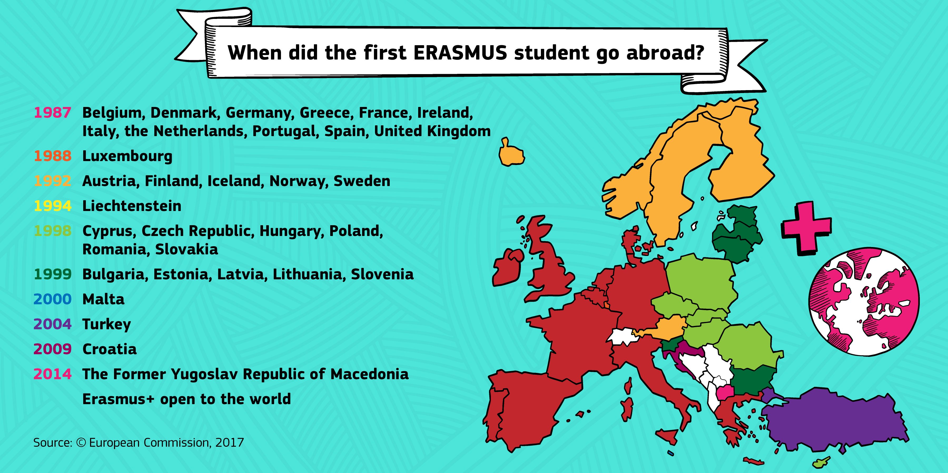
25% of participants
find their
long-term partner.
There are over
1,000,000
Erasmus babies!

Slide 35

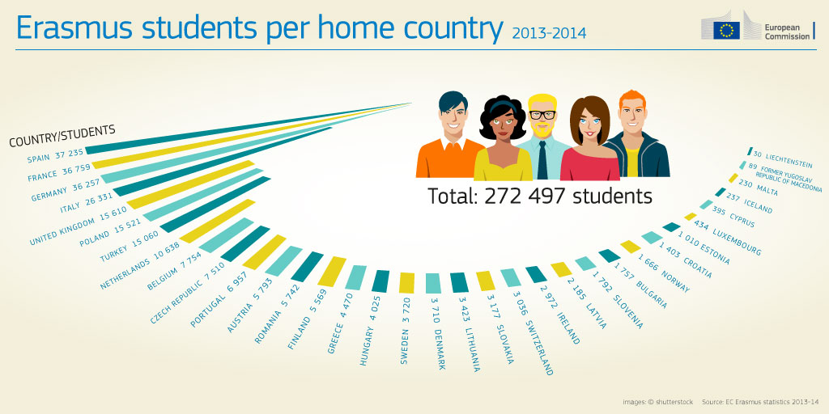

Slide 36
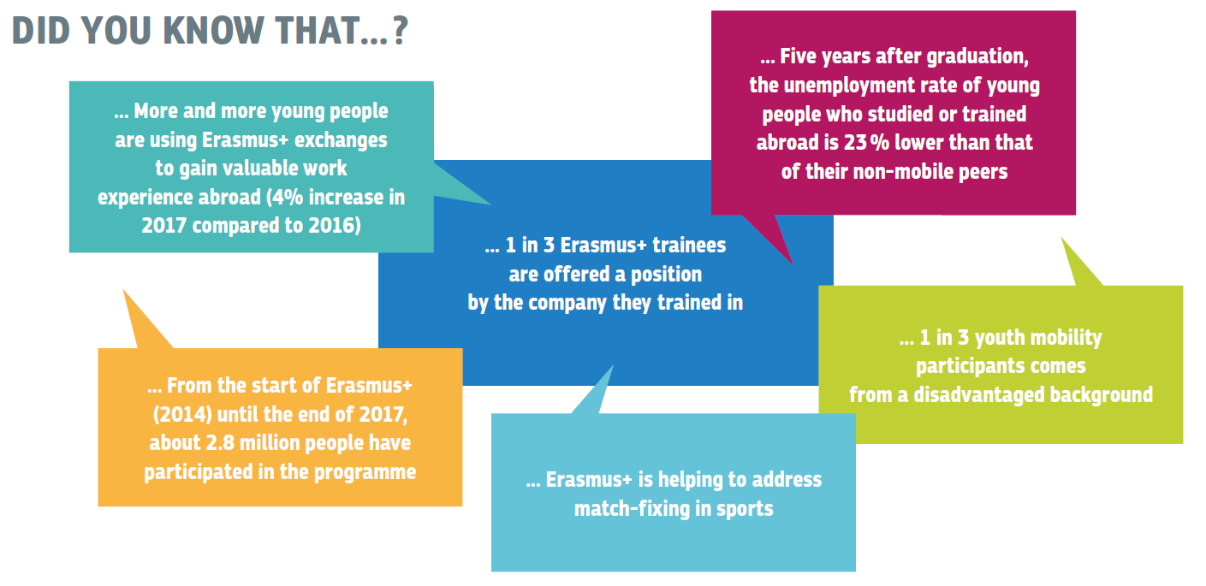

Slide 37
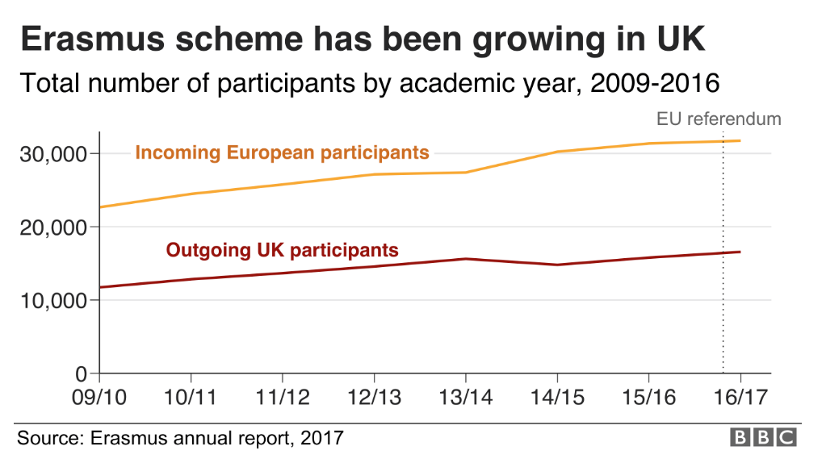

Slide 38
Data Commentary HW #3
Go to : https://ec.europa.eu/programmes/erasmus-plus/about/statistics_en
Choose two sets of data.
Make a list of points you wish to consider.
Write a brief text (100 words) on your chosen data.
Label your document: Last name,Texts, HW #3
Upload your document to a shared folder on Google Drive before our 4th class.

Slide 39
HOMEWORK #3
Read article p.14 of the class booklet on black academics in UK universities
Read article pp. 15-16 on opinions vs. reality. Choose a paragrah to analyze. Take notes. Be prepared to discuss this in class.
Visit: https://www.theguardian.com/society/2015/apr/19/britain-uncovered-survey-attitudes-beliefs-britons-2015 Take notes and be prepared to discuss this in class.
Watch this video (again, already seen on Thursday). https://www.youtube.com/watch?v=le77XQNnPyI

Slide 40

skedaddle = to depart quickly or hurriedly

