Slide 1
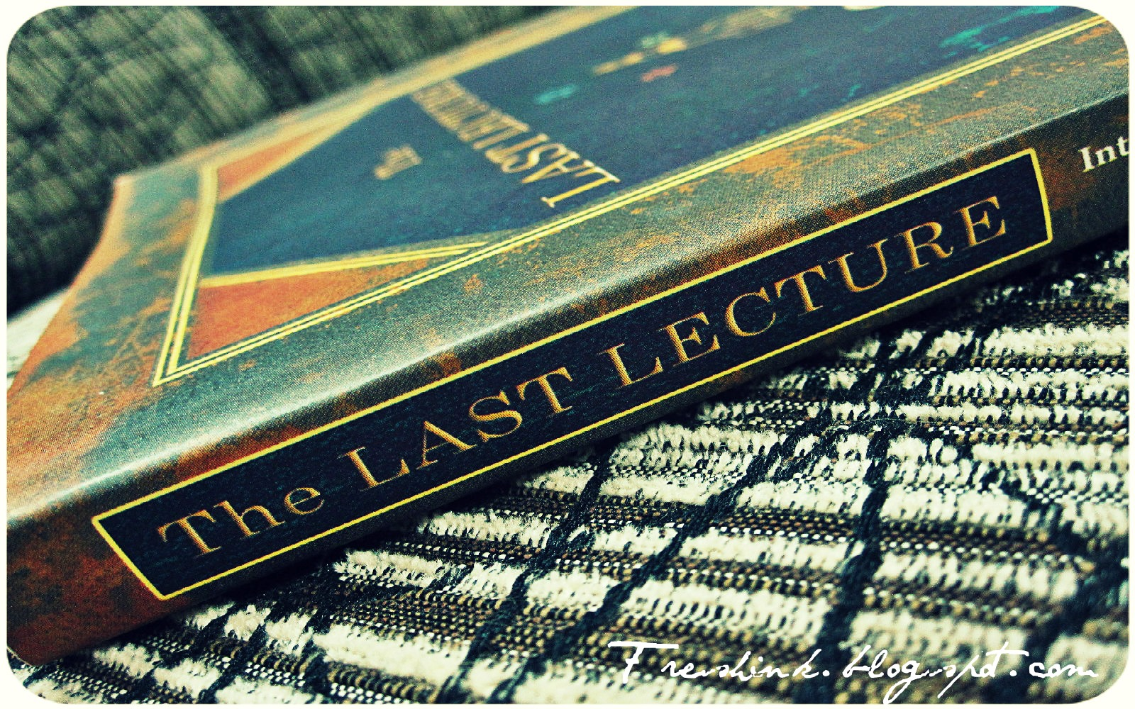
The Study and
Production of
Texts
Lesson 9

Slide 2
What skills do good writers demonstrate?
Authoring
Having something to say
(a sense of purpose)
Being aware of the reader
(a sense of audience)
Developing the ideas
(a sense of direction)
Crafting
Organizing the content clearly and in a logical manner
Using the conventions, e.g. spelling, layout
Getting the grammar right
Developing sentence structure
Linking ideas in a variety of ways
Having a range of vocabulary

Slide 3
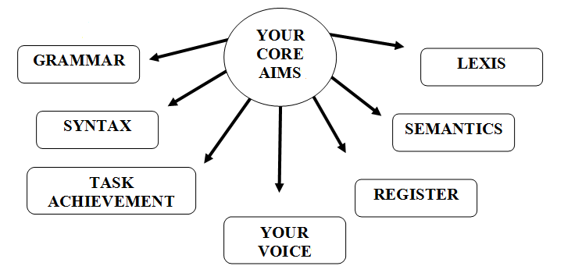

Slide 4
This
semester…
Purpose
Audience
Register
Paragraph structure
Cohesion
Lexis
Grammar
In order to be in a strong position to analyse a text successfully for Test 1, we have looked at the following elements:
lexical cohesion
grammatical cohesion
topic sentences
The final text feature
we need to address is
development and support.

Slide 6
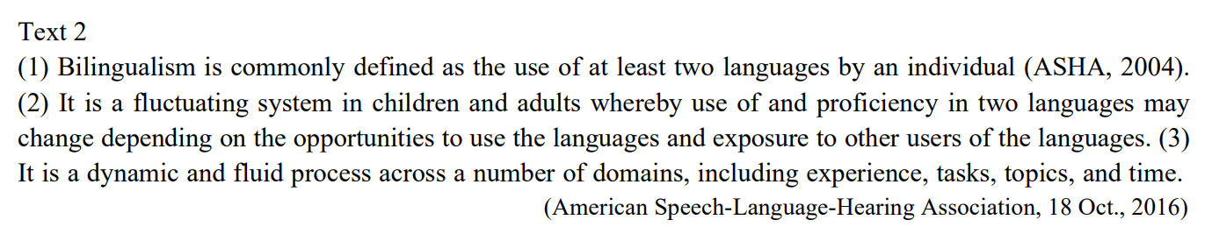
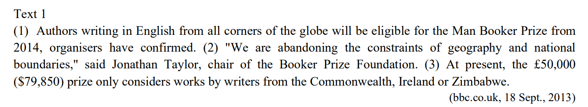

Slide 7
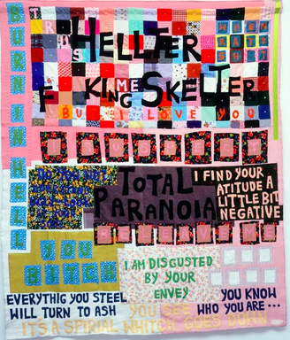
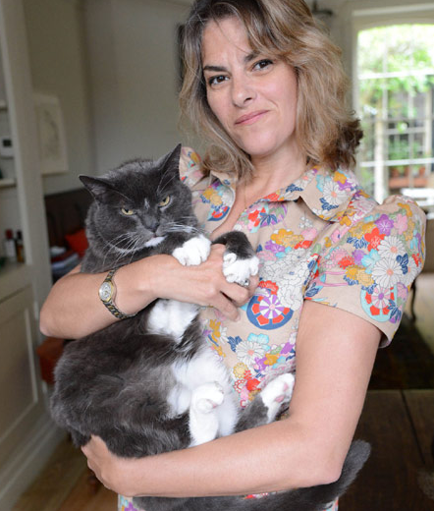
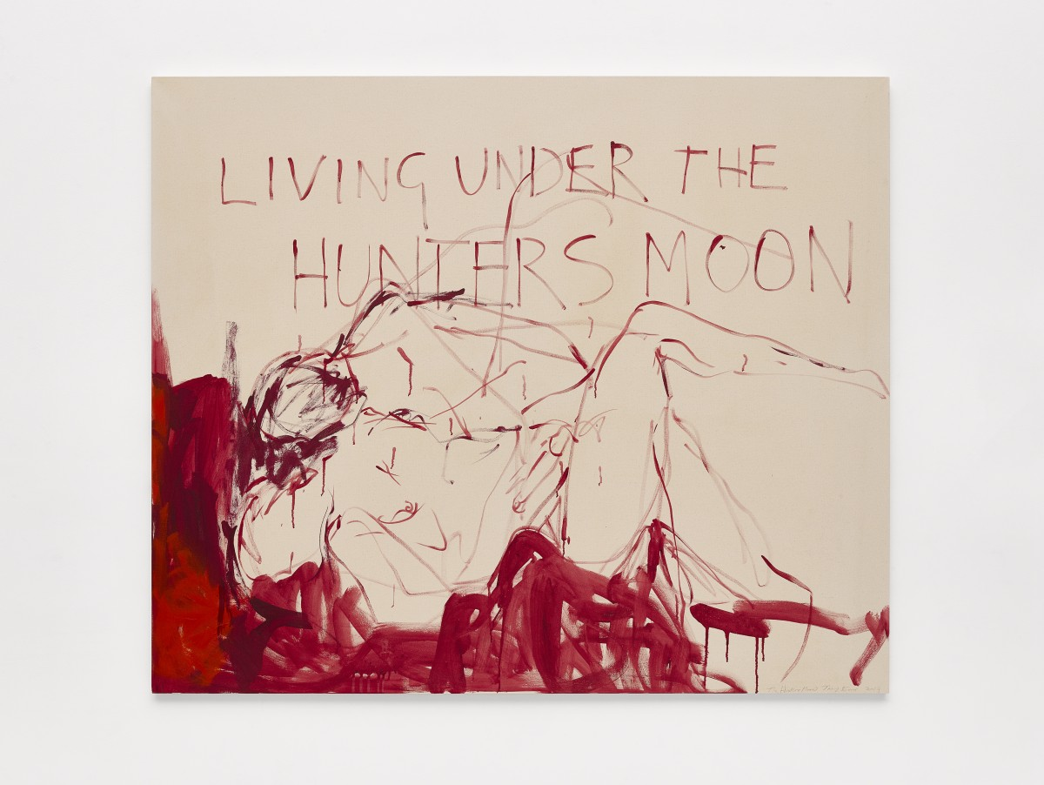
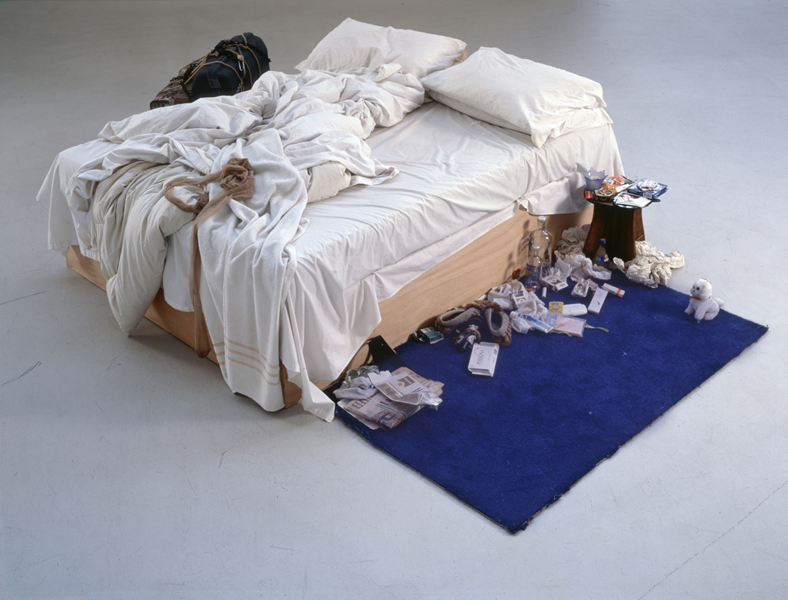
Tracey Emin

Slide 8
A Life in the Day of Tracey Emin Ria Higgins, The Sunday Times. June 8, 2008
The 44-year-old artist lives on her own with her cat, Docket, in east London. Now a Royal Academician, she has curated a room in this year’s summer show at the Royal Academy of Arts, which opens tomorrow.
I wake up at about 6:30 in the morning, and the first thing I do is turn on the BBC World Service. Docket, who’s my little soul mate, often sleeps with me. He’s grey and white with pink paws and big yellow eyes, and with him at my heel I’ll then head downstairs to make some tea. I live in an 18th-century weaver’s house with five floors; my bedroom’s at the top and my kitchen’s at the bottom. Docket will open his little cupboard and nudge at his food, while I reach for my china teapot. Mum gave it to me. It’s got a pink rose on it and has a matching cup and saucer and milk jug. I put it all on a wicker tray and head back upstairs to my satin sheets.
This, to me, is a perfect start to the day. On my own, catching up on my thoughts, my ideas — me time. If I don’t have that, I end up in a bad mood. About 9, I’ll make some porridge and two slices of toast with strawberry jam, and then get ready. My bathroom and dressing room are on the floor below, and it’s either a shirt and jeans or a shirt and skirt. If the outfit doesn’t work, I go to pieces — it’s potentially the first massive problem of the day. Jewellery is something I always wear — I have done so since I was a kid. It’s not a bling thing, it’s tradition — I’m half Turkish Cypriot. This gold chain, for instance, was a present from my twin brother, Paul, and I keep my nan’s wedding rings on it.

Slide 9
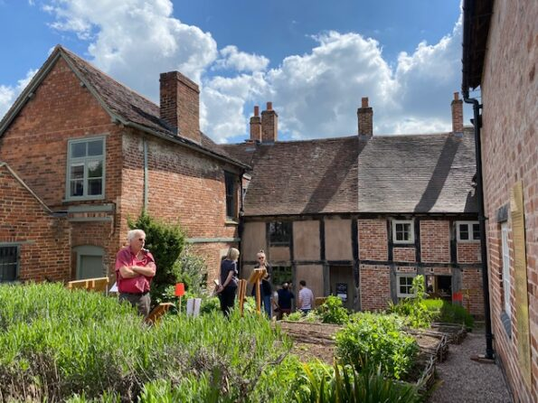
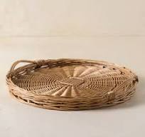
Weavers’ House; Wicker Tray
to weave; weaver = tessere, intrecciare; tessitore
wicker = vimini

Slide 10
First step: analyze
Possible TEST question:
Consider the use of lexis
in paragraphs 1 and 2.
A Life in the Day of Tracey Emin Ria Higgins, The Sunday Times, June 8, 2008
The 44-year-old artist lives on her own with her cat, Docket, in east London. Now a Royal Academician, she has curated a room in this year’s summer show at the Royal Academy of Arts, which opens tomorrow.
I wake up at about 6.30, and the first thing I do is turn on the BBC World Service. Docket, who’s my little soul mate, often sleeps with me. He’s grey and white with pink paws and big yellow eyes, and with him at my heel I’ll then head downstairs to make some tea. I live in an 18th-century weaver’s house with five floors; my bedroom’s at the top and my kitchen’s at the bottom. Docket will open his little cupboard and nudge at his food, while I reach for my china teapot. Mum gave it to me. It’s got a pink rose on it and has a matching cup and saucer and milk jug. I put it all on a wicker tray and head back upstairs to my satin sheets.

Slide 11
A Life in the Day of Tracey Emin Ria Higgins, The Sunday Times, June 8, 2008
The 44-year-old artist lives on her own with her cat, Docket, in east London. Now a Royal Academician, she has curated a room in this year’s summer show at the Royal Academy of Arts, which opens tomorrow.
I wake up at about 6: 30 in the morning, and the first thing I do is turn on the BBC World Service. Docket, who’s my little soul mate, often sleeps with me. He’s grey and white with pink paws and big yellow eyes, and with him at my heel I’ll then head downstairs to make some tea. I live in an 18th-century weaver’s house with five floors; my bedroom’s at the top and my kitchen’s at the bottom. Docket will open his little cupboard and nudge at his food, while I reach for my china teapot. Mum gave it to me. It’s got a pink rose on it and has a matching cup and saucer and milk jug. I put it all on a wicker tray and head back upstairs to my satin sheets.

Slide 12
Model answer :
Consider the use of lexis in the first paragraph.
The most striking characteristic of this text is the way the very tightly connected lexical items operate as semantic blocks, in order to transmit the message of the text. There are four recognizable examples of this. The first relates to the main topic of the text, Tracy Emin, who is presented in the first paragraph as an ‘artist’ and ‘a Royal Academician’ and referred to as ‘she’ and ‘her’ and then, on taking up the role of narrator, is presented in the chain of reference words, ‘I’, ‘my’, ‘me’, which runs like a thread throughout the whole text. The second group of lexical items refers to ‘Docket’, Emin’s cat, the colourful description of whom (‘he’s grey and white with pink paws and big yellow eyes’) helps reinforce his role as Emin’s ‘little soul mate’, and who is personalised by the anaphoric reference words ‘him’ and ‘his’. The third important chain of lexical items, which forms a solid net in the centre of the text, is made up of items referring to Emin’s ‘weaver’s house with five floors’ ‘in east London’, introduced in the first sentence. The sense of space is created by the words ‘five floors’, ‘downstairs’, ‘upstairs’, ‘at the top’, ‘at the bottom’, which all operate over two adjacent sentences. The concept of a house transforms into that of a home, thanks to the last lexical group which describes the items related to the making of Emin’s tea: ‘china teapot’, ‘pink rose on it’, ‘matching cup and saucer’ and ‘milk jug’. The effect is one of intimacy. The inclusion of the words’ wicker tray’ and ‘satin sheets’ reinforces this effect.
(word count 271)

Slide 13
Homework from week 8
Review & Reflect on today’s lesson
Revisit the Lenny Kravitz grammar explanation (last week’s slides).
Study Inversion p. 37.
Do the exercises p. 38.
Complete the task on p. 39 on Topic Sentences.
Reflect on the final three tasks today.

Slide 14
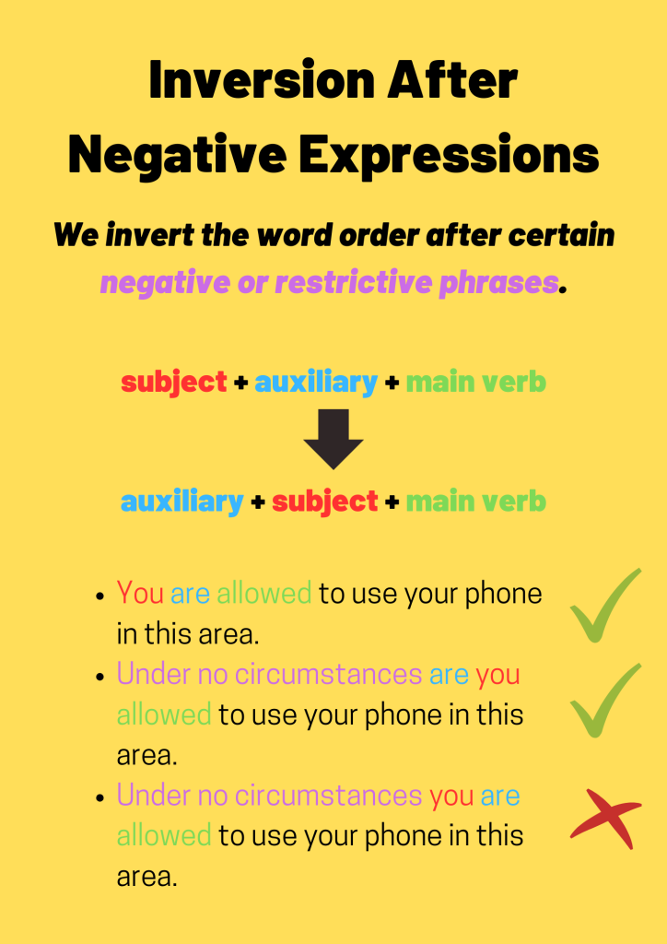
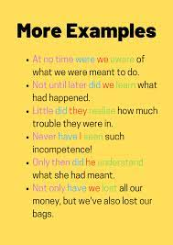
Inverting Syntax (word order)

Slide 15
p. 38 Exercise 1
1. Not until it was too late did I remember to ring my mother.
2. Hardly had we found our seats than the film began.
3. No sooner had it stopped raining than the bus arrived.
4 Only after checking in the dictionary did I know how to spell ‘participate’
5. Only when the letter arrives, shall we know if our offer has been accepted.
6. Only two students remembered to do the homework.
7. Only if you promise not to tell anyone else shall I tell you what happened last night.

Slide 16
p. 38 Exercise 2
Not only does my friend speak English, but she also speaks French.
Little did I suspect that my best friend was going out with my boyfriend.
Seldom is it so warm in February.
4. Never have I seen such a fine performance of Hamlet.
5. Rarely had the teacher come across a student with such a good level of English.
6. No sooner had I got used to my Bancomat number when I lost the card.
7. Neither in the rain nor in the snow will Jane go out.
8. “Under no circumstances will you have a party in the house while we are away!” said her parents as they left for the weekend.

Slide 17
Final Test 1
Thursday, Dec. 7th, 3-5 PM, Capponi, 1
Wednesday, Dec. 20th, 3- 5 PM, Verdiana, 15 (last class is Dec. 13th)
75 minutes
Academic text of c. 400 words
Three Questions:
Text Structure
Lexis
Your writing
Grade out of 30 (18 is passing).
Failing students can retake the test later in June.

Slide 18
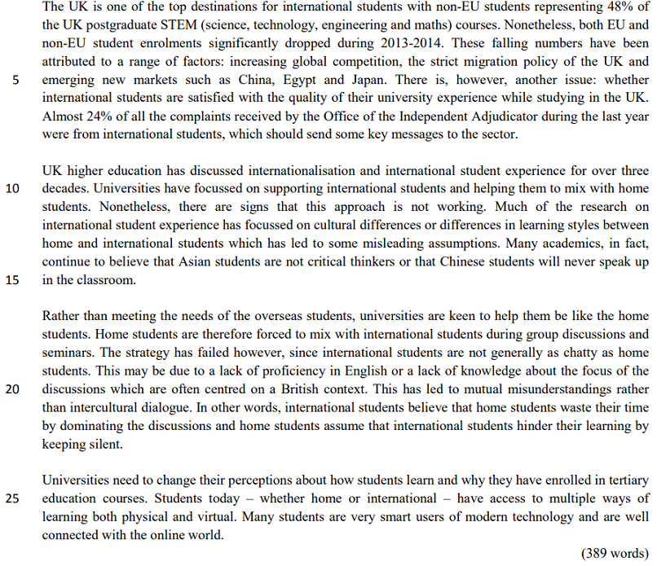
Purpose
Audience
Register
Paragraph structure
Cohesion
Lexis
Grammar

Slide 19


Three Example Questions

Slide 20







Slide 21
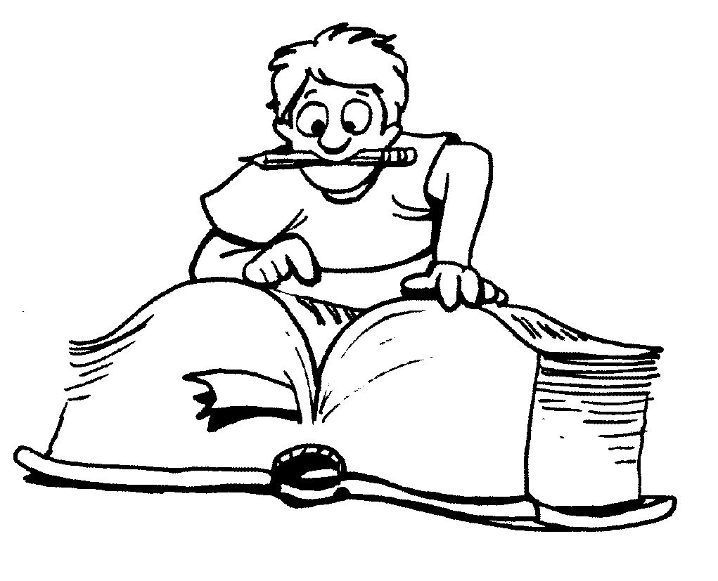
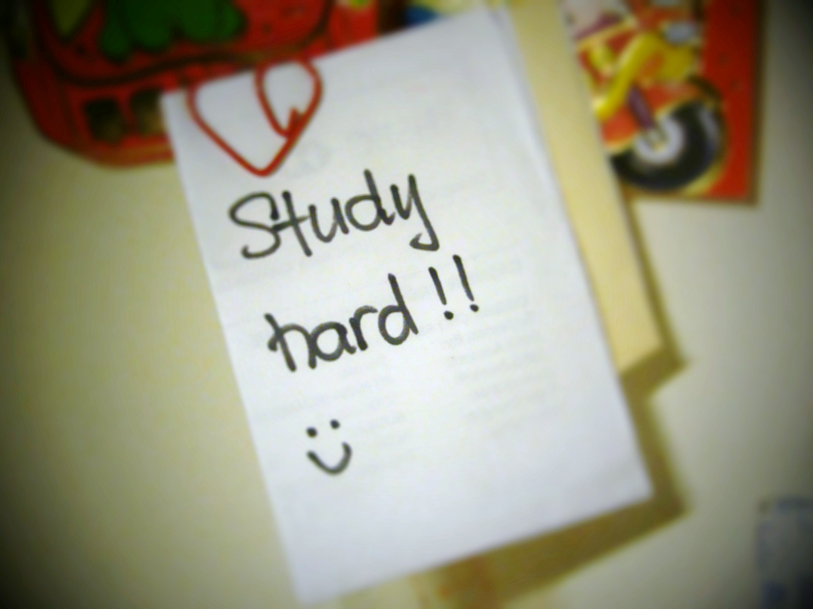

See you on Thursday, Dec 7th (3 PM) or
Wednesday, Dec 20th (11 AM)
for the final!

