Slide 1
The Study and
Production of
Texts
Fall Semester
7th Class

Slide 2





Slide 3
Homework for today
Start working on the section on lexis pages 17-24.
Reflect on how lexical nets can raise the level of your writing.
Did you?

Slide 4
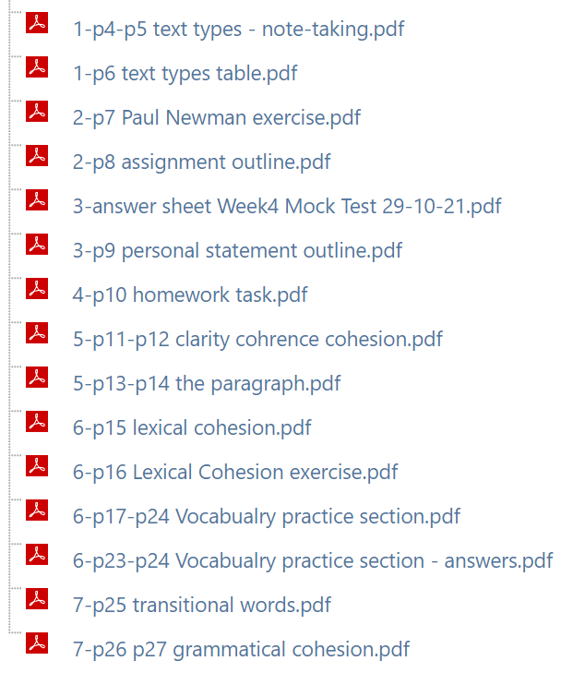

Slide 5





Slide 6

TRANSITIONS
Today’s class

Slide 7
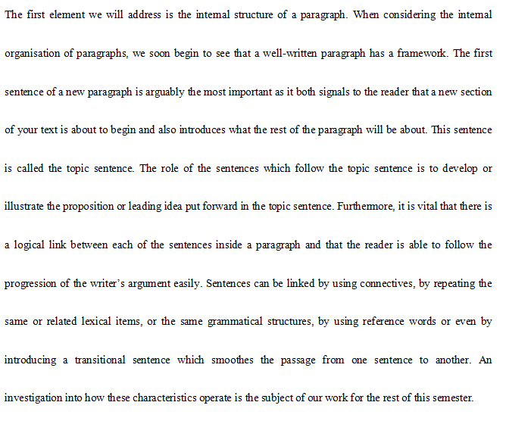
p11

Slide 8
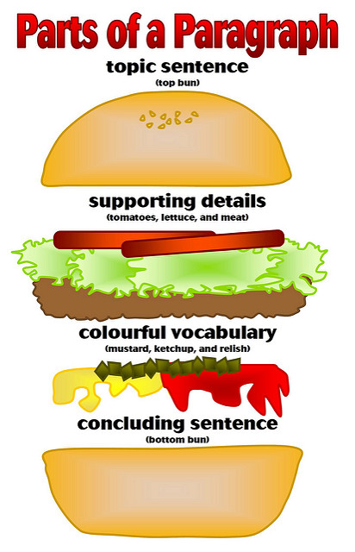

Slide 9
TRANSITIONS
Words
Sentences
Paragraphs
Sections

Slide 10

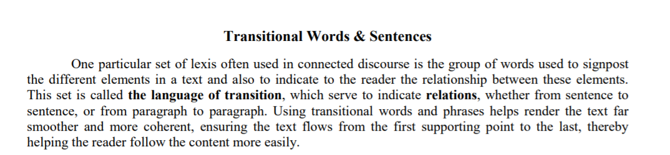
p25

Slide 11
(1) One particular set of lexis often used in connected discourse is the group of words used to signpost the different elements in a text and also to indicate to the reader the relationship between these elements.
(2) This set is called the language of transition, which serves to indicate relations, whether from sentence to sentence, or from paragraph to paragraph.
(3) Using transitional words and phrases helps render the text far smoother and more coherent, ensuring the text flows from the first supporting point to the last, thereby helping the reader follow the content more easily.

Slide 12
(1) One particular set of lexis often used in connected discourse is the group of words used to signpost the different elements in a text and also to indicate to the reader the relationship between these elements.
(2) This set is called the language of transition, which serves to indicate relations, whether from sentence to sentence, or from paragraph to paragraph.
(3) Using transitional words and phrases helps render the text far smoother and more coherent, ensuring the text flows from the first supporting point to the last, thereby helping the reader follow the content more easily.
1

Slide 13
(1) One particular set of lexis often used in connected discourse is the group of words used to signpost the different elements in a text and also to indicate to the reader the relationship between these elements.
(2) This set is called the language of transition, which serves to indicate relations, whether from sentence to sentence, or from paragraph to paragraph.
(3) Using transitional words and phrases helps render the text far smoother and more coherent, ensuring the text flows from the first supporting point to the last, thereby helping the reader follow the content more easily.
2

Slide 14
(1) One particular set of lexis often used in connected discourse is the group of words used to signpost the different elements in a text and also to indicate to the reader the relationship between these elements.
(2) This set is called the language of transition, which serves to indicate relations, whether from sentence to sentence, or from paragraph to paragraph.
(3) Using transitional words and phrases helps render the text far smoother and more coherent, ensuring the text flows from the first supporting point to the last, thereby helping the reader follow the content more easily.
3

Slide 15
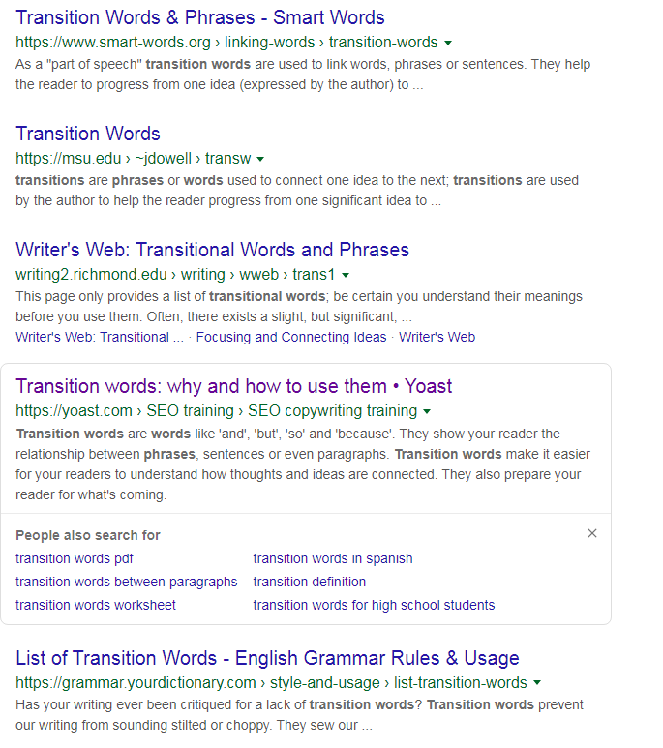
Google them!

Slide 16
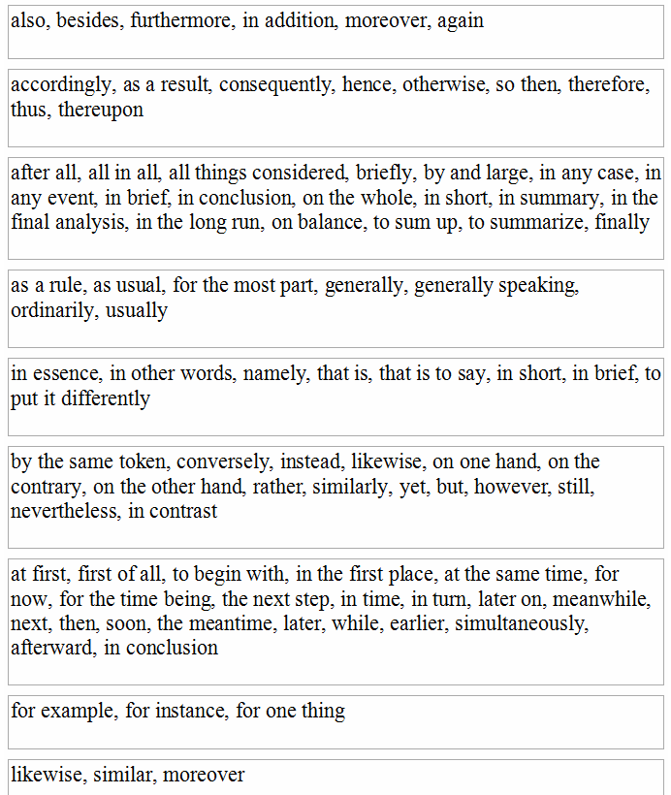
p25
Semantic Function
Generalizing
Sequence
Illustration
Similarity
Addition
Direction
Consequence
Complication
Location
Summarizing
Restatement
Contrast/Comparison

Slide 17
Addition
Consequence
Summarizing
Generalizing
Restatement
Contrast/ Comparison
Sequence
Illustration
Similarity
Not used: Complication Direction Location

Slide 18
Back to p11 again

Slide 19
Sentence 1 = what?
One particular set of lexis often used in connected discourse is the group of words used to signpost the different elements in a text and also to indicate to the reader the relationship between these elements.
This set is called the language of transition, which serve to indicate relations, whether from sentence to sentence, or from paragraph to paragraph.
Using transitional words and phrases (1) helps render the text far smoother and more coherent, (2) ensuring the text flows from the first supporting point to the last, thereby (3) helping the reader follow the content more easily.
Sentence 2 = nomination + how?
Sentence 3 = why?

Slide 20

TRANSITIONS
THIS
NOT THIS

Slide 21

Cohesion is the term for the quality of a text such that it appears as a single unit, not as a random sequence of thoughts or sentences. Students may have trouble understanding a text that seems to have easy words and concepts because they fail to identify the cohesive ties, or even because the student has not yet learned how to tie English sentences together clearly and naturally with the appropriate cohesive devices.

Slide 22

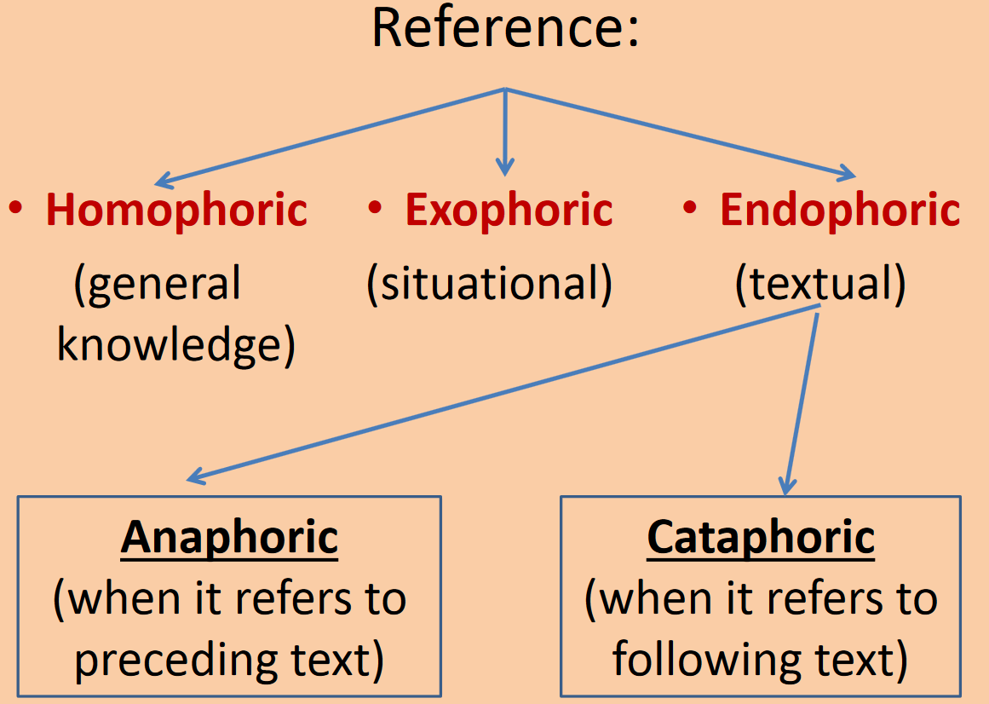
GRAMMATICAL
COHESION
LEXICAL
COHESION

Slide 23
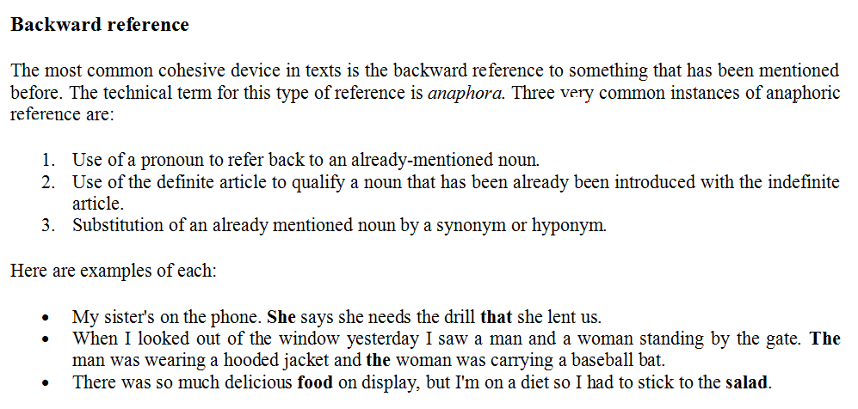
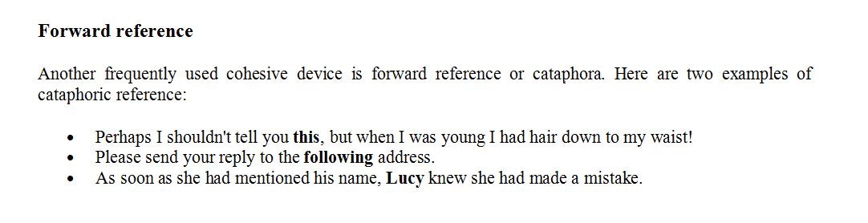
p26

Slide 24
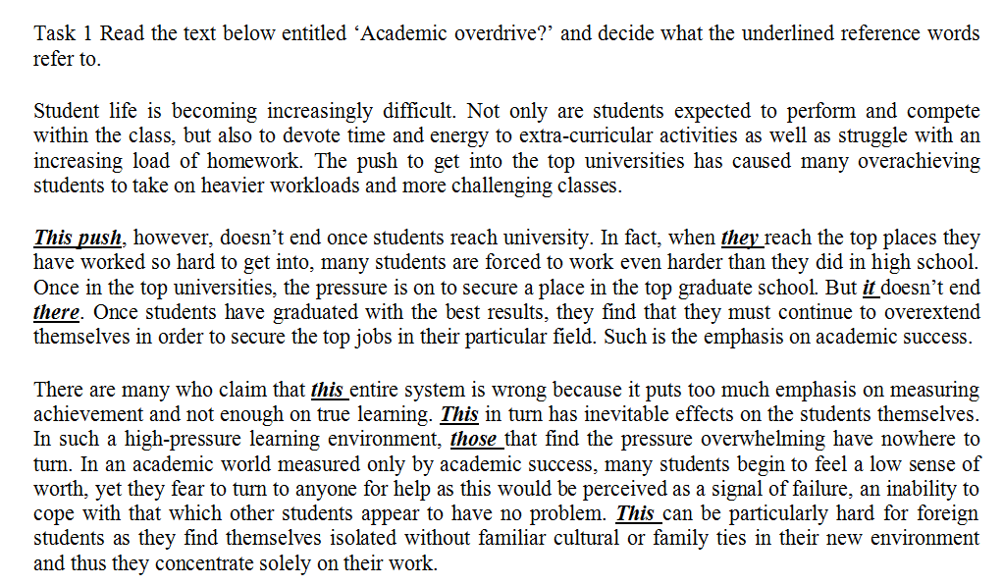
p27

Slide 25
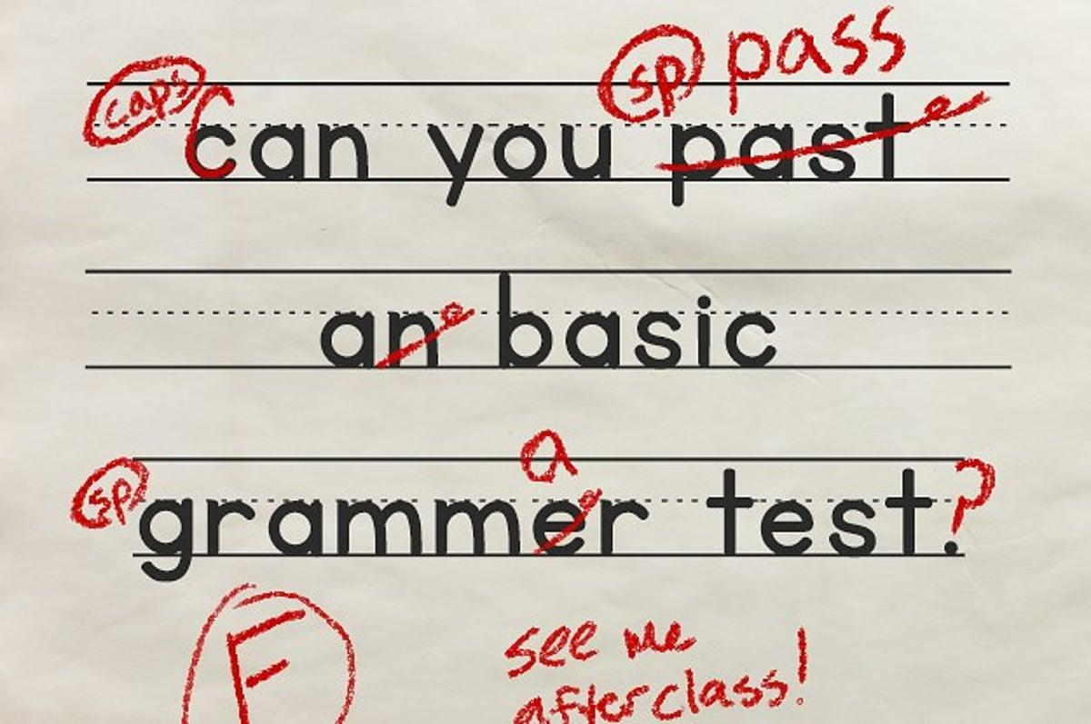

Slide 26

p28 – p32 (Answers p33 - 34)

Slide 27
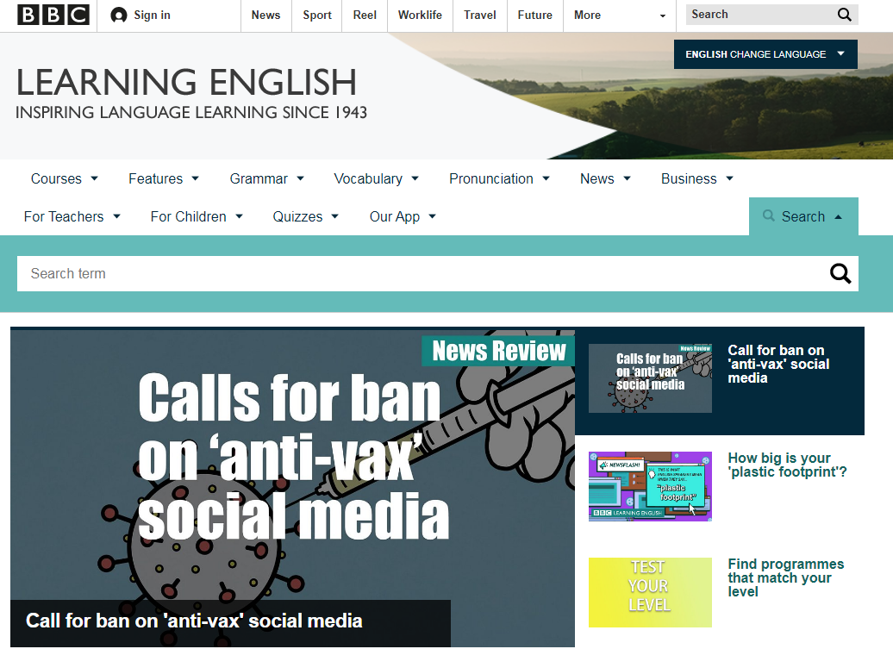


Do
some
research!!

Slide 28
Lingua inglese 1 =
Lettorato course: The Study and Production of Texts
Lettorato course: Sounds of English
Grammar Test (Jan./June/Sept.)
Exam with Prof. Brownlees
or Prof. Samson

Slide 29
Guidelines for Grammar Test
You have 35 minutes to do the test.
The test is in three parts.
Part 1 is a conversation w/ multiple choice.
Part 2 transformation exercises using word substitution.
Part 3 vocabulary with multiple choice.

Slide 30
Grading Breakdown
part 1 = /12
part 2 = /24
part 3 = /14
total out of 50
x 2 = final % grade (mark)
Over 60% - students already required level and encouraged to try at first Test session

Slide 31
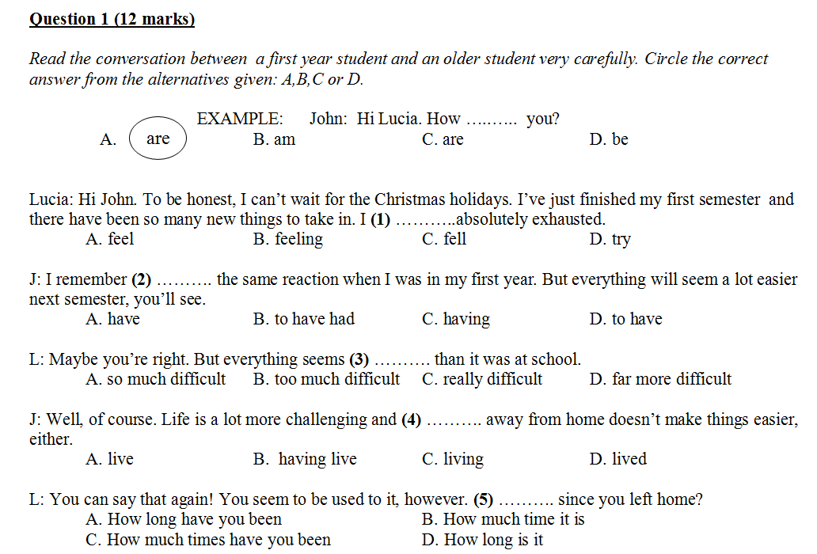

Slide 32
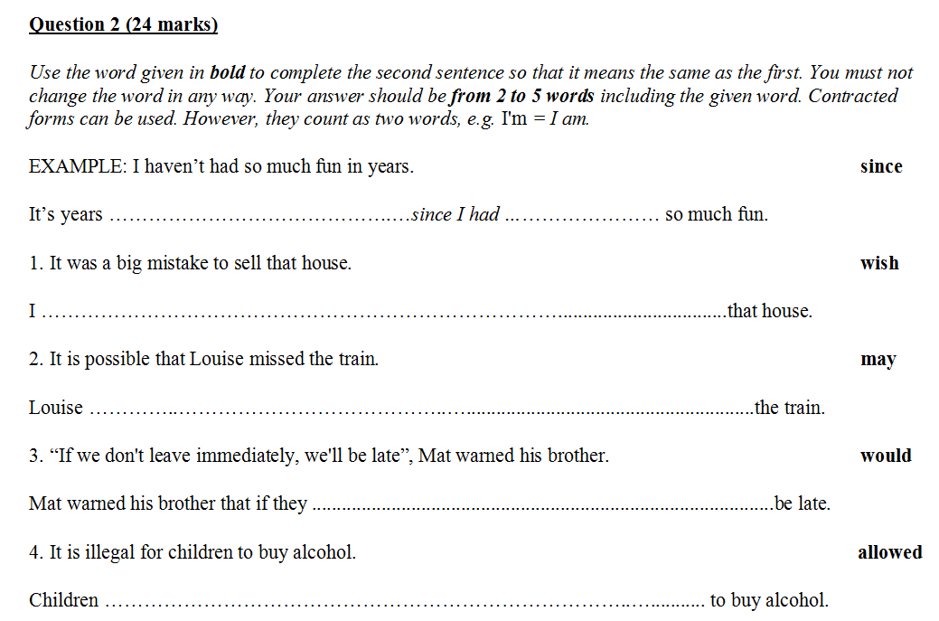

Slide 33
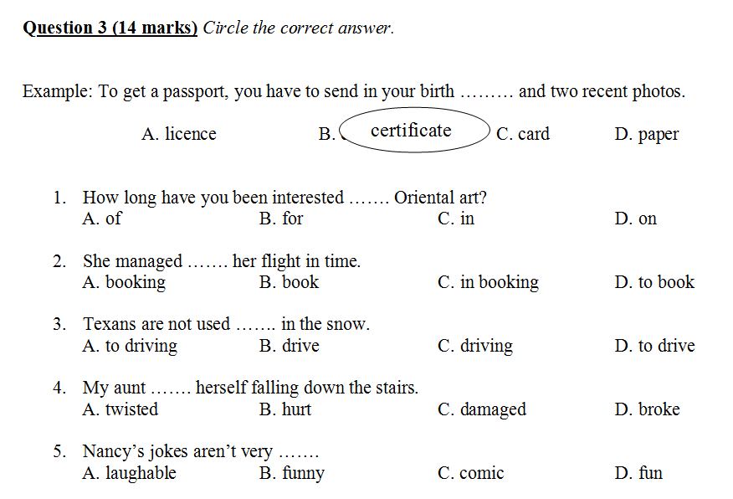

Slide 34

The Three Minute Test

Slide 35
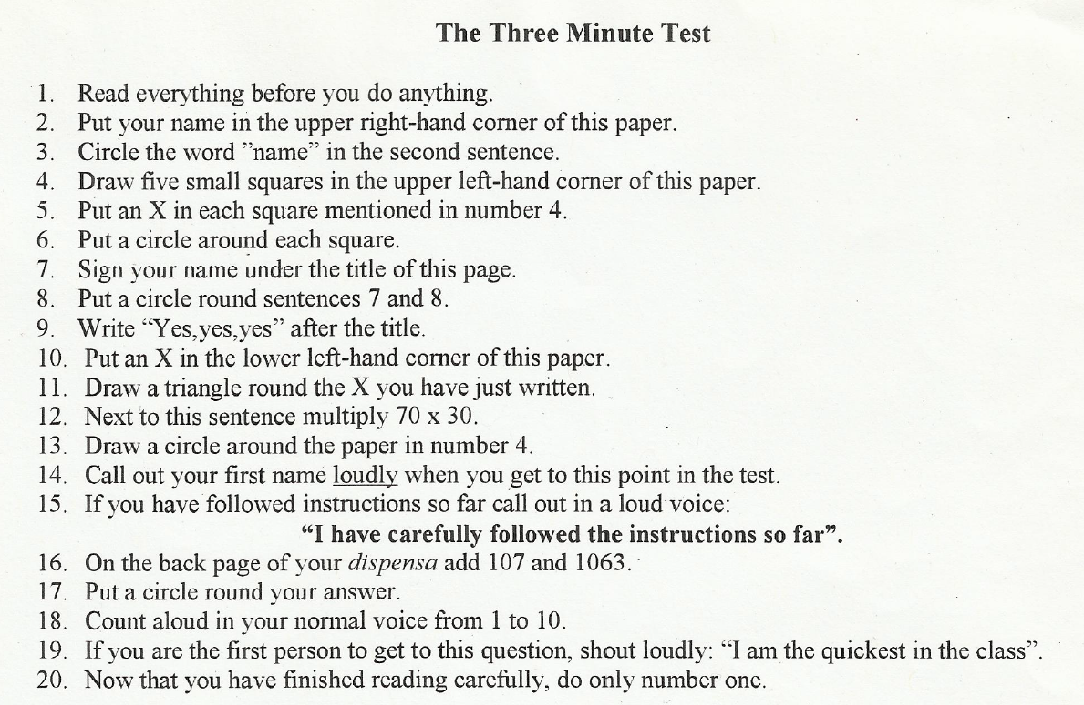

Slide 36
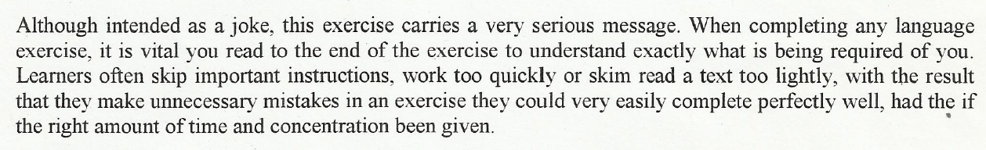


Slide 37
Homework for Lesson 8
Read (and study) pp. 26-27 & complete task #2 found in the booklet folder (dispensa).
Start the grammar section on pp. 28-32 and visit some grammar practice sites.
Study The Grammar Test section.
Read (and study) the Lenny Kravitz text on p. 35: consider the role of grammar in this text.

Slide 38


