Slide 1
The Study and
Production of
Texts
Fall Semester
5th Class

Slide 2
Next week!
Mock essay exams to be returned.

Slide 3

Lessons 5 - 9
Test 1
Semester II
Test 2
Test 3
Text
Analysis
Data
Commentary
Essay
December 13th ?

Slide 4


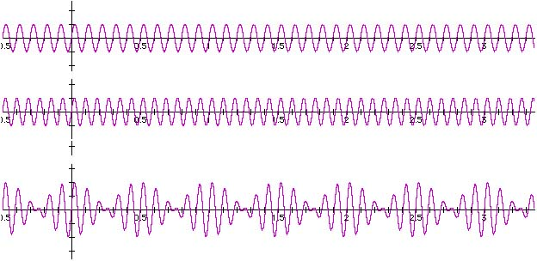


Slide 5
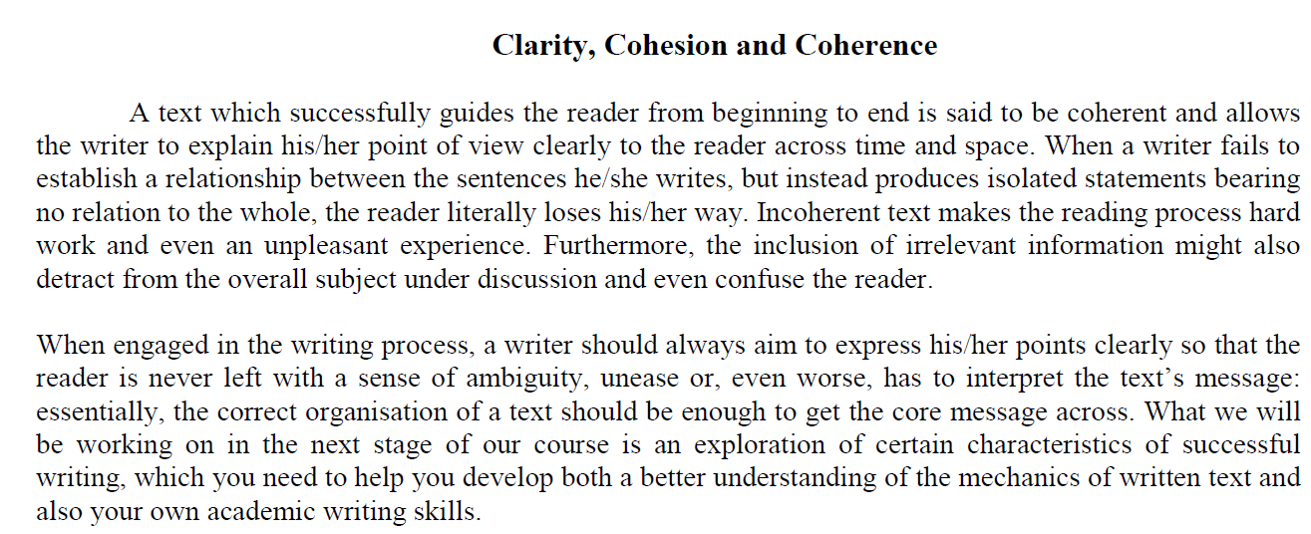
p11
PURPOSE
AUDIENCE
REGISTER
LANGUAGE
To inform, explain, advise, warn
University students of language
Formal, academic: lofty
Linear argument, complex syntactic, grammatical choices, academic tone,
lexical choices connected to discussion of text

Slide 6

p11
Purpose: To inform, explain, advise,

Slide 7
1. explain his or her point of view clearly to the reader across time and space
(paragraph 1)
2. to express his or her points clearly
3. correct organization
(paragraph 2)

Slide 8
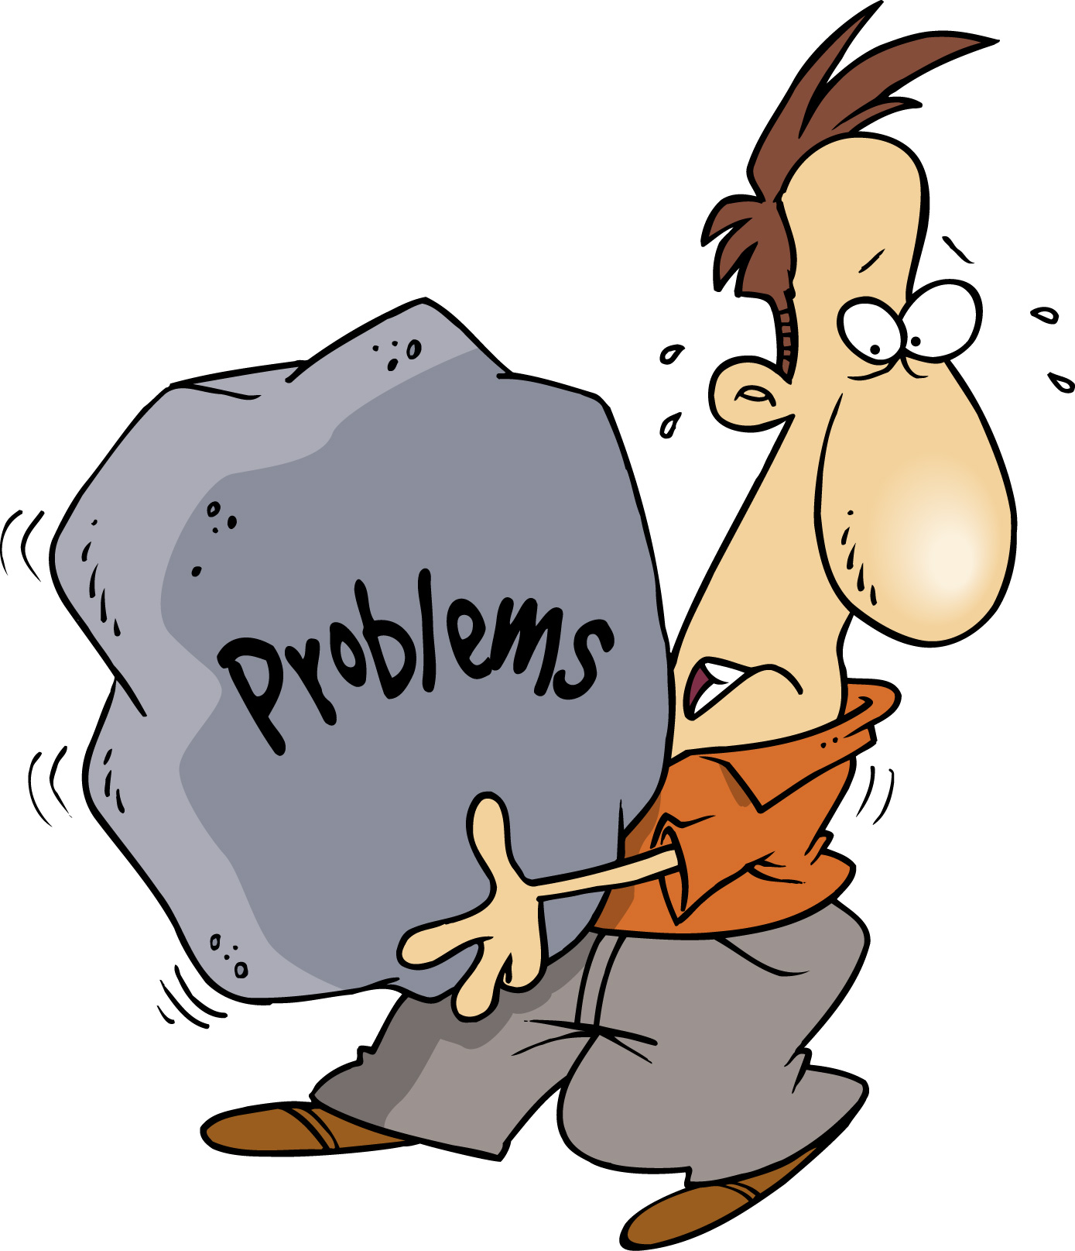
p11
Purpose: to inform, explain, advise, warn

Slide 9
fails to establish a relationship between the sentences he or she writes
produces isolated statements
the reader literally loses his or her way
incoherent text makes the reading process hard work and even an unpleasant experience
irrelevant information
detract from your overall argument and confuse the reader
(paragraph 1)
7. a sense of ambiguity
8. the reader … has to interpret the text’s message
(paragraph 2)

Slide 10
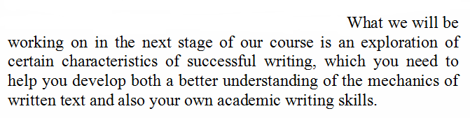
Closing sentence
what
why
Purpose:to inform, explain

Slide 11
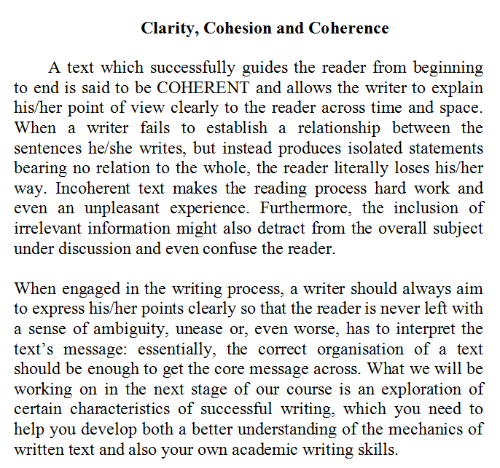
what
why

Slide 12





Slide 13
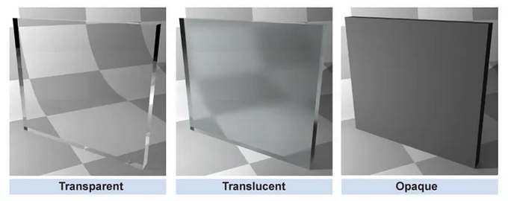

Slide 14
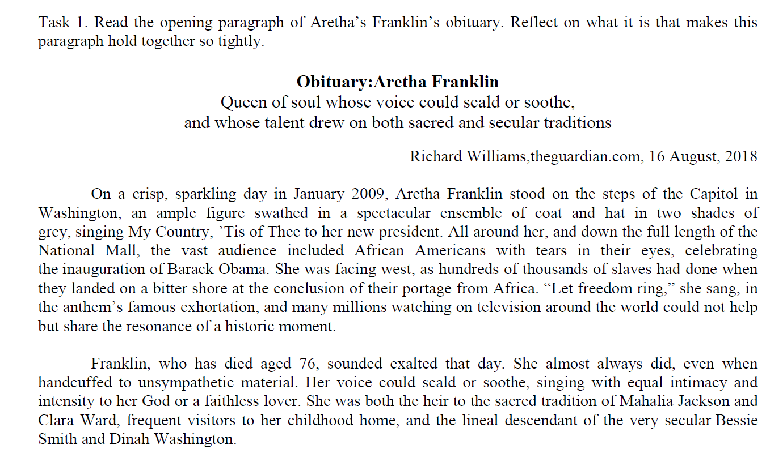
p11

Slide 15
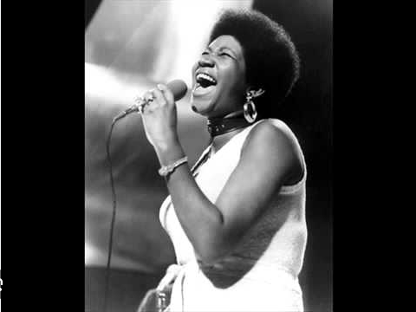
Aretha Franklin (1942-2018)
“Say a Little Prayer” (1968) https://www.youtube.com/watch?v=TDyiREoBw0o https://www.youtube.com/watch?v=y1wFX1TPW6E

Slide 16

Glee (TV series) https://www.youtube.com/watch?v=sefQqCMusJI https://www.youtube.com/watch?v=T04w5jb9YxE

Slide 17
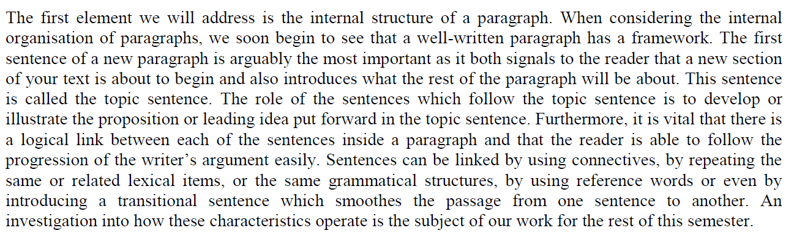

p11

Slide 18
one paragraph = one main idea, topic, or theme
all sentences will be concerned with same central topic
each paragraph has its own internal structure
topic sentence = introduces the main idea
each sentence in the chain builds on the previous sentence so that the main message of the paragraph is gradually developed and made clearer to the reader through illustration and examples of the idea presented in the topic sentence
all sentences are linked, even in a number of ways: connectives, grammar, lexis

Slide 19
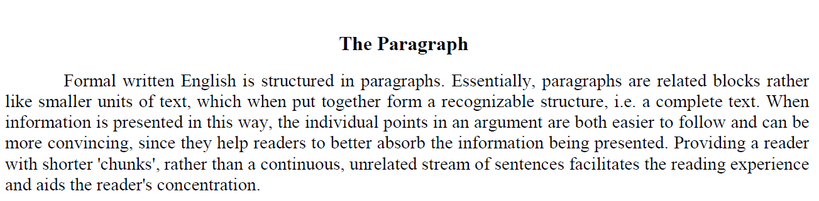
p13
Analyse this paragraph. Consider:
text thread
syntax
grammatical choices
tone
lexical choices

Slide 20
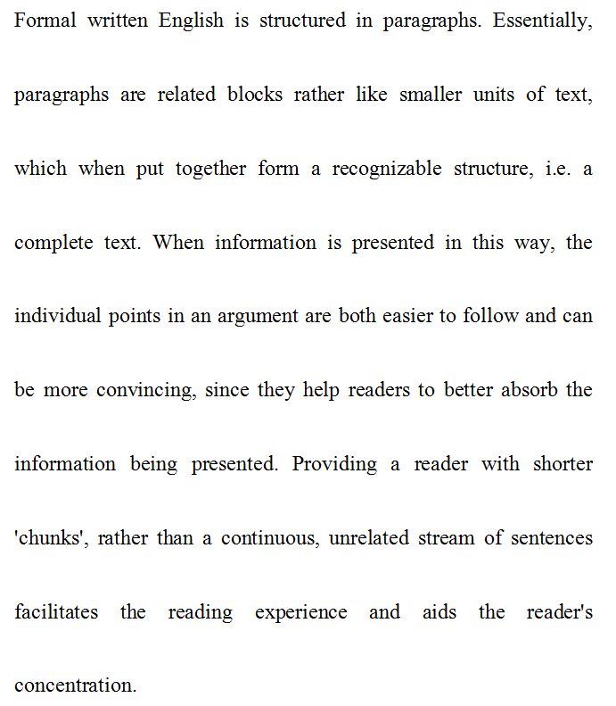
Text purpose:
to inform
to explain
4 sentences
clear
topic sentence
linear argument
formal tone
complex clauses
clear lexical field

Slide 21

HOMEWORK

Slide 22
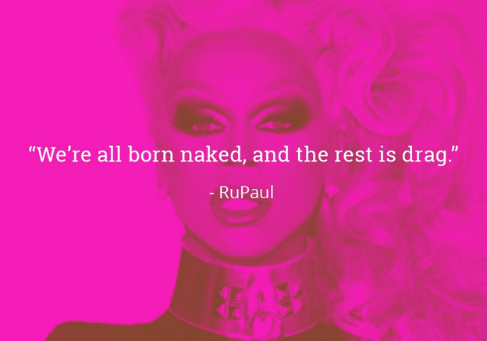
“Drag makes literal what (gender theorist Judith) Butler calls gender performativity in fancy words, and what each one of us does every day without even realizing it, that is ‘pretending’ to be…”

Slide 23
HOMEWORK for next week
Watch the interview below. Reflect on today’s lesson and the notion of the presentation of self, especially in the wake of our work on the personal statement. How do we portray the best versions of ourselves? Why? Consider RuPaul’s quote and listen to her discuss it with Oprah Winfrey. Write a brief paragraph that analyzes RuPaul’s idea. Make sure it is clear, coherent, and cohesive (and concise)! Bring these notes of analysis to class for discussion.
https://www.oprah.com/own-supersoulsessions/rupaul-explains-were-all-born-naked-and-the-rest-is-drag

Slide 24


