Slide 1
The Study and
Production of
Texts
Fall Semester
3rd Class
1

Slide 2

Personal Statement – Example 2:
Application for an undergraduate
Art History program
authentic text
native speaker
584 words
Notes:
2

Slide 3
Paragraph 1
The History of Art is the door to artistic, cultural, historical, and personal enrichment. With motivation and effort it can also lead to truly interesting career opportunities, most notably as far as I am concerned, a fine art auctioneer. It is one of the most appealing and diverse subjects you can work with as it expresses itself through various supports. It allows you to gain access to cultures throughout the world, their beliefs, and history through a single still image, a sculpture or even a white canvas.
3

Slide 4
Paragraph 2
Art is an uncompromised, satirical, and beautiful gateway to the world and the history of mankind. Art is not only beautiful, choking, impressive, or aesthetical, art is a testimony of historical patrimony, and this is one of the main reasons I want to study History of Art.
4

Slide 5
Paragraph 3
My interest in this subject started in my school years during which I obtained outstanding grades in history, art, and literature. My passion for the subject flowed out into my social life as I attended weekly cultural seminars organized by "Les Amis des Arts et de la Culture" in Monaco. For personal reasons, I decided not go to university after completing my baccalaureat, but this did not affect my interest in art. In my spare time, I developed a great enthusiasm for photography. My grandfather taught me how to develop pictures when I was 13 and I was at once attracted to the mixture of art and information as captured by the legendary Cartier Bresson. Furthermore, being able to step away from the world and become more than a spectator was a welcome relief from a hard day's work.
5

Slide 6
Paragraph 4
During my professional experience I was fortunate enough to be involved in the "Dalí a Monte Carlo" exhibition organized in Monaco during the summer of 2005, by contributing to the research and drafting of the press book. This was a challenging and demanding task, which involved compiling and summarizing the content of the exhibition/show. I thoroughly enjoyed carrying out an in-depth study of the artist as revealed by the photographs exposed to the public, which were taken during the autumn he spent in Monaco. Recently, I have been fortunate enough to work as assistant to Walera Martynchik two nights a week, which I believe, will greatly expand my artistic horizons.
6

Slide 7
Paragraph 5
Outside of art I very much enjoy music including blues, folk, rock and jazz. During my professional career I have had the good fortune to be involved in various radio and music magazine based projects, culminating in an interview with Frank Black over a cup of tea after the Pixies concert in Six-Fours-les-Bains. I try to attend concerts as often as possible as I enjoy combination of the enthusiasm and spectacle with the music that create “the show.” I am also very much a travel enthusiast and recently traveled around South America. On my travels I learned Spanish, giving me a firsthand insight into various foreign cultures.
7

Slide 8
Paragraph 6
All this considered, I would like to make art a greater part of my life and turn my passion for the subject into a career. I aim to work in an auction house, as a fine arts specialist. As a mature student, I can truly benefit from the cultural background I acquired through my personal and professional activities and become a successful student. I realize I still have much to learn and discover and I believe that an undergraduate course in art history presents me with the perfect opportunity to achieve my goals.
8

Slide 9
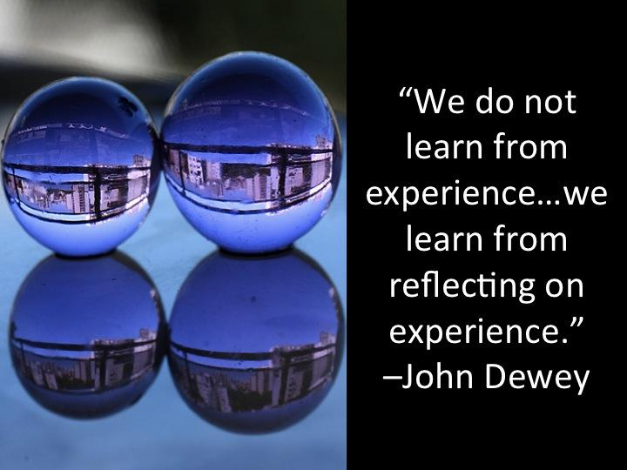
Make your dispensa PERSONAL
9

Slide 10
HOMEWORK from Week 2
2. Visit:
https://www.personalstatementwriter.org/good-personal-statement-examples-by-our-writers/
3. Visit: https://www.studential.com/university/applying/UCAS-application-guide/personal-statements/writing-guide
4. Update your vocabulary section in your Texts course notes
5. Read in English every day.
Yes! Every day. Do not fall into the trap of underestimating the importance of this.

Slide 11
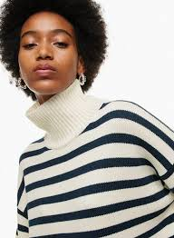
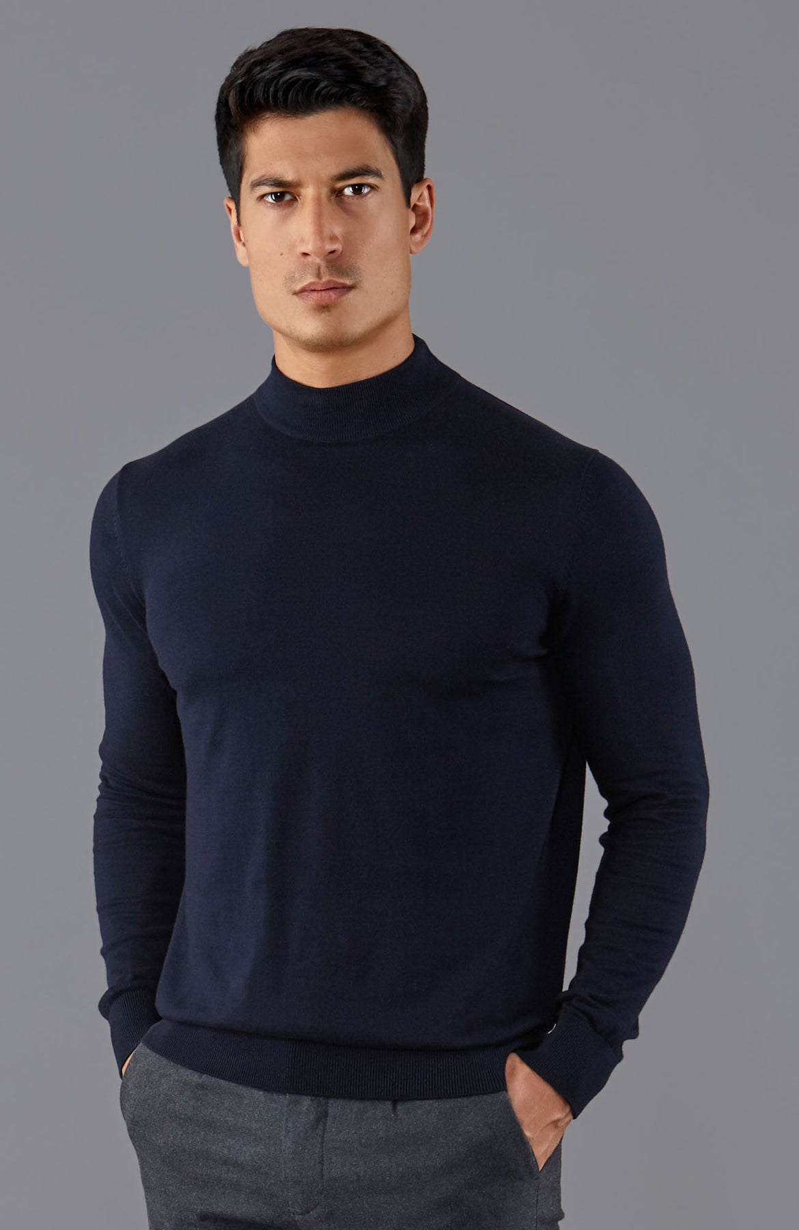
Turtleneck vs. mock turtleneck (collo a lupetto, finto dolcevita)

Slide 12


Week 4 Mock Writing Test
Today’s
Lesson
12

Slide 13
Week 4: The Mock Writing Test
You will be given a description of a candidate who wishes to apply for a university course.
Read and assimilate the content, as you will need to elaborate this information.
Plan and construct a cohesive text made up of three paragraphs.
Write the personal statement that this candidate would write, based on the information provided (as if you were the candidate).
13

Slide 14
Test Requirements
correct layout & use of paragraphs
appropriate development of information provided
appropriate order of information
correct register: formal, no contracted forms, slang, etc.
correct grammar and variety of tenses
appropriate lexis from semantic field pertinent to subject
14

Slide 15


15

Slide 16
Text type: Personal Statement
PURPOSE
AUDIENCE
REGISTER
LANGUAGE
PURPOSE To help you get you admitted to the program of your choice.
(i) explain why you have chosen to apply for that specific course
(ii) outline your achievements, skills, talents, experience, goals
AUDIENCE The Admissions Committee:
— program director
— future professors
— applications staff
16

Slide 17
From
Lesson 2
A text is written for a certain audience for a certain purpose.
Therefore, the test will conform to recognizable text type characteristics.
The register for that text type will be automatically adopted.
The language used will conform to the register of that text.
Hence, the writer will make certain grammatical and lexical choices.
REGISTER consistently formal
rigid layout
organized in recognizable,
cohesive paragraphs
LANGUAGE consistently informative
factual, clear, direct
personal, yet detached
written in first person
COHESIVE
17

Slide 18


Slide 19

19

Slide 20
Skeleton information
Federica Capecchi, aged 21: currently studying political science and international studies at the University of Florence. Applying for a graduate program in international conflict at the University of Swansea, Walkes, UK.
Skills/talents: bilingual (Italian and French)
Interests: volunteer first responder with her local Red Cross ambulance service for two years, plays in 5-a-side soccer team
Experience: spent 3 months in Geneva on internship with the International Red Cross, working on their migrant assistance program
Goals: to work in international mediation for the European Council in Brussels.
20

Slide 21

?
1. Plan your answer:
brainstorm ideas and vocabulary
organize content before writing
2. Organize your time:
plan = 15 minutes
write = 50”
proofread/ revise = 10”
21

Slide 22
Text Organization
Paragraph 1
Presentation
Explain who you are.
Describe your student profile (educational background).
Outline why you are interested in this particular program (course of study), at this particular university.
22

Slide 23

Text Organisation Paragraph 1 Presentation
Federica Capecchi, age 21: currently studying political science and international studies at the University of Florence. Applying for a graduate program in international conflict at the University of Swansea, Wales, United Kingdome.
Who is Federica Capecchi?
Student profile: Favorite courses studied
at UniFi? Grades? Scholarships? Prizes?
Other courses studied?
Why THIS course at this university?
Why the UK? Why Swansea?
23

Slide 24
Text Organization
Paragraph 2
Expansion
Describe your skills, talents, achievements, and experience that relate to this program (course of study).
Be relevant.
Refer to recent related experience that fit with the program of study for this degree.
Outline your academic goals and future plans.
24

Slide 25
Text Organization Paragraph 2 Expansion
Skills/talents: bilingual (Italian and French)
Interests: volunteer first responder with her local Red Cross ambulance service for two years, plays in 5-a-side soccer team
Experience: spent 3 months in Geneva on internship with the International Red Cross, working on their migrant assistance program
Character profile: bilingual? How come?
Communicative? Lived abroad/ Experience with foreign speakers?
Why this type of work experience? Successful? Why? What was learned / skills acquired?
Sports lover? Team player? Skills?
Internship: why do this? What was learned / skills acquired? Fascinating? Challenging?
25

Slide 26
Text Organization
Paragraph 3
Rounding Off (wrapping up)
Restate why you have applied.
Outline how this course will help you reach your goals.
Be enthusiastic, but not overwhelming.
26

Slide 27


Concluding

Slide 28
Text Organization Paragraph 3 Rounding Off
Goals: to work in international mediation for the European Council in Brussels
Why this goal? Why Brussels?
What will she learn doing this job?
What challenges will she face?
In what ways will this course help her achieve this goal?
Is her personality suited to this job? Will this graduate program help her? How so?
28

Slide 29

29

Slide 30
Week 4 Mock Writing Test Guidelines
How many words? c.300 (350 max.)
You have one hour and 15 minutes to write the personal statement.
Write ONE copy.
You must write a outline/plan (15 minutes) on the first page of your answer sheet.
30

Slide 31
31

Slide 32

HOMEWORK
32

Slide 33


HOMEWORK for the 4th week
Prepare for next week’s Test!
33

Slide 34

34

Slide 35
https://www.studential.com/personal-statement-examples/language-personal-statement-examples
35

